Slide 1


Getting Started with CLIFF:
A Guide for Counselors

Slide 2



`
Get Started with CLIFF in 4 Steps
Step 1
Step 2
Step 3
Identify appropriate CLIFF tool(s)
Learn online with CLIFF Academy
Test with hypothetical examples

Slide 3
Step 2) Using the right tool for the right client in the right situation
Step 1: Identify Appropriate CLIFF tool(s)
Survive
INITIAL CLIENT INTAKE & ASSESSMENT
Thrive
Client is focused on immediate financial stability
Client is actively planning for career advancement
SNAPSHOT
DASHBOARD
PLANNER
Identify an immediate path to financial stability
Explore the potential financial returns of different careers
Create a detailed budget in support of a career move
Client is interested in understanding the potential short-term financial impact of a new job or income change.
Client is interested in long term career planning AND wants a general idea about potential financial barriers to career advancement.
Client is interested in detailed career planning AND wants to create a customized budget that will help them navigate potential financial barriers to career advancement.
Time to Complete
Customized Work Hours + Wages | Yes
Career Selection Component | No
Occupational Wage Information | No
Custom Expenses | Some
Time to Complete
Customized Work Hours + Wages | No
Career Selection Component | Yes
Occupational Wage Information | Yes
Custom Expenses | No
Time to Complete
Customized Work Hours + Wages | Yes
Career Selection Component | Yes
Occupational Wage Information | Yes
Custom Expenses | Yes
Note: This diagram features three tools—Dashboard, Planner, and Snapshot—even though your organization might not be using all three tools.

Slide 4
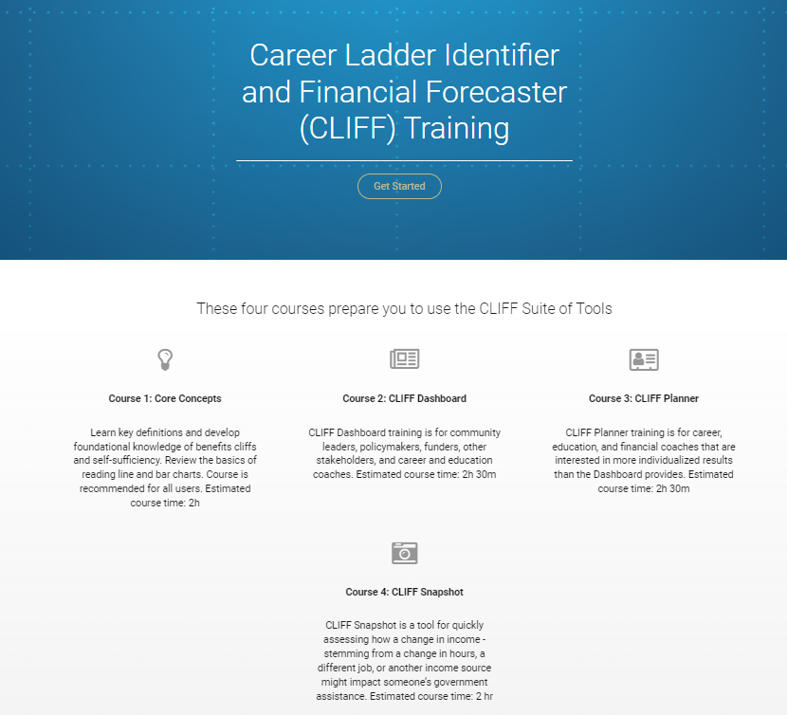
`
Step 2: CLIFF Academy
We recommend starting with Course 1: Core Concepts
Depending on your organization’s needs, you can then complete one or more of the following courses
Course 2: CLIFF Dashboard
Course 3: CLIFF Planner
Course 4: CLIFF Snapshot
https://academy-clifftool.thinkific.com/.

Slide 5
`
Step 3: Test with Hypothetical Examples
Walk through CLIFF with a representative client, Leia.
Fill in the information below
Leia lives in:
Her household consists of
For work, she wants to be a(n)
To achieve this goal, she needs to go to school for
Now, launch each of the tools your organization is using and imagine taking ‘Leia’ through the tool:
See if you can interpret the results and answer questions that your clients commonly have.
County, state
https://emar-data-tools.shinyapps.io/clifftool/.
Number of Adults & Children
Job
Number of Months

Slide 6
`
Additional Support
CLIFF Team is committed to providing ongoing support to our partners.
For technical support or any other issues, please reach out to us at:
cliff@atl.frb.org.

