Slide 1

Lesson 1
Katrina Strikes
Part 1
FINANCIAL AND EMERGENCY PREPAREDNESS

Slide 2
Lesson Objectives
Lesson 1: Katrina Strikes
Students will:
Define natural disaster.
Develop an emergency plan for their family.
Recognize the need for EMERGENCY AND financial preparedness in the face of a disaster.
2

Slide 3
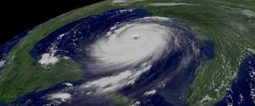
Have You Ever Experienced
A Natural Disaster?
Lesson 1: Katrina Strikes
Natural disasters are naturally occurring events that can cause severe threats to the public health.
—U.S. Department of Health and Human Services
Natural disasters occur all around the world and range in impact.
Tornadoes, hurricanes, volcanoes, and earthquakes each have a classification system developed to gauge the intensity of the event by assessing a number of set factors. These classification methods help researchers study disaster patterns. They also help to educate the public and encourage them to plan and prepare for potential disasters.
3

Slide 4

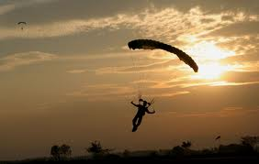
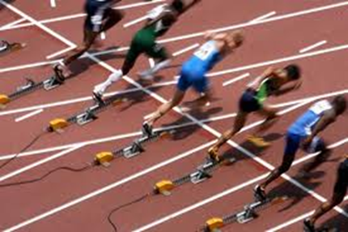
Lesson 1: Katrina Strikes
Financial and Emergency Preparedness
Why is it important to prepare for life events or activities in which you want to be successful?
Are there sports or activities that you have to prepare for before you can participate?
4

Slide 5
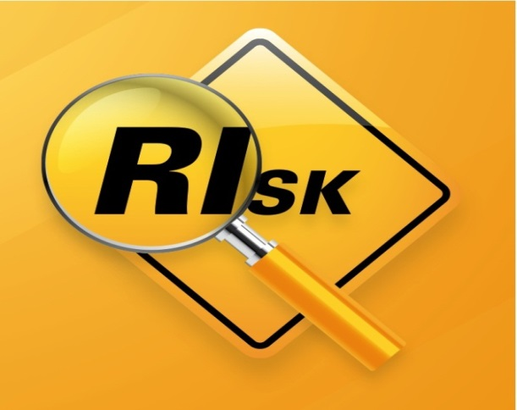
Lesson 1: Katrina Strikes
Managing Risk through emergency Preparedness
Risk is the uncertainty about the outcome of a situation or event.
To manage risk you must identify the sources of risk and estimate potential losses.
We take risks every day. The risk from natural disasters, which cannot be eliminated, can in some cases be minimized with adequate planning and preparation.
5

Slide 6
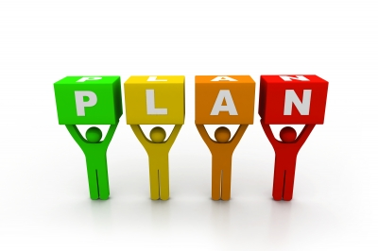
Lesson 1: Katrina Strikes
Planning
Planning helps people make
decisions to accomplish their goals.
Planning includes managing
decisions related to education,
earning income, spending, and saving in order to achieve goals.
Planning also includes keeping yourself safe in an emergency situation. One of the first important decisions you will need to make is whether to stay where you are or evacuate to a safer location. You should understand and plan for both possibilities.
6

Slide 7
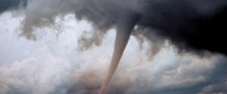
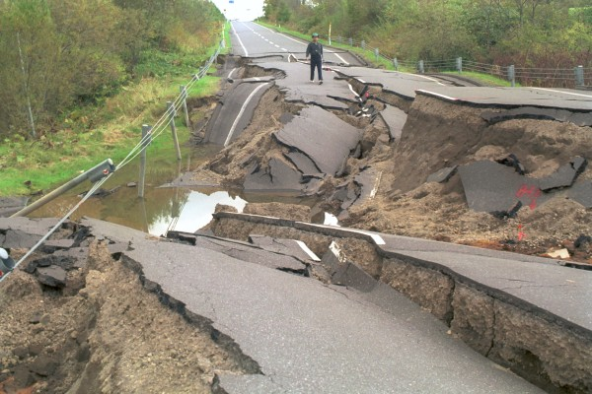
Lesson 1: Katrina Strikes
Why Is it Important To Plan Ahead for an Emergency?
Tornado
Natural disasters give little advance warning.
Hurricane
Earthquake
7

Slide 8
Lesson 1: Katrina Strikes
IN Summary
Natural disasters are naturally occurring events that can cause severe threats to the public health.
In the face of disaster, it is important to take steps for emergency and financial preparedness.
8

Slide 9
Katrina’s Classroom was developed by a team of
Senior Economic and Financial Education Specialists at the Federal Reserve Bank of Atlanta.
Claire Loup, New Orleans Branch • Julie Kornegay, Birmingham Branch • Jackie Morgan, Nashville Branch
For additional classroom resources and professional development opportunities,
please visit www.frbatlanta.org/education
9

