Slide 1

Lesson 2
In the Aftermath

Slide 2
Lesson Objectives
Lesson 2: In the Aftermath
Students will:
Adopt strategies for managing important documents.
Analyze various deposit accounts.
Compare and contrast the various banking tools.
Demonstrate skill in basic financial tasks.
Evaluate types of financial institutions.
Explore the benefits of a positive relationship with financial institutions.
Identify types of important documents.
2

Slide 3

What would you need if there were an emergency?
Lesson 2: In The Aftermath
Are there personal items that you would take?
How much money would you need?
How would you access your money?
What important documents would you need?
3

Slide 4
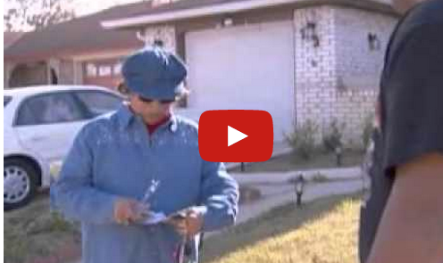
IN THE AFTERMATH
Lesson 2: In The Aftermath
4

Slide 5
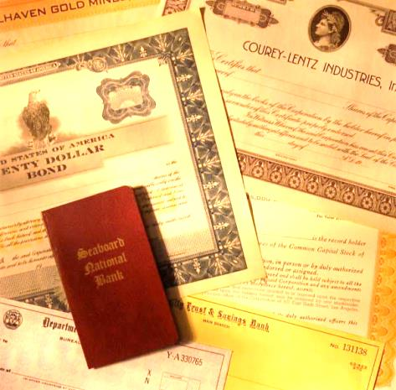
What Did Nick’s Family Take When They Fled New Orleans?
Lesson 2: In The Aftermath
What personal items did Nick take?
What important documents did they bring?
How did they access their money?
Why didn't they have to take cash with them?
How did their emergency preparations help once they returned home?
5

Slide 6

Emergency Fund
Lesson 2: In The Aftermath
An emergency fund is:
Money set aside that can be accessed quickly for unexpected expenses.
Vital for emergencies including natural
disasters and unexpected life situations.
Generally 3-6 months of living expenses.
For example: If your living expenses are
$1,000 a month, you will need a $3,000–$6,000 emergency fund.
6

Slide 7
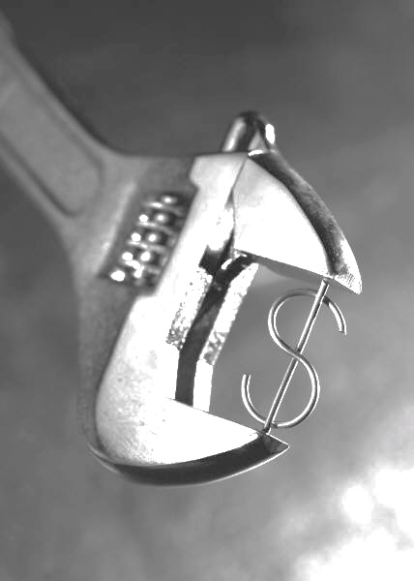
Banking Relationships
Lesson 2: In The Aftermath
Establishing a positive relationship with a financial institution can help you:
Develop sound financial management.
Create financial stability.
Plan for emergencies.
7

Slide 8

Financial Institutions and the Fed
Lesson 2: In The Aftermath
Federal Reserve Bank | Commercial Bank | Credit Union
Central bank of the United States | For-profit business with the goal of making a profit for shareholders | Not-for-profit organization
A bank for banks and the U.S. government. Provides payment services for banks | A bank for consumers and businesses | A financial institution for members (not open to general public) with a common bond (e.g., they work at the same place)
Along with other federal and state regulators, supervises and regulates financial institutions | Accepts deposits and makes loans | Accepts deposits and makes loans
Responsible for U.S. monetary policy | Provides a variety of services (demand deposits, saving, investing, and loans)
 | Insured by Federal Deposit Insurance Corporation (FDIC)—$250,000 on checking, savings, CDs, and money market deposit accounts | Insured by National Credit Union Administration (NCUA)—$250,000 on checking, savings, CDs, and money market deposit accounts
8

Slide 9
Types of Deposit Accounts
Lesson 2: In The Aftermath
Checking Account | Savings Account | Certificate of Deposit (CD) | Money Market Account (MMA)
Most common form of demand deposit (money available on demand) | Designed to help save money | Deposit locked in for a specific amount of time and interest rate | Offers variable interest rates
Designed for frequent transactions | Often used for emergency fund and other short-term savings goals | Often used for intermediate-term savings goals | Generally offers higher rates of return on deposits
Uses money you have available in your bank account | May have minimum balance requirements and withdrawal restrictions | Minimum opening balance requirements | Minimum balance requirements
May have monthly fees | May have monthly fees | Penalties for early withdrawals | May have monthly fees
May earn interest | Earns interest | Earns interest | Earns interest
FDIC- or NCUA-insured | FDIC- or NCUA-insured | FDIC- or NCUA-insured | FDIC- or NCUA-insured
9

Slide 10


Lesson 2: In The Aftermath
LIQUIDITY CHALLENGE
HOW QUICKLY CAN YOU ACCESS YOUR MONEY IN AN EMERGENCY?
Rank these financial tools from most to least liquid:
Money Market Account
4
Certificate of Deposit
5
Savings Account
3
Cash
1
Checking Account
2
10

Slide 11
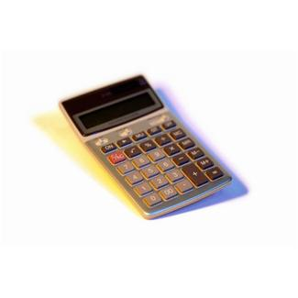

Lesson 2: In The Aftermath
LEARNING MORE ABOUT DEPOSIT ACCOUNTS
 | What is the minimum balance to open? | How much do you have to deposit to avoid fees? | What fees are associated with the account? | What is the annual percentage yield (APY) on the account? | How much interest would you earn monthly? Quarterly? Yearly?
Checking Account |  |  |  |  | M = Q = Y =
Savings Account |  |  |  |  | M = Q = Y =
Certificate of Deposit |  |  |  |  | M = Q = Y =
Money Market Account |  |  |  |  | M = Q = Y =
11

Slide 12
Lesson 2: In The Aftermath
IT’S IN YOUR HANDS:
WHERE WOULD YOU PUT THE MONEY?
SCENARIOS
Scenario #1:
You received your monthly allowance and will need to pay for incidentals like gas and fast food.
Scenario #4:
You are 30 years old with a steady job. After paying bills, you have $500 left over.
Scenario #6:
You receive your paycheck and need to pay your monthly bills.
Scenario #7:
You receive an income tax refund in the amount of $500.
Scenario #9:
You are saving $50 a week from a summer job for college in a few years.
Scenario #2:
You receive a dividend from your money market account of $50.
Scenario #5:
You are in college and have a job. Money is tight, but you have managed to save $1,000.
Scenario #8:
Your retired grandparents are searching for a safe way to keep $5,000 and have ready if they need it.
Scenario #3:
You receive a $100 birthday gift from a relative.
Checking
Savings
CD
MMA
1. Allowance
3. Birthday gift
7. Tax refund
2. Dividend
6. Pay bills
Money left after bills are paid
9. Summer savings
8. Grandparents
5. College money
12

Slide 13
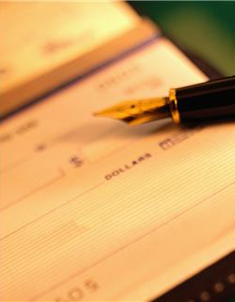
Benefits of Checking Accounts
Lesson 2: In The Aftermath
Convenience
Flexibility
Reliability
Direct deposit funds available the same day
Security
Variety of account tools
13

Slide 14
Check
Lesson 2: In The Aftermath
A check is a written set of instructions to your financial institution.
Transfers money from your account to another account
Has blanks that you fill in to tell your financial institution:
  The date you want to transfer the funds
  To whom you want the funds to go
  The amount of money you want to transfer
  That you authorize the transfer (by signing the check)
1-1-14
1
2
John Smith
3
100.00
One hundred and no/100
Jane Doe
4
14

Slide 15
Lesson 2: In The Aftermath
CHECK
CHECK MICR LINE
MICR = Magnetic Ink Character Recognition
Dollar value of check
(added at retailer or financial institution)
Bank routing number
Account number
Check number
15

Slide 16
Electronic Check Conversion (ECC)
Lesson 2: In The Aftermath
Check MICR line
The MICR line is used as a source of information, providing the:
1) check number, 2) account number, and 3) financial institution routing number.
The information is used to make a one-time electronic payment from your account—an electronic funds transfer.
Many big box retailers and doctor offices use ECC.
Source: “When Is Your Check Not A Check?” Federal Reserve Board Of Governors (www.federalreserve.gov/pubs/checkconv/ )
16

Slide 17
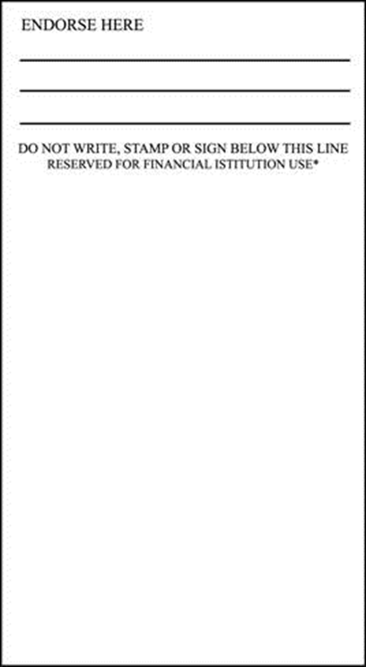
Lesson 2: In The Aftermath
CHECK ENDORSEMENTS
Blank Endorsement
Restrictive Endorsement
Special
Endorsement
John Smith
For Deposit Only
Pay To The Order Of
John Smith
Lisa Reynolds
John Smith
You sign your name the same way it appears on the front of the check.
Do not sign your check with a blank endorsement until you are about to either cash or deposit it. If you do, someone else could try to cash your check.
Anyone can cash the check once you endorse it with a blank endorsement.
This is a safer method to endorse your check, and recommended if you are mailing the deposit or someone else is depositing the check into your account for you.
Write the phrase "For Deposit Only" and sign your name underneath.
The check may only be deposited to your specific bank account.
This method allows you to sign your check over to someone else (a third party), who can then deposit or cash it.
Write "Pay to the order of" and then the name of the person to whom you are giving the check.
Then sign your name underneath.
17

Slide 18
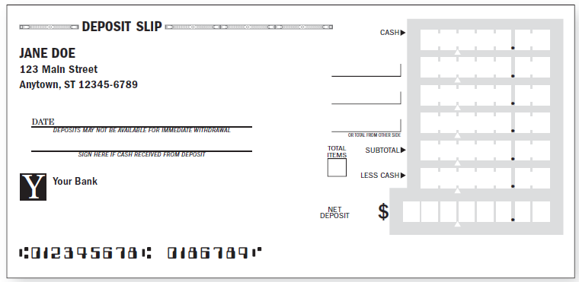
Lesson 2: In The Aftermath
DEPOSIT SLIP
5 0 0 0
1217
2 0 0 0
809
1 0 0 0
1-1-14
8 0 0 0
8 0 0 0
Deposit Scenario
You have the following items for deposit:
Cash = $50 Check 1217 = $20 Check 809 = $10
How would you complete the deposit slip?
18

Slide 19
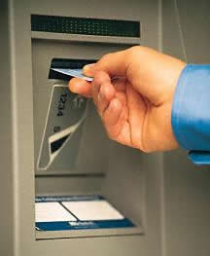
Automated Teller Machine (ATM) Card
Lesson 2: In The Aftermath
An ATM card can only be used with a personal identification number (PIN) at an ATM.
ATM fees may be charged when the cardholder uses the ATMs of other financial institutions.
19

Slide 20
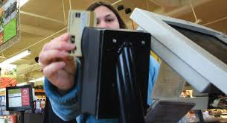
Debit Card
Lesson 2: In The Aftermath
A debit card is used for cash withdrawals, deposits, and transfers. It is also used with a PIN at an ATM (checking or savings account).
When used for purchases, the
transaction looks like a credit card
transaction, but the purchase
amount is deducted directly from
your checking account.
20

Slide 21

Online Banking
Lesson 2: In The Aftermath
Online banking:
Works as an organizational and financial management tool.
Allows consumer to view account balances, see recent transactions, make transfers between accounts, and make payments.
Offers a variety of options, depending on specific financial institution.
Includes online bill pay.
Enables scheduled payments.
21

Slide 22
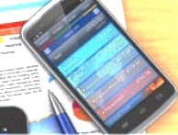
Mobile Banking
Lesson 2: In The Aftermath
Mobile web browser
  Pay bills and transfer funds
  Send money to other bank customers
  Explore detailed account activity
Smartphone apps
  Deposit checks
  Pay bills and transfer funds
  Manage account and review activity
Text banking
  See account balances
  Review recent account activity
  Transfer funds
22

Slide 23
Lesson 2: In The Aftermath
EVOLVING ACCOUNT TOOLS
Banking and account tools are continually evolving.
  Smart chips
  Fingerprint technology
  What’s next?
Understand the potential responsibilities and risks of the financial tools you use.
portalsandrails.frbatlanta.org/2013/05/which-is-riskier-change-or-avoiding-it.html
23

Slide 24
Electronic Deposits
Lesson 2: In The Aftermath
Direct deposit
  An electronic deposit of funds (such as paychecks) to your account
  Benefits:
    Availability of funds the same day as the deposit
    Convenience
    Reliability
    Security
    Flexibility
ATM and mobile banking deposits
  No deposit slip necessary
  Completed at an ATM or by smartphone
24

Slide 25
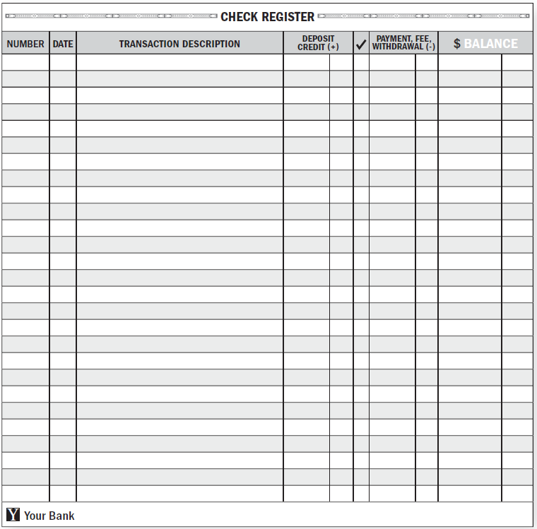
CHECKING ACCOUNT REGISTER
Number | Date | Transaction Description | Deposit Credit (+) |  | Payment Fee Withdrawal (-) | $ Balance
 |  | Beginning Balance |  |  |  | 612.04
181 | 4/1 | Books |  |  | 15.00 | 597.04
182 | 4/3 | Donation to XYZ |  |  | 17.00 | 580.04
Cash | 4/3 | ATM withdrawal |  |  | 40.00 | 540.04
Cash | 4/4 | ATM withdrawal |  |  | 20.00 | 520.04
Cash | 4/5 | ATM withdrawal |  |  | 20.00 | 500.04
Transfer | 4/8 | Transfer from savings | 1,200.00 |  |  | 1,700.04
183 | 4/10 | Utilities payment |  |  | 217.54 | 1,482.50
Fee | 4/15 | Monthly maintenance fee |  |  | 3.50 | 1,479.00
Deposit | 4/16 | ATM deposit | 521.78 |  |  | 2,000.78
184 | 4/20 | House payment (mortgage) |  |  | 1,232.27 | 768.51
185 | 4/20 | Gym membership fee |  |  | 25.00 | 743.51
186 | 4/21 | Cell phone payment |  |  | 54.47 | 689.04
Deposit | 4/27 | Direct deposit (paycheck) | 258.90 |  |  | 947.94
187 | 4/28 | Personal loan payment |  |  | 53.97 | 893.97
Deposit | 5/1 | ATM Deposit | 50.00 |  |  | 943.97
25

Slide 26
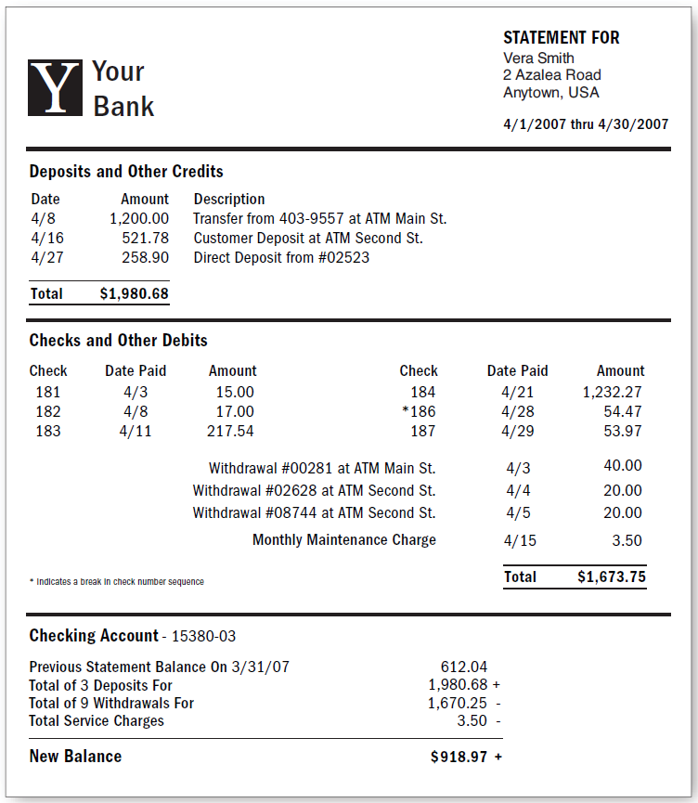
RECONCILING YOUR ACCOUNT
Number | Date | Transaction Description | Deposit Credit (+) |  | Payment Fee Withdrawal (-) | $ Balance
 |  | Beginning Balance |  |  |  | 612.04
181 | 4/1 | Books |  |  | 15.00 | 597.04
182 | 4/3 | Donation to XYZ |  |  | 17.00 | 580.04
Cash | 4/3 | ATM withdrawal |  |  | 40.00 | 540.04
Cash | 4/4 | ATM withdrawal |  |  | 20.00 | 520.04
Cash | 4/5 | ATM withdrawal |  |  | 20.00 | 500.04
Transfer | 4/8 | Transfer from savings | 1,200.00 |  |  | 1,700.04
183 | 4/10 | Utilities payment |  |  | 217.54 | 1,482.50
Fee | 4/15 | Monthly maintenance fee |  |  | 3.50 | 1,479.00
Deposit | 4/16 | ATM deposit | 521.78 |  |  | 2,000.78
184 | 4/20 | House payment (mortgage) |  |  | 1,232.27 | 768.51
185 | 4/20 | Gym membership fee |  |  | 25.00 | 743.51
186 | 4/21 | Cell phone payment |  |  | 54.47 | 689.04
Deposit | 4/27 | Direct deposit (paycheck) | 258.90 |  |  | 947.94
187 | 4/28 | Personal loan payment |  |  | 53.97 | 893.97
Deposit | 5/1 | ATM Deposit | 50.00 |  |  | 943.97
26

Slide 27

Overdraft
Lesson 2: In The Aftermath
It is important to take personal responsibility for your finances.
OVERDRAFT FEES
Charges per transaction can range from $20 to $40.
  Example:
  Your account balance is $100.
  You write a check for $150.
  Your account is overdrawn for $50.
  Your bank charges you $30 in overdraft fees.
  Your account balance is now -$80.
Overdraft protection—opt in or out.
27

Slide 28

Choosing and Establishing a Relationship with a Financial Institution
Lesson 2: In The Aftermath
CRITERIA TO CONSIDER
Location
Accessibility
Account options
Meets your financial needs
28

Slide 29

Traditional versus Nontraditional
Financial Institutions
Lesson 2: In The Aftermath
Why use a traditional financial institution rather than a nontraditional option like check cashing stores?
The traditional financial institution:
Likely has lower fees.
May have accounts that earn interest.
Offers better safety and security.
Insures deposits.
Offers more products and services.
Provides monthly statements to help manage expenses and savings.
29

Slide 30
Lesson 2: In The Aftermath
IN Summary
Adopting strategies for managing important documents can help your family recover from an emergency more quickly.
Establishing a positive relationship with a financial institution helps develop sound financial management, create financial stability, and plan for emergencies.
Benefits of checking accounts include convenience, flexibility, reliability, direct deposit funds available the same day, security, and offer a variety of account tools.
30

Slide 31
Katrina’s Classroom was developed by a team of
Senior Economic and Financial Education Specialists at the Federal Reserve Bank of Atlanta.
Claire Loup, New Orleans Branch • Julie Kornegay, Birmingham Branch • Jackie Morgan, Nashville Branch
For additional classroom resources and professional development opportunities, please visit www. frbatlanta.org/edresources
31

