Slide 1

Lesson 3
A Fresh Start

Slide 2
Lesson Objectives
Lesson 3: A Fresh Start
Students will:
Analyze the types of credit and determine the characteristics of each.
Compare credit card offers.
Define credit and debt.
Evaluate a credit card statement.
Explain the components of a credit score.
Identify the opportunity cost of using credit.
Understand the importance of having access to credit.
Weigh the impact of interest rates on monthly payment amounts.
2

Slide 3

Are You Financially Prepared for an Emergency Situation?
Lesson 3: A Fresh Start
Do you have enough cash on hand or in a bank account to cover immediate needs and financial obligations?
Do you have access to credit or credit cards to meet the needs that exceed your available cash?
Financial preparedness includes:
  An emergency fund.
  An established banking relationship.
  Access to credit.
3

Slide 4

A Fresh START
Lesson 3: A Fresh Start
4

Slide 5
Emergencies Come in All Forms
Lesson 3: A Fresh Start
Natural disasters can lead to financial emergencies.
What are other situations that could create a financial
emergency?
  Illness or injury
  Loss of job
  Loss of family member
  Unexpected expenses
5

Slide 6
Understanding Credit
Lesson 3: A Fresh Start
Credit is:
  Any arrangement in which you receive goods, services or money in exchange for a promise to repay at a later date.
  The assessment of your ability to fulfill financial obligations.
Debt is:
Something, typically money, that you owe or is due.
Anyone having borrowed money or goods from another owes a debt and must return the goods or repay the money, usually with interest.
6

Slide 7
Responsibilities When Using Credit
Lesson 3: A Fresh Start
Understand and abide by the terms and conditions.
Make timely payments.
Consequences of nonpayment include:
  Garnishment of wages.
  Repossession of property.
  Negative entries on credit report.
7

Slide 8


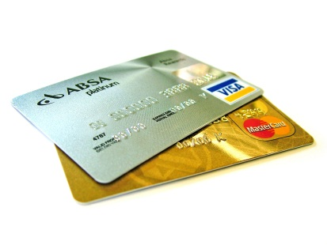
Types of Credit
Lesson 3: A Fresh Start
Revolving credit
Installment (or term) credit
Noninstallment (or service) credit
Credit conditions:
  Secured credit
  Unsecured credit
8

Slide 9
Types of Credit
Lesson 3: A Fresh Start
Examples of typical credit arrangements | Revolving | Installment | Service | Secured | Unsecured
Credit cards
Student loans
Car loans
Cell phone contracts, utility bills
Home mortgages
Home equity line of credit
Personal line of credit
9

Slide 10
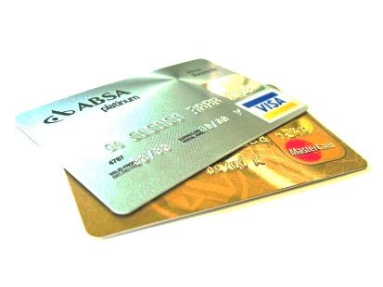
Revolving Credit
Lesson 3: A Fresh Start
Open ended
Can be secured or unsecured
Allows you to borrow at any time up to a limit set by creditor
Offers flexible payments with a minimum payment required
Minimum payment usually calculated as a percentage of the balance due
Computes periodic finance charges on the unpaid balance
Examples: credit card, personal line of credit, home equity line of credit
10

Slide 11

Installment (or Term) Credit
Lesson 3: A Fresh Start
Close ended
Can be secured or unsecured
Allows you to borrow a specific amount for a specific purpose for a specific amount of time at a given interest rate
Has the loan term, loan amount, number and dollar value of payments, and total finance charges agreed on at start of loan
Typically has fixed number of payments of predetermined amount
Examples: home mortgage, car loan, student loan
11

Slide 12
Noninstallment (or Service) Credit
Lesson 3: A Fresh Start
Unsecured
Paying for a service that you have already used
Requires payment in full by a specified date
Does not have interest
Results in service fees or discontinuation of service if you fail to pay within specified time
Examples: cell phone plan, utility bill
12

Slide 13

Lesson 3: A Fresh Start
Types of Credit
Examples of typical credit arrangements | Revolving | Installment | Service | Secured | Unsecured
Credit cards
Student loans
Car loans
Cell phone contracts, utility bills
Home mortgages
Home equity line of credit
Personal line of credit
13

Slide 14
Using Credit Wisely
Lesson 3: A Fresh Start
Borrowing can help you meet short-term needs and long-term goals.
Know the real cost of borrowing for the purchase. The real cost includes the principal, interest, loan term, and possibly other fees.
Understand the opportunity cost of using credit.
  Purchasing power of future money for past purchases
  The future earning power of money spent on interest and fees
14

Slide 15

Loan Basics: Total Cost of Credit
Lesson 3: A Fresh Start
FACTORS TO CONSIDER
  Principal
  Interest
  Interest rate
  Loan term (length of loan)
  Other fees
15

Slide 16
Factors of Total Cost of Credit: Principal
Lesson 3: A Fresh Start
The principal is the original amount of money that you borrowed or still owe on which interest is charged.
When you repay some of the principal, the amount of money subject to interest is reduced, and, thus, the amount of interest charged is also reduced.
16

Slide 17
Factors of Total Cost of Credit: Interest
Lesson 3: A Fresh Start
INTEREST
The price you pay for the use of money you borrow from a lender
An expense to you and income to the lender
INTEREST RATE
The price you pay for using someone else’s money, expressed as a percentage
17

Slide 18
Factors of Total Cost of Credit: INterest
Lesson 3: A Fresh Start
ANNUAL PERCENTAGE RATE (APR)
APR is the interest rate applied on loans, credit, mortgages, and more. It reflects the annual cost of borrowing money.
APR CATEGORIES
Nominal APR is the basic calculation of the interest rate applied to the principal amount as stated on the loan.
Effective APR is the calculation of the interest rate applied to the principal amount as stated on the loan, plus additional fees that have been added to the loan.
18

Slide 19
Factors of Total Cost of Credit: Loan Term
Lesson 3: A Fresh Start
The loan term is the length of loan.
In general, the longer the term of the loan, the higher the cost of borrowing.
Longer-term loans generally have higher interest rates than shorter-terms loans.
Even if the interest rates are equal, when you take longer to pay, there are more payment periods on which interest is applied.
19

Slide 20
Loan Basics: Total Cost of Credit
Lesson 3: A Fresh Start
To find out how much it would cost to borrow $1,000 for one year at 20% interest, use the following simple interest formula:
I = PRT
(Interest = Principal x Rate x Time)
Note: to convert a percentage to a decimal, move the decimal two spots to the left and drop the percentage sign.
I = $1,000 x .20 x 1
I = $200 x 1
I = $200
20

Slide 21
Loan Basics: Calculating Your Payment
Lesson 3: A Fresh Start
To determine how much your monthly payments on this loan would be, take the principal ($1,000) plus interest ($200) and divide it by the term (12 months).
($1,000 + $200) / 12
$1,200 / 12 = $100
21
Notes:
SMART slide 20

Slide 22
What would your monthly payment be?
Lesson 3: A Fresh Start
1
You would like to borrow $5,000 for a car at 8% interest for 3 years.
2
You get a better offer and now plan to borrow $5,000 at 5% for 3 years.
3
You put $500 down and would like to borrow $4,500 at 5% for 30 months.
$172.22
$159.72
$168.75
What option allows you to pay the least amount of interest?
Option 3
22
Notes:
SMART slide 21

Slide 23
About Credit Cards
Lesson 3: A Fresh Start
A credit card is a high-interest, revolving, unsecured loan.
It offers multiple transaction types, including:
  Purchases.
  Balance transfers.
  Cash advances.
It has potential incentives, including:
  Low promotional interest rates.
  Store discounts.
  Rewards programs (points or cash back).
23

Slide 24
Lesson 3: A Fresh Start
SORT THE FOLLOWING CONCEPTS ABOUT CREDIT
CONCEPTS
Concept #4:
Convenience
Concept #1:
Having goods and services while paying for them later
Concept #7:
It is easy to spend even though you don’t have money to pay for the item.
Concept #8:
Possible identity theft
Concept #3:
Misuse of credit may result in bankruptcy.
Concept #10:
Misuse of credit restricts future income.
Concept #2:
Earn incentives for card use
Concept #9:
Can cost more than paying in cash
Concept #11:
Misuse of credit may result in higher credit costs.
Concept #12:
Purchasing goods or services you couldn’t otherwise afford with cash
Concept #5:
Not having to carry cash
Concept #6:
Being able to pay for emergencies
Advantage
Disadvantage
Having goods and services now and paying for them later
Misuse of credit can result in bankruptcy.
It is easy to spend even though you don’t have money to pay for the item.
Can earn incentives for card use
Convenience
Possible identity theft
Not having to carry cash
Can cost more than paying in cash
Being able to pay for things during emergencies
Misuse of credit restricts future income.
Purchasing goods or services you couldn’t otherwise afford with cash
Misuse of credit may result in higher credit costs.
24
Notes:
SMART slide 23

Slide 25
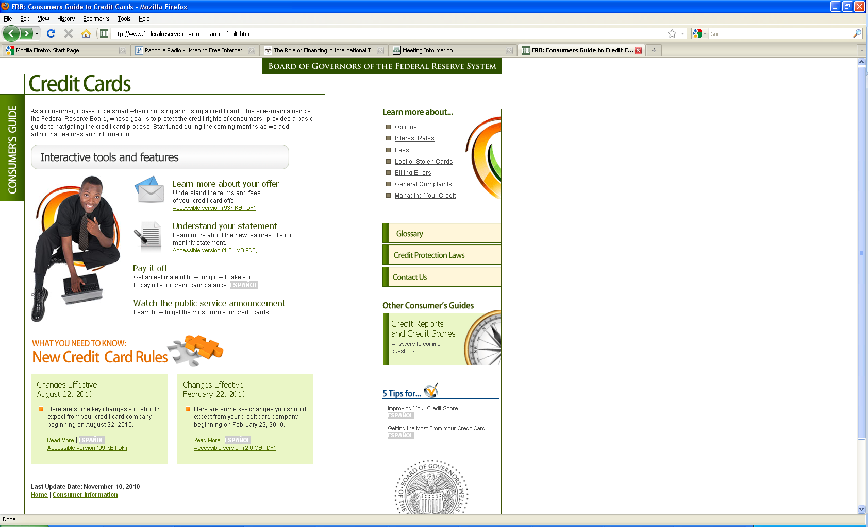
Consumer’s Guide to Credit Cards
Lesson 3: A Fresh Start
from the Federal Reserve Board of Governors*
* The Dodd-Frank Wall Street Reform and Consumer Protection Act of 2010 (also known as the Dodd-Frank Act) established the Consumer Financial Protection Bureau to enforce federal consumer protection laws.
.
25

Slide 26
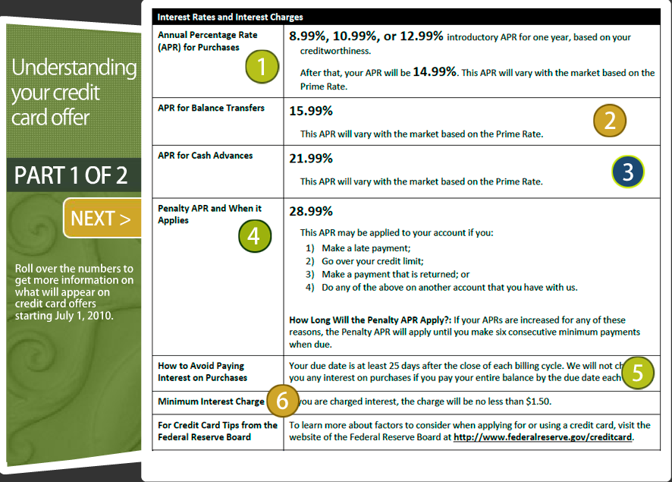
Learn More About the Offer
Lesson 3: A Fresh Start
26

Slide 27
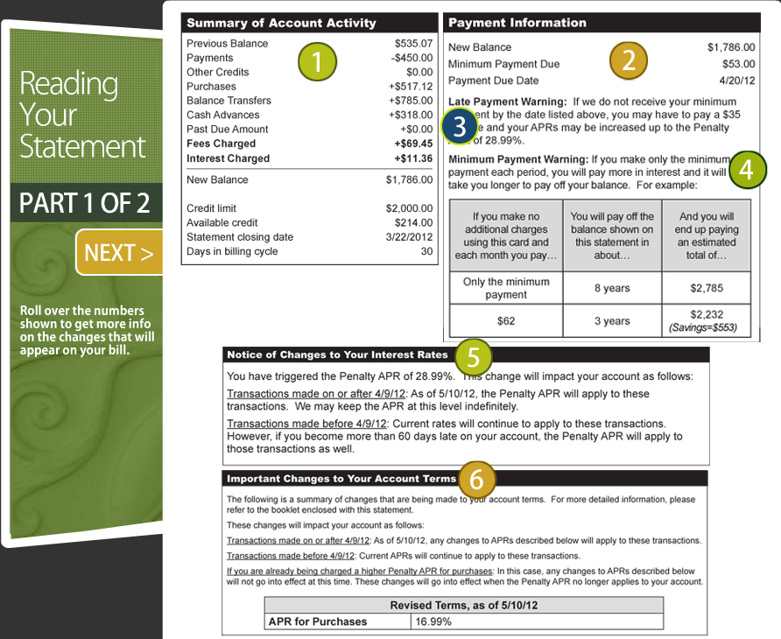
Reading Your Credit Card Statement
Lesson 3: A Fresh Start
27

Slide 28
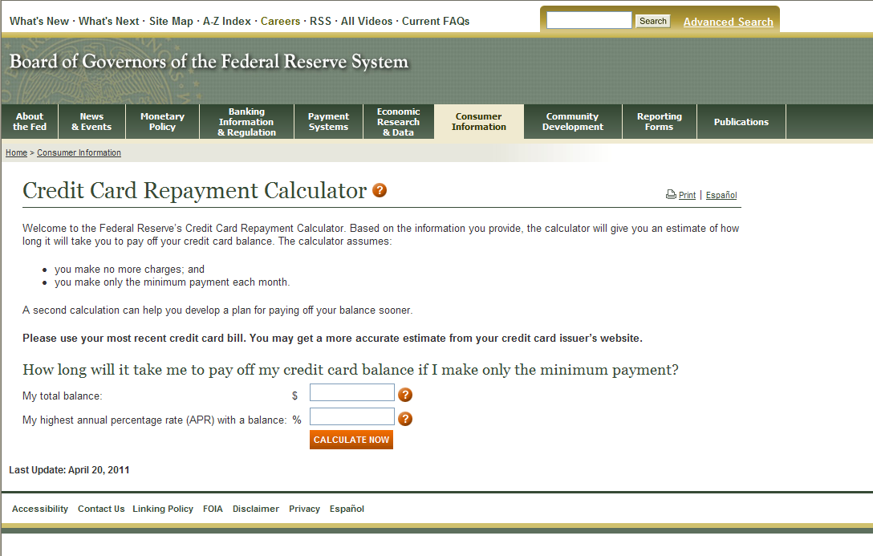
Credit Card Repayment Calculator
Lesson 3: A Fresh Start
28

Slide 29



Lesson 3: A Fresh Start
29

Slide 30

Credit History and Credit Report
Lesson 3: A Fresh Start
It’s important to monitor your credit history regularly.
  Ensure that information is reported accurately.
  Obtain and review free credit reports annually.
Three major credit bureaus:
  Equifax
  Experian
  Transunion
30

Slide 31
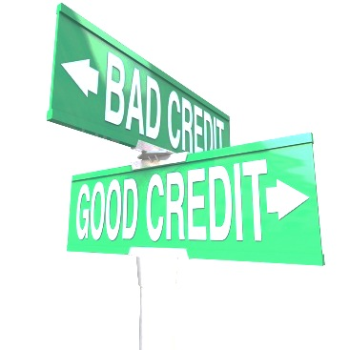
Impact of Entries in Your Credit Report
Lesson 3: A Fresh Start
POSITIVE INFORMATION
  Increases credit opportunities
  Decreases cost of borrowing
NEGATIVE INFORMATION
  Reduces credit opportunities
  Increases cost of borrowing
  May negatively impact your ability to qualify for service credit
  May eliminate you from some job offers
31

Slide 32
Establishing and Maintaining a Good Credit History
Lesson 3: A Fresh Start
Building and keeping good credit is critical to financial stability.
Pay all your credit obligations on time.
Establish a relationship with a financial institution.
Open checking and savings accounts.
Ask a bank for a small, short-term cash loan.
Apply for a credit card (not every credit card).
Maintain accurate financial records (checking account, credit cards).
Protect identity on financial tools and statements.
32

Slide 33
Credit Score Components
Lesson 3: A Fresh Start
Source: myfico.com
33

Slide 34
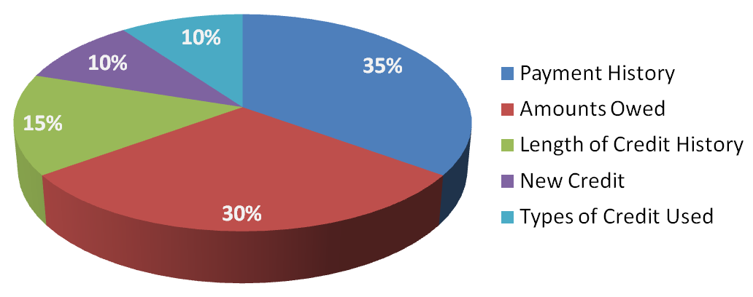
Credit Score Components
Lesson 3: A Fresh Start
PAYMENT HISTORY (35%)
  Number of accounts, number paid on time, number paid late
  Amounts past due on delinquent accounts
AMOUNTS OWED (30%)
  Total amount owed on all accounts
  Number of accounts with balances
  Balances due on installment loans
  Revolving credit – credit utilization rate (amount owed / credit limits)
34

Slide 35
Credit Score Components
Lesson 3: A Fresh Start
LENGTH OF CREDIT HISTORY (15%)
  Average time since accounts opened
  Length of time accounts open by account type
  Date of last activity
NEW CREDIT (10%)
  Number of recently opened accounts
  Length of time since last credit inquiry
  Re-establishment of positive credit history
  Length of time since new account opened
TYPES OF CREDIT USED (10%)
  The mix of revolving debt and installment debt
35

Slide 36

Impact of a Credit Score
Lesson 3: A Fresh Start
CREDIT SCORES COUNT!
Higher scores:
  Earn better loan terms (lower costs of borrowing).
  Have greater access to credit options.
Need proof?
36

Slide 37
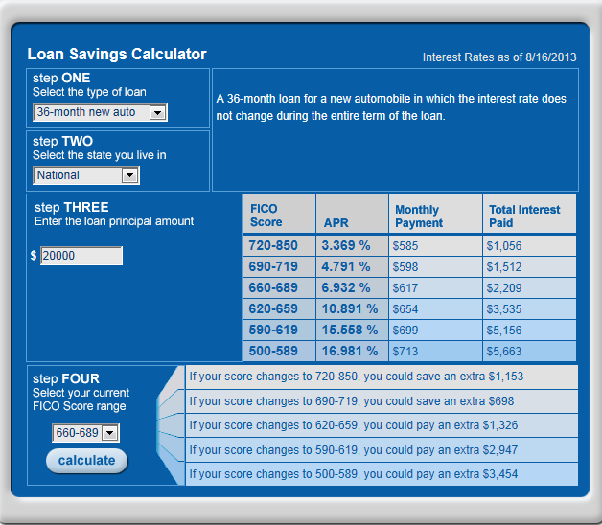
Impact of a Credit Score
Lesson 3: A Fresh Start
The Loan Savings Calculator shows how scores can affect the cost of credit.
37

Slide 38
Lesson 3: A Fresh Start
WORD BANK
APR
Credit
Credit history
Credit report
VOCABULARY REVIEW
Credit score
Debt
Installment credit
Revolving credit
Word
Description
Revolving credit
A credit arrangement that allows you to borrow at any time up to the limit set by the creditor
Installment credit
An amount of money borrowed for a specific purpose, amount of time, and interest rate.
Credit history
Information that lists credit obligations and your record of payment to creditors over a long period
APR
The interest rate as applied on loan; reflects the annual cost of borrowing money
Credit report
Information submitted by creditors about your repayment behaviors to the major credit bureaus
Debt
Something, typically money, that you owe or is due
Credit score
The numerical representation of how you handle your financial obligations
Credit
Goods, services, or money received in exchange for a promise to repay at a later date
38
Notes:
SMART slide 36

Slide 39
In Summary
Lesson 3: A Fresh Start
Credit is a privilege not a right.
The opportunity cost of credit is the purchasing power of future money for past purchases.
Our credit use is reflected in our credit history, credit report, and credit score.
Having access to credit can be a part of your financial preparedness plan.
39

Slide 40
Katrina’s Classroom was developed by a team of
Senior Economic and Financial Education Specialists at the Federal Reserve Bank of Atlanta.
Claire Loup, New Orleans Branch • Julie Kornegay, Birmingham Branch • Jackie Morgan, Nashville Branch
For additional classroom resources and professional development opportunities, please visit www. frbatlanta.org/edresources
40

