Slide 1

Lesson 4
Back to School
Part 2
EVALUATING
POSTSECONDARY OPPORTUNITIES

Slide 2
Lesson Objectives
Lesson 4: Back to School
Part 2: evaluating postsecondary opportunities
Students will:
Evaluate the opportunities and expenses associated with postsecondary education.
Explain and use the vocabulary associated with postsecondary education,
Identify postsecondary institutions that offer specific programs of study.
2

Slide 3
evaluating postsecondary
Opportunities
3

Slide 4

Education Pays… But It Also Costs
Lesson 4: Back to School
$10,556 = Average yearly tuition and fees at a public four-year college
$10,556 x 4 years = $42,224 total
69 percent of college seniors graduated with debt from student loans.
The average debt load was $28,950.
Sources: College Costs FAQ (College Board, bigfuture.collegeboard.org/pay-for-college/college-costs/college-costs-faqs) and the Project on Student Debt (projectonstudentdebt.org/state_by_state-data.php)
4

Slide 5

Student Loan Rule of Thumb
Lesson 4: Back to School
A suggestion: Don’t borrow more money for all the years of your postsecondary education than you anticipate making in your first year of employment.
For a public relations manager:
  Requirement: Bachelor’s degree
  Starting salary: $40,862
  Median salary: $101,510
Sources: Bureau of Labor Statistics Occupational Outlook Handbook (www.bls.gov/ooh/)
5

Slide 6

Paying for College: Do Your Homework
Lesson 4: Back to School
Scholarships
Grants
Work study
Savings
Student loans
6

Slide 7

Planning for Postsecondary Education
Lesson 4: Back to School
Complete an interest inventory.
Identify career goals.
Research postsecondary options.
Research the application process.
Research strategies to finance your education.
7

Slide 8

Activity: Evaluating Postsecondary Opportunities and Expenses
Lesson 4: Back to School
Scenario: You are exploring options for attending college next year to obtain a bachelor’s degree for your chosen career (see the career card).
Cost is a major factor in your decision.
Scholarships, together with help from your
parents, will cover half the expenses.
You will pay for the other half with student loans.
You will attend school in your home state.
You have not yet decided whether to live on
or off campus.
8

Slide 9
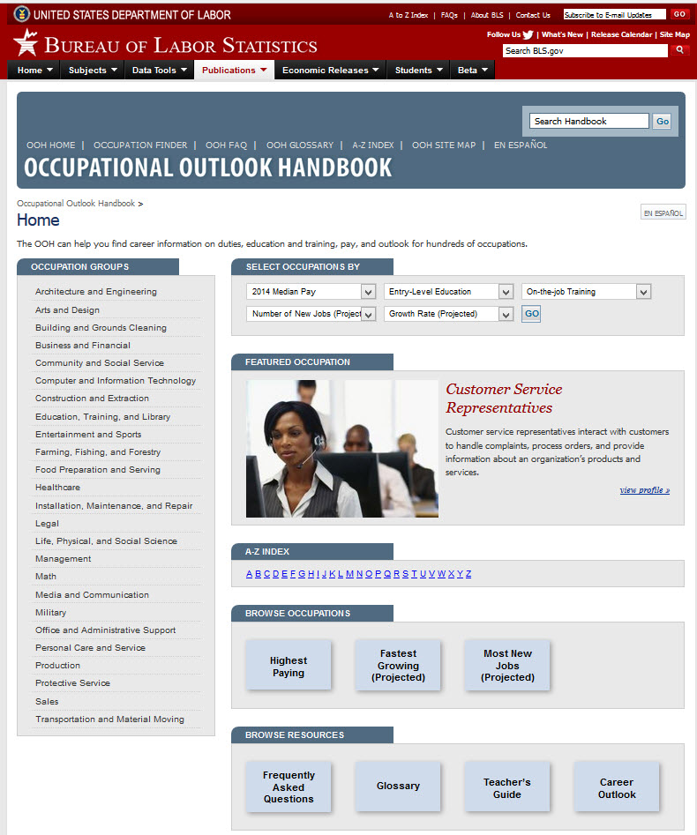
Lesson 4: Back to School
1
1
9

Slide 10
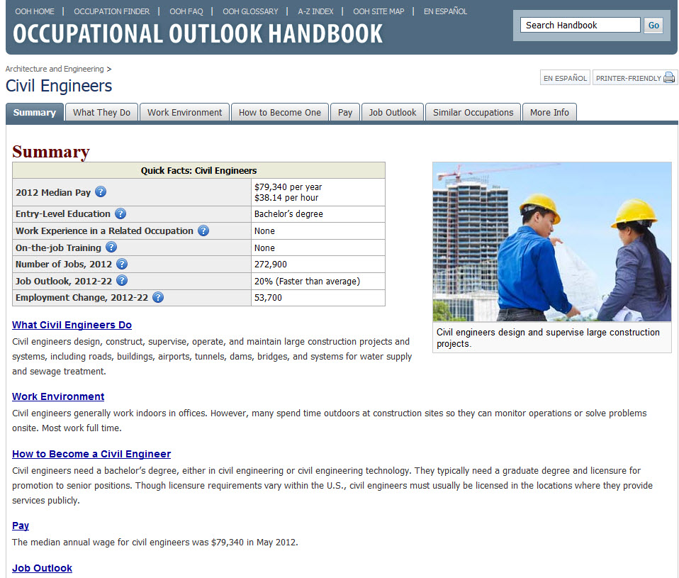
Lesson 4: Back to School
1
2
3
4
10

Slide 11
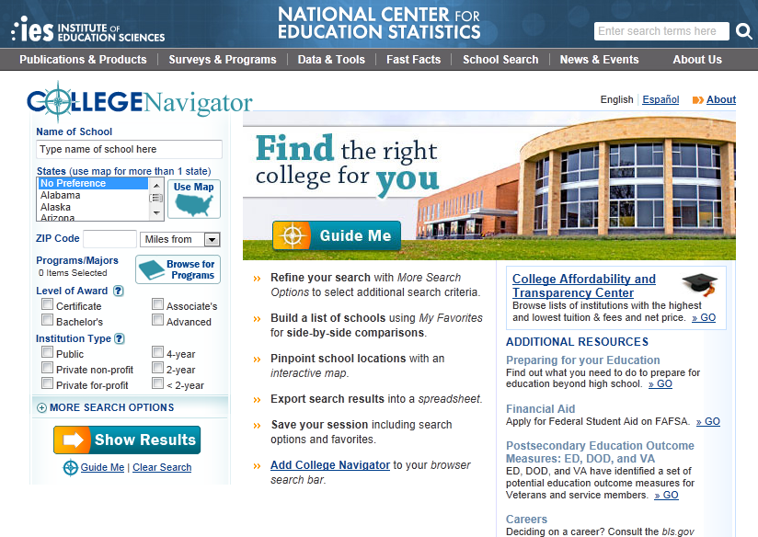
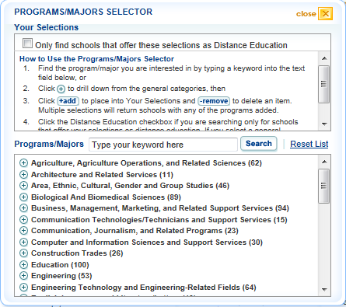
Lesson 4: Back to School
5
1
4
3
2
6
11

Slide 12

Lesson 4: Back to School
1
2
12

Slide 13

Activity: Evaluating Postsecondary Opportunities and Expenses
Lesson 4: Back to School
DEBRIEFING
What career option did you evaluate?
What school was selected as the best alternative for this career and why?
What is the opportunity cost of this decision?
Will the entry-level salary support the estimated student loan payment? Why or why not?
What are some strategies to reduce the amount borrowed to finance postsecondary education?
13

Slide 14
In Summary
Lesson 4: Back to School
Planning for postsecondary education includes considering career goals, postsecondary options, financing strategies, and necessary documentation.
14

Slide 15
Katrina’s Classroom was developed by a team of
Senior Economic and Financial Education Specialists at the Federal Reserve Bank of Atlanta.
Claire Loup, New Orleans Branch • Julie Kornegay, Birmingham Branch • Jackie Morgan, Nashville Branch
For additional classroom resources and professional development opportunities,
please visit www. frbatlanta.org/education
15

