Slide 1

Lesson 4
Back to School
Part 1
Human Capital and Employment

Slide 2
Lesson Objectives
Lesson 4: Back to School
Part 1: HUMAN CAPITAL AND EMPLOYMENT
Students will:
Assess their current and future human capital.
Analyze graphs and charts related to education.
Understand the relationship between human capital and income.
2

Slide 3
Human CAPITAL
AND Employment
3

Slide 4

Human Capital: Invest in Yourself
Lesson 4: Back to School
Human capital is the knowledge, skills, and training that people possess.
There is a strong correlation between the level of a person’s human capital and that person’s income.
Invest in human capital by going to school, pursuing additional training, and developing skills.
4

Slide 5
Your Human Capital
Lesson 4: Back to School
 | Current human capital | Future human capital
Areas and subjects in which you have a lot of knowledge
Education
Additional training
Employment
Other skills
REFLECTION QUESTIONS
How does your current human capital differ from your future human capital?
What steps do you need to take to achieve your future human capital? human capital?
5

Slide 6
How Long Will It Take to Earn $1 Million?
Lesson 4: Back to School
 | How much each year? (2015 Median Annual Salary) |  | How many years to earn $1 million?
Level of Education | Estimate | Actual | Estimate | Actual
Less than high school diploma
High school diploma
Some college, no degree
Associate’s degree
Bachelor’s degree
Master’s degree
Professional degree
Doctoral degree
$25,636
39.0
$35,256
28.4
$38,376
26.1
$41,496
24.1
$59,124
16.9
$69,732
14.3
$89,960
11.1
$84,396
11.8
Source: Current Population Survey (U.S. Bureau of Labor Statistics, bls.gov/emp/ep_chart_001.htm)
6

Slide 7
Graph: How Long WILL It Take to Earn $1 Million?
Lesson 4: Back to School
Source: Current Population Survey (U.S. Bureau of Labor Statistics, bls.gov/emp/ep_chart_001.htm )
7

Slide 8
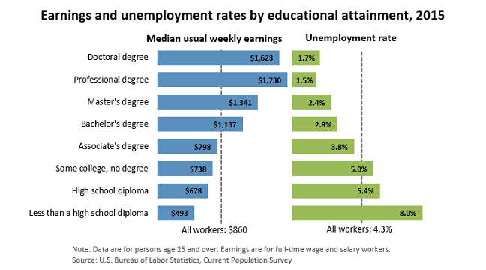
Earnings, Unemployment Rates, and Education
Lesson 4: Back to School
Source: Current Population Survey (U.S. Bureau of Labor Statistics, bls.gov/emp/ep_chart_001.htm)
8

Slide 9
Teen Unemployment Rates
Lesson 4: Back to School
Average Unemployment Rate by Year
Unemployment Rate = Number of unemployed / Labor force
Note: Labor Force = Number of employed + number of unemployed
Source: Employment Situation Historical Data (U.S. Bureau of Labor Statistics, bls.gov/cps/cpsatabs.htm)
9

Slide 10
In Summary
Lesson 4: Back to School
Human capital is the knowledge, talent, and skills that people possess.
Education can increase human capital and earning potential as well as decrease unemployment risk.
10

Slide 11
Katrina’s Classroom was developed by a team of
Senior Economic and Financial Education Specialists at the Federal Reserve Bank of Atlanta.
Claire Loup, New Orleans Branch • Julie Kornegay, Birmingham Branch • Jackie Morgan, Nashville Branch
For additional classroom resources and professional development opportunities,
please visit www. frbatlanta.org/education
11

