Slide 1
Exploring Careers in Energy
Federal Reserve Bank of Atlanta
February 7, 2018

Slide 2

Welcome
Logistics
Call-in number: 888-625-5230
Participant code: 8514 9454#
Webinar link: https://www.webcaster4.com/Webcast/Page/577/22570
You can listen through your PC or dial in to the phone.
  The webinar experience depends on your connection. If at any time you’re experiencing problems, please dial the toll-free number.
This call is being recorded and will be available at a later date.
Click the Materials button to access a pdf version of this presentation.
To Ask a Question
Click the Ask Question button
(Located in the lower-left section of the webinar window)
Disclaimer:
The views expressed in this presentation do not necessarily reflect official positions of the Federal Reserve Bank of Atlanta or the Federal Reserve System.

Slide 3


MAXIMUM EMPLOYMENT MATTERS:
Exploring Careers in Energy
Julie Kornegay
Senior Economic and Financial Education Specialist
Federal Reserve Bank of Atlanta – Birmingham Branch

Slide 4
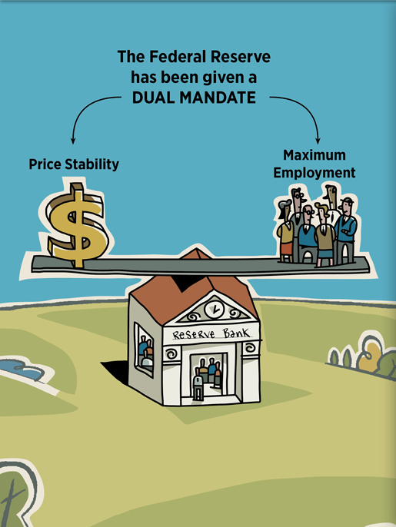
Why is the Federal Reserve Bank hosting a webinar on careers in energy?
  Dual mandate of price stability and maximum employment

Slide 5
Developing Human Capital
Produces
Skilled Labor
Attracts
New Industry
Creates High- Paying Jobs
Increases Standard of Living

Slide 6
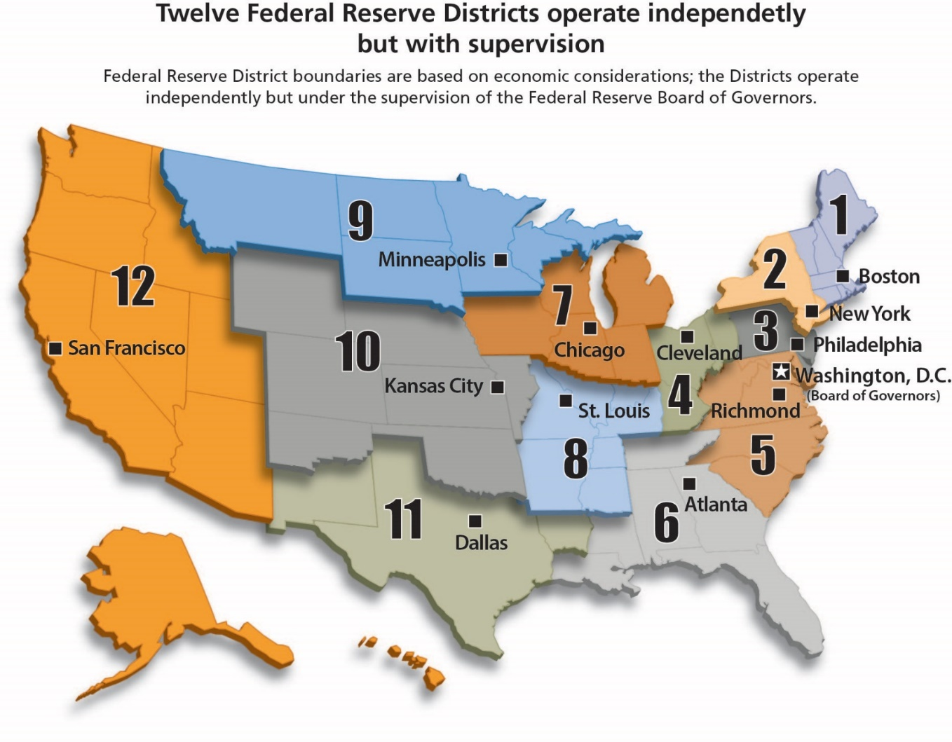
The Fed offers education outreach programs that are economic and personal finance oriented.
Notes:
The Fed Today Infographic

Slide 7

MAXIMUM EMPLOYMENT MATTERS:
Exploring Careers in Energy
Gail Psilos
REIN Director
Federal Reserve Bank of Atlanta –
New Orleans Branch

Slide 8

The Sixth District
Nashville
Birmingham
Atlanta
Jacksonville
New Orleans
Miami
Notes:
The Sixth District of the Federal Reserve Bank of Atlanta represents six states across the southeast. The GDP of these six states mirrors that of the entire United States. So when our President, Raphael Bostic goes to the FOMC meetings in Washington, his brethren around the table listen carefully to the information he provides for monetary policy deliberation. I’m going to give you a big picture overview of how the energy industry touches so many parts of our lives today and breadth of career opportunities available to your students.

Slide 9









Energy Touches All Parts of Your Life
Notes:
From the moment you wake up in the morning until the moment you go to bed, the things you wear, from you make-up to your sneakers, the lights you use, the vehicle you drive, the fuel in the vehicle, the fertilizer on your plants and lawn, the fidget spinner your kids play with, the pacifier the baby uses, the bottles your milk, water, detergent and bleach come in - are all made from an oil by-product.

Slide 10



Careers Today
Blue collar jobs of yesterday are gone.
Highly skilled careers have replaced the blue collar jobs of yesterday.
Notes:
The blue color jobs of yesterday are gone replaced by the need for highly skilled careers.
Today, Lucy and Ethel would be required to have computer technology skills to run the machines that are making and packaging the chocolates, run the diagnostics on the machines if they went down, and analyze how to get them up and running as quickly as possible, rather than eating the profits!

Slide 11
Factors That Are Changing the Industry
Advancements in technology
  Innovation/Cutting edge technology
  Higher skills
Global environment
  Onshoring / Offshoring
Labor and demographics
  Soft skills
  Baby Boomers retiring; Millennials & Gen Z’ers will dominate the workforce
  The Census Bureau noted that in 2015, millennials outnumbered baby boomers (83.1m vs. 75.4m) and are more diverse
Skills mismatches
  Computer skills
  Work with your hands
Notes:
Advancements in technology today, have every industry looking at the way they do business in today’s world; they look for innovation, cutting edge technology in an environment that competes on a global playing field.
Today, businesses are looking for a workforce at every level to help them compete, and there are many careers out there offering something for everyone.
The Utilities industry is not just about power lines & transmission, it’s about renewables, solar, battery storage, electric and natural gas transmission, home energy efficiencies, analytics, engineers, lineman, and so much more. The Energy industry is about careers in construction, building and maintaining billion dollar refineries and utility plants, LNG plants, offshore and onshore oil rigs, pipe for pipelines, and all of the small businesses who need workers to provide the materials to help the industry build and operate. The electricians, welders, plumbers, mechanics , engineers, analysts, pipefitters - all worthy highly skilled career paths.
Baby boomers are retiring and today, millennials and Generation Z will dominate the workforce. The millennials already outnumber baby boomers according to the Census Bureau.

Slide 12
MAXIMUM EMPLOYMENT MATTERS:
Exploring Careers in Energy
Julie Kornegay
Senior Economic and Financial Education Specialist
Federal Reserve Bank of Atlanta – Birmingham Branch

Slide 13
MAXIMUM EMPLOYMENT MATTERS:
Exploring Careers in Energy
Employ 6.4 million Americans
Increased in 2016 by just under 5%
Adding over 300,000 net new jobs
Roughly 14% of all jobs created in the country
https://www.energy.gov/downloads/2017-us-energy-and-employment-report

Slide 14

Four Sectors Within Energy
Electrical Power Generation and Fuels
Transmission, Distribution and Storage
Energy Efficiency
Motor Vehicles
https://www.energy.gov/downloads/2017-us-energy-and-employment-report

Slide 15
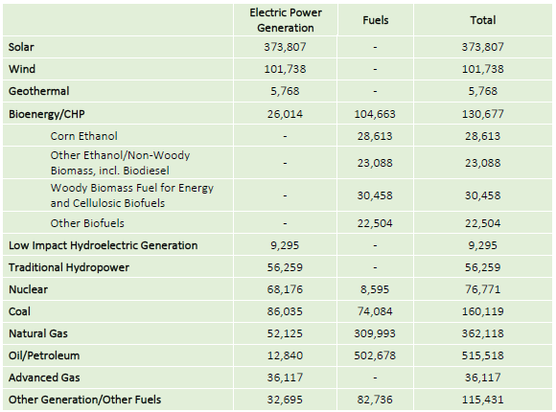
Four Sectors Within Energy
Electric Power Generation and Fuels directly employs more than 1.9 million workers.
https://www.energy.gov/downloads/2017-us-energy-and-employment-report

Slide 16
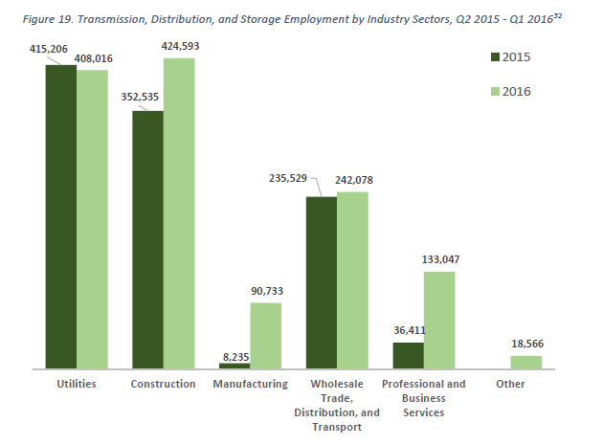
Four Sectors Within Energy
Transmission, Distribution, and Storage employs about 2.3 million workers.

Slide 17
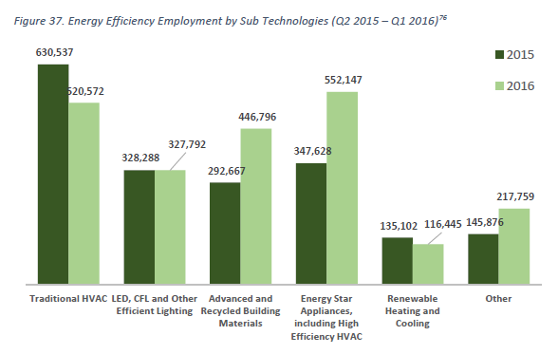
Four Sectors Within Energy
Energy Efficient Products and Services employs
2.2 million workers.

Slide 18
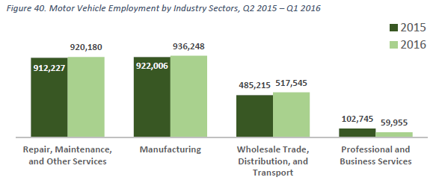
Four Sectors Within Energy
Motor Vehicles and Component Parts employs just over 2.4 million Americans.

Slide 19
Careers in Energy
https://www.bls.gov/ooh/

Slide 20

MAXIMUM EMPLOYMENT MATTERS:
Exploring Careers in Energy
Rob Sunderland
Talent Acquisition Operations Manager
Southern Company

Slide 21
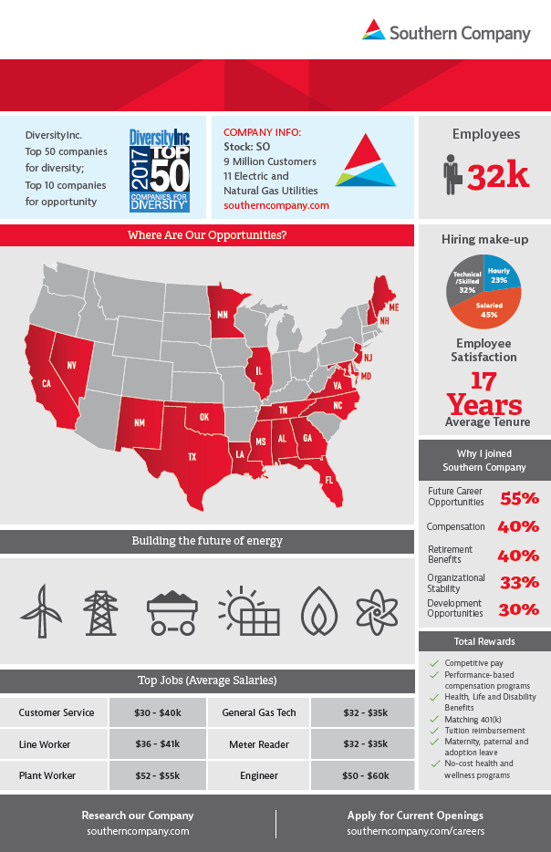
Who is Southern Company
Make, move, sell energy
A product we all depend upon
Honor our past (100 year old company), build for the future (innovation), keep customers at the center of everything we do
32,000 employees, across the United States
A career, not a job
Variety of Opportunities
21
Notes:
Industry:
- 7 million jobs (5% of all jobs)
- 15 years average employment (good pay, good benefits)
- Median annual wage: $73K

Slide 22
Labor Market – Industry Response
Labor Market Headlines:
- Record low unemployment
(4.1%)
- Less STEM/Skilled Trades
graduates
- Highest number of unfilled
positions (5.9M)
- Baby Boomer retirements
- Career interests of Millennials
- Declining health of labor force
Energy Industry Mitigation Plan:
- Career Awareness K – 12 Grades
- Energy Industry Cluster in targeted
High Schools
- Technical College Programs
    Lineworker Certification
    Instrumentation & Controls
    Gas Technician Certification
    Nuclear Engineering Technology
    Electrical Utility Technician
- Summer camps & mentoring
students
    Engineering
- Military Recruiting
- Total Rewards (retirement, healthcare,
career)
22
Notes:
K-12 grade education is responsible to educate students of different careers
We as an industry are helping with this by engaging in high schools with career clusters
- move from general electives to electives that align with careers/industries
- exist in many schools (national career cluster model)
- don’t have to wait to college to get introduced to careers
- 3 years of academics; 4th year entails an internship/work based learning/senior project or capstone
Welder/Electrician/HVAC/Carpentry pipeline programs NCCER certifications – serve on advisory boards – curriculum/classroom modifications

Slide 23
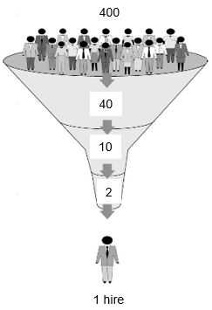
Job Seeker Realities
Tremendous competition for jobs
10% - 15% of applicants are qualified
30% - 50% pass rate on pre-hire assessments
5%+ fail pre-employment screenings
Rural locations more challenging to find talent
23

Slide 24




Key Talent Categories – Opportunities for all
Personal Effectiveness
Dependability & Reliability
Ability to learn
Self-development
Motivation
Professionalism
Interpersonal skills
Reputation
Flexibility & Adaptability
Academic Competencies
Mathematics
Reading comprehension
Writing
Listening
Speaking
Critical & Analytical thinking
IT
STEM
Workplace Competencies
Teamwork
Following directions
Planning, organizing
Problem solving
Ethics
Working with hand & power tools
Emerging Skill/Mind Set
Innovation
Willingness to change
Curious
Advanced Automation
Machine Learning
Robotics
24
Notes:
Our company has a variety of jobs – all types of skills, work environments and educational requirements. What career aligns with your interests?
Emerging skill/mind set:
- Drones, smart grid, renewables, customer service – automation, technology
Don’t be left behind – keep up skills, never stop learning, be open to change

Slide 25
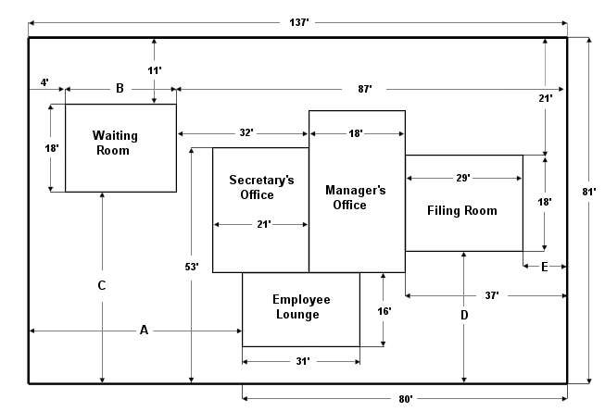
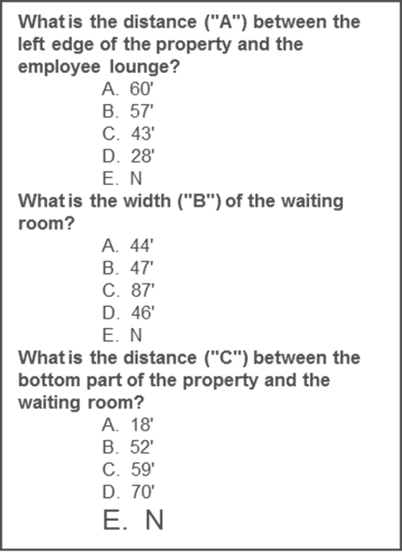
Knowledge, Skill and Ability Assessments
Core KSAs include: Basic Math; Mechanical Concepts; Reading Comprehension, Graphs and Charts
25
Notes:
30-50% pass rates

Slide 26

Knowledge, Skill and Ability Assessments
26

Slide 27


Key Talent Categories – Education & Salaries
4 Year Degree
Required
$55K – 70K
2 Year Degree
$52K – 55K + OT
2 or 4 Year Degree
$45 – 70K + OT
Certificate - 2 Year Degree
$36 – $41K + OT
Certificate - 2 Year Degree
$32 – $35K + OT
2 or 4 Year Degree
$55K – 70K
4 Year Degree
Preferred
$55K – 65K
Talent Pipeline
for many positions
4 Year Degree
Required
*Entry level pay figures
27
Notes:
Our company has a variety of jobs – all types of skills, work environments and educational requirements. What career aligns with your interests?
Not every job requires a 4 year degree
Tuition reimbursement – go back and get 4 year degree

Slide 28


Building the future of energy
Energy is everywhere - assess your daily actions – how reliant are you on energy?
Futuristic industry and opportunities
  Electric Transportation
  Renewables
  Automation
  Consumerism
Aging workforce + changing industry = Tremendous Opportunity
28
Notes:
National attrition data forecasts in our industry: 30-50% over next 5-10 years

Slide 29


MAXIMUM EMPLOYMENT MATTERS:
Exploring Careers in Energy
Stephen Toups
Executive Vice President
29

Slide 30
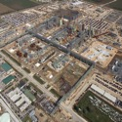






CONSTRUCTION
Largest contractor in Texas & Louisiana
MAINTENANCE & TURNAROUNDS
#1 Industrial Maintenance Contractor (U.S.)
PIPE
FABRICATION
Largest private pipe fabricator in the U.S.
EQUIPMENT
& RIGGING
State-of-the-art repair and maintenance hub with one of the largest paint booth rooms in the U.S.
SPECIALTY
SERVICES
A diverse range of services with specialized assets and capabilities
UNION
MAINTENANCE
Ability to serve the union markets with #1 ranked maintenance quality
30

Slide 31

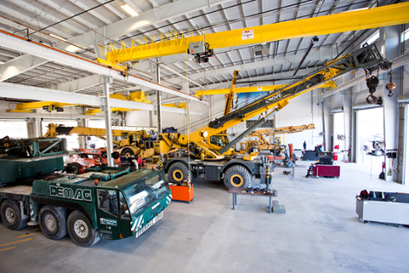

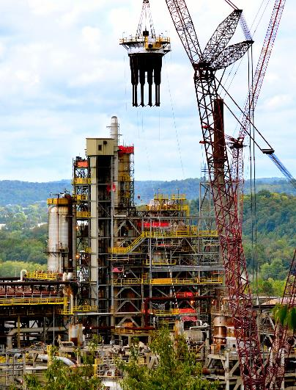
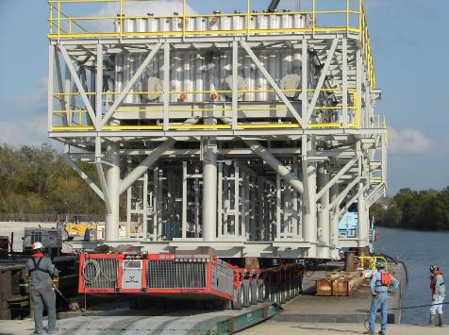
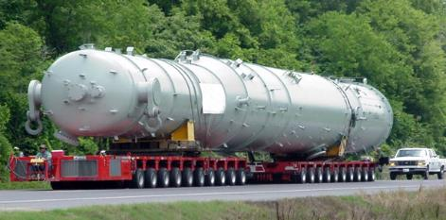
What is Industrial Construction?
31

Slide 32
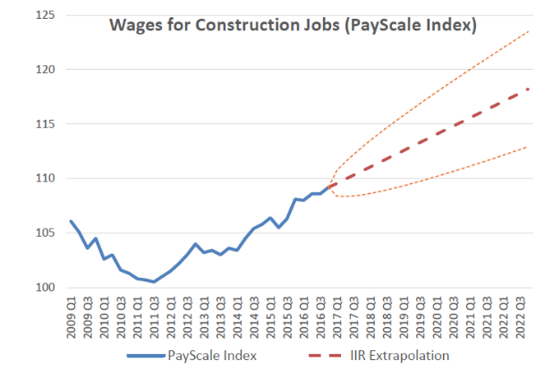
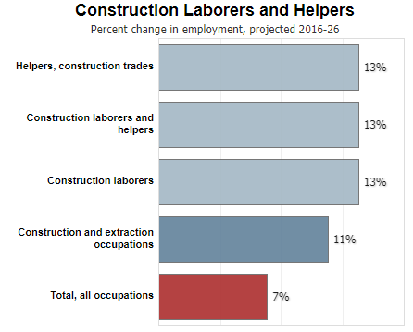
BLS Sector: Construction
7,000,000 people
1:4 own their business
1,632,800 by 2026
bls.gov/ooh/construction-and-extraction/construction-laborers-and-helpers.htm
32

Slide 33
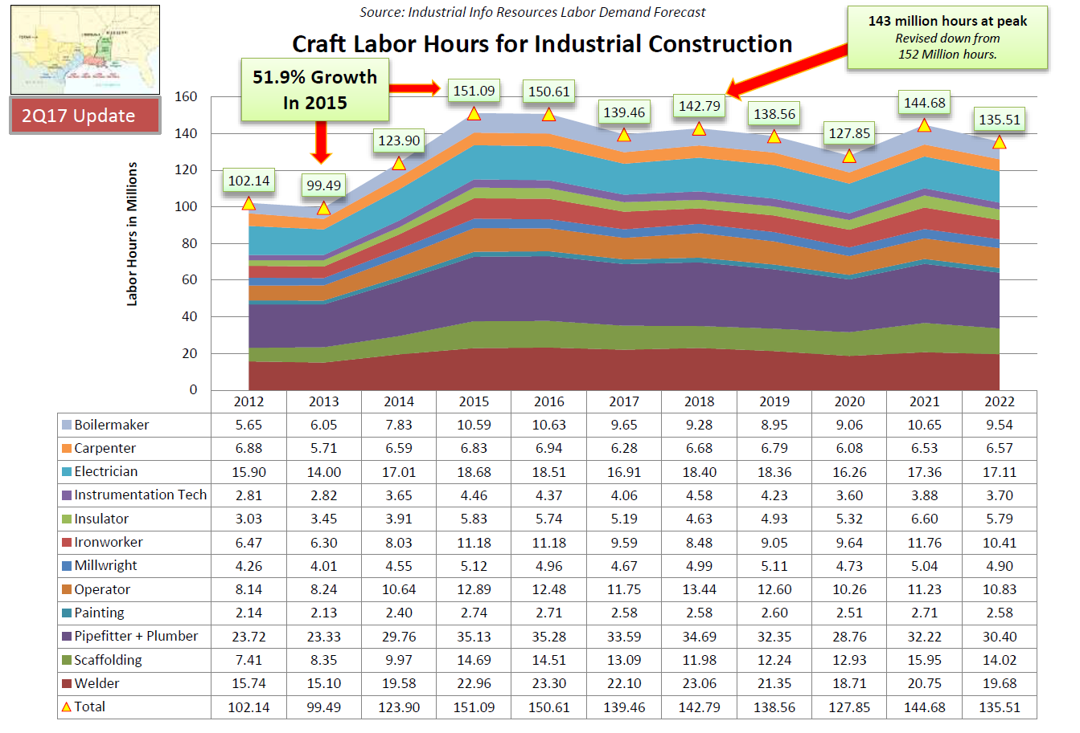
Skilled Workforce – 5 year Regional Outlook
33

Slide 34
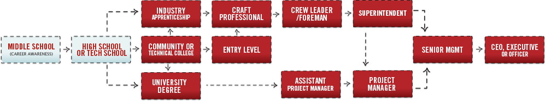
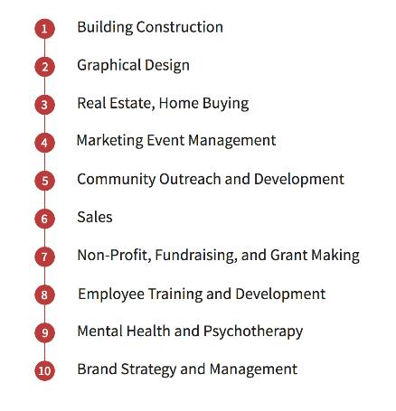
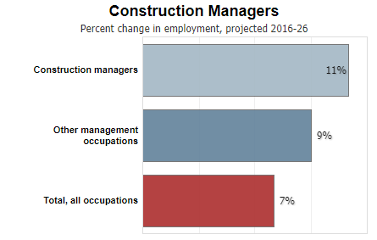
Construction Industry Career Path
34
bls.gov/ooh/management/construction-managers.htm

Slide 35
What is Industrial Construction?
35

Slide 36
What is Industrial Construction?
36

Slide 37
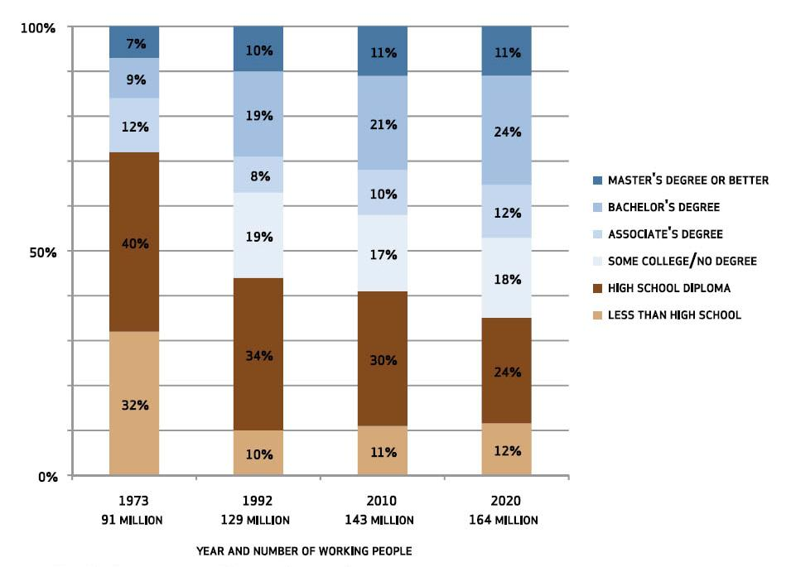
The World is Changing
37

Slide 38
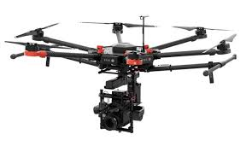











What is Industrial Construction?
38

Slide 39
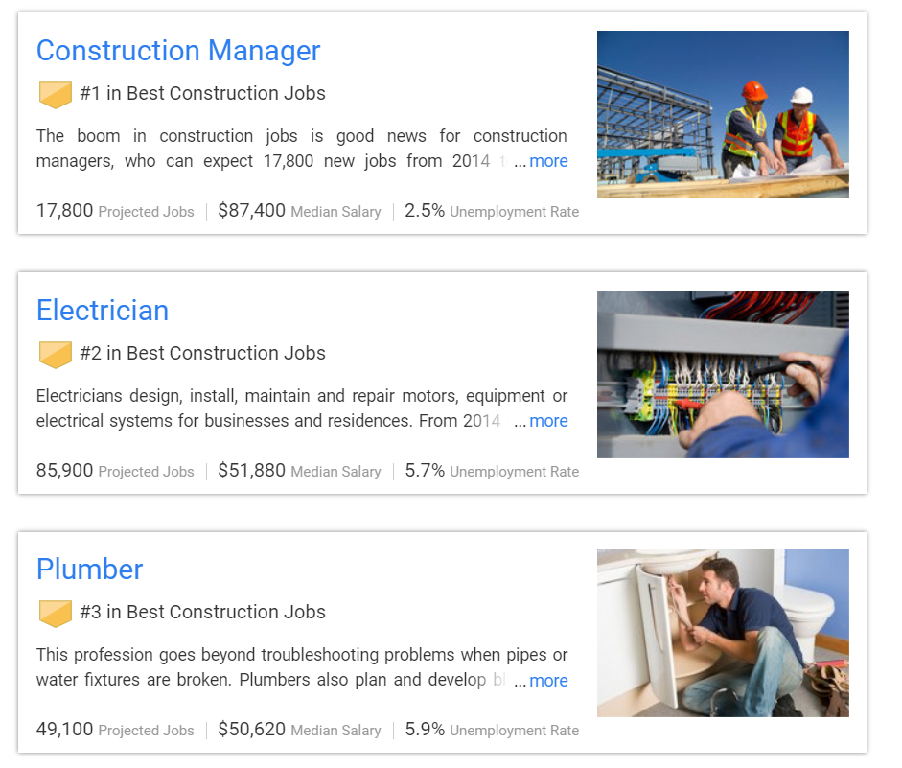

Maximum Employment Matters
39

Slide 40

Questions?
To Ask a Question:
Click the Ask Question button in the lower-left section of the webinar window.
40

Slide 41
Upcoming MEM
Exploring Careers in…
Marketing
Technology
And More!
41

Slide 42
Thank You For Participating
Federal Reserve Bank of Atlanta
Survey
Resources
Notification of Online Archive
Find information about other upcoming programs and classroom resources at:
https://www.frbatlanta.org/education
42

