Slide 1
Exploring Careers in Financial Services
Federal Reserve Bank of Atlanta
October 30, 2017

Slide 2

Welcome
Logistics
Call-in number: 888-625-5230
Participant code: 851 785 39#
Webinar link: https://www.webcaster4.com/Webcast/Page/577/21750
You can listen through your PC or dial in to the phone.
  The webinar experience depends on your connection. If at any time you’re experiencing problems, please dial the toll-free number.
This call is being recorded and will be available at a later date.
Click the Materials button to access a pdf version of this presentation.
To Ask a Question
Click the Ask Question button
(Located in the lower-left section of the webinar window)
Disclaimer:
The views expressed in this presentation do not necessarily reflect official positions of the Federal Reserve Bank of Atlanta or the Federal Reserve System.

Slide 3
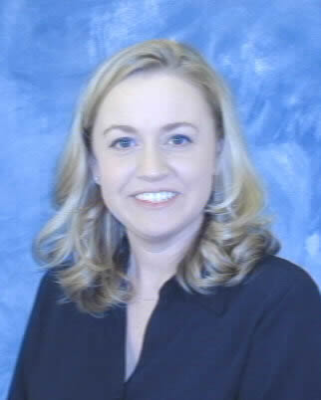

MAXIMUM EMPLOYMENT MATTERS:
Careers in Financial Services
Julie Kornegay
Senior Education Program Manager
Federal Reserve Bank of Atlanta – Birmingham Branch

Slide 4
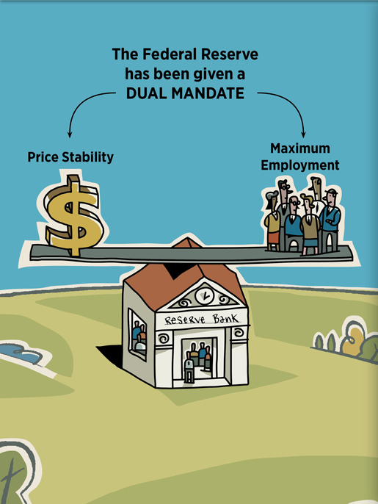
Why is the Federal Reserve Bank hosting a webinar on careers in financial services?
  Dual mandate of price stability and maximum employment

Slide 5
Developing Human Capital
Produces
Skilled Labor
Attracts
New Industry
Creates High- Paying Jobs
Increases Standard of Living

Slide 6
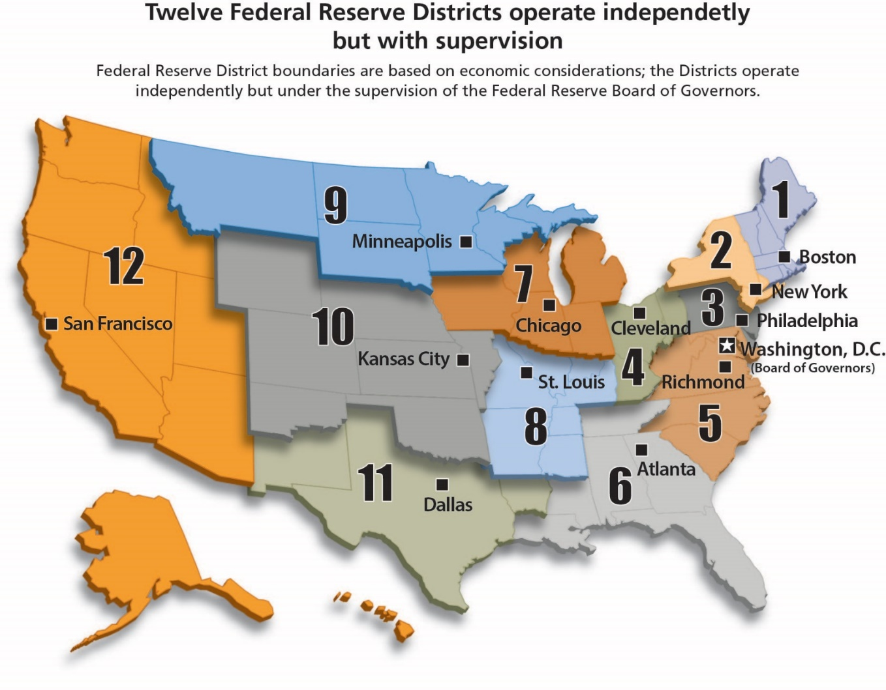
The Fed offers education outreach programs that are economic and personal finance oriented.
Notes:
The Fed Today Infographic

Slide 7

What are Financial Services?
Professional services involving the investment, lending, and management of money and assets.
Banking
Accounting
Insurance
https://en.oxforddictionaries.com/definition/financial_services

Slide 8

Industry Forecast for Job Growth
Business and financial occupations are projected to grow 8 percent from 2014 – 2024 adding about 632,400 new jobs.
Median annual wage for business and financial occupations was $66,530 in May 2016.
This is higher than median annual wage for all occupations of $37,040.
https://www.bls.gov/ooh/business-and-financial/home.htm

Slide 9
Careers in Financial Services
https://www.bls.gov/ooh/business-and-financial/home.htm

Slide 10
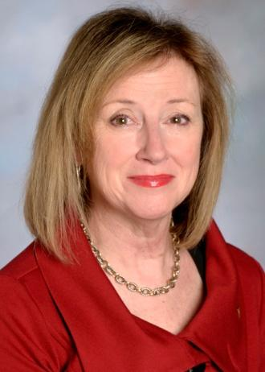

MAXIMUM EMPLOYMENT MATTERS:
Exploring Careers in Financial Services
Janet Parker
Executive Vice President
Corporate Human Resources
Regions Bank

Slide 11
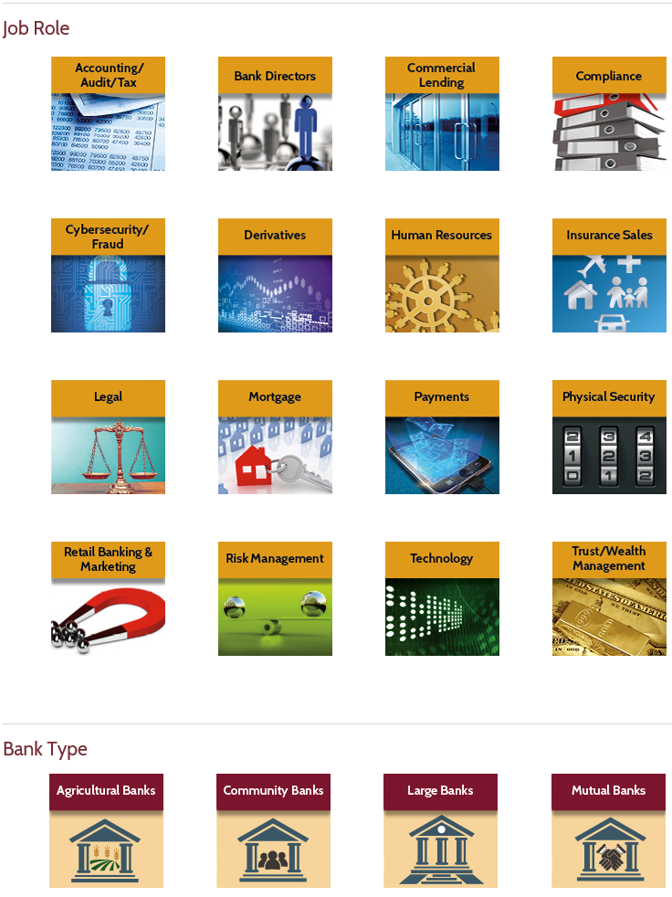
Resources by bank type/job role
https://www.aba.com/Tools/Function/Pages/default.aspx

Slide 12

Banking innovations
https://www.aba.com/Tools/Infographics/Pages/Infographic-BankingInnovations.aspx

Slide 13
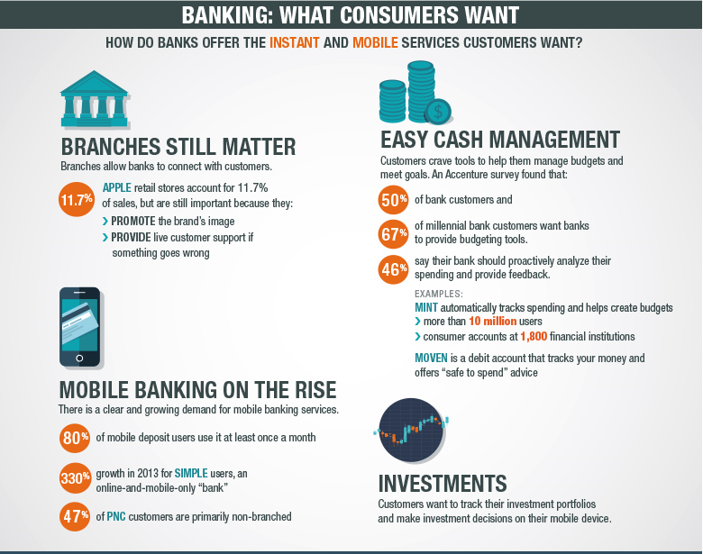
Changing landscape of banking
https://www.aba.com/Tools/Infographics/Pages/Infographic-BankingInnovations.aspx

Slide 14

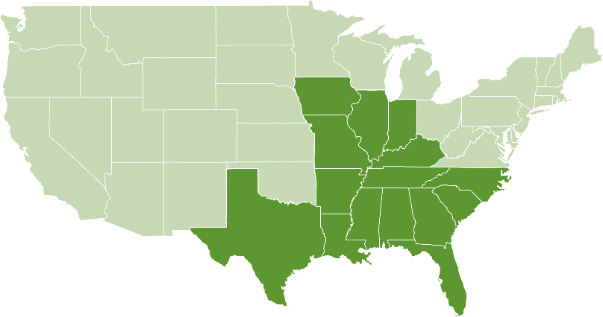
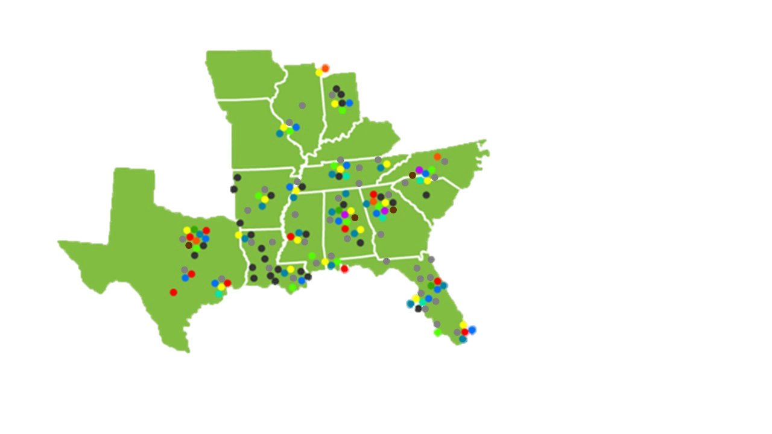
Our banking franchise
Regions aims to be the premier regional financial institution in America
Ranked 16th Nationally in Total Deposits⁽²⁾
Line of Business Coverage
•
Corporate Banking
(1) Branch Locations by State
•
•
Business Capital
Capital Markets
Dealer Finance
Equipment Finance
Government/Institutional
Specialized Industry
Institutional Services
Insurance
Private Wealth
Real Estate
Corporate Banking
Commercial Banking
Alabama – 206 | Louisiana – 99
Arkansas – 77 | Mississippi – 119
Florida – 320 | Missouri – 55
Georgia – 120 | North Carolina – 6
Illinois – 46 | South Carolina – 25
Indiana – 51 | Tennessee – 211
Iowa – 8 | Texas – 72
Kentucky – 11
•
•
22,101 Associates
In 15 States
Birmingham, Alabama
•
•
•
•
•
•
•
•
•
14
4
Full Service branches as of 6/30/2017
Source: SNL Financial as of 06/30/2016

Slide 15
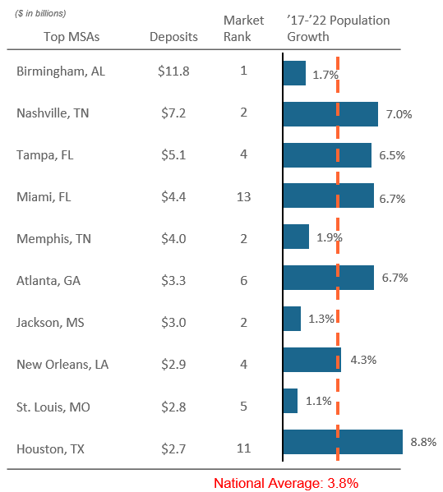
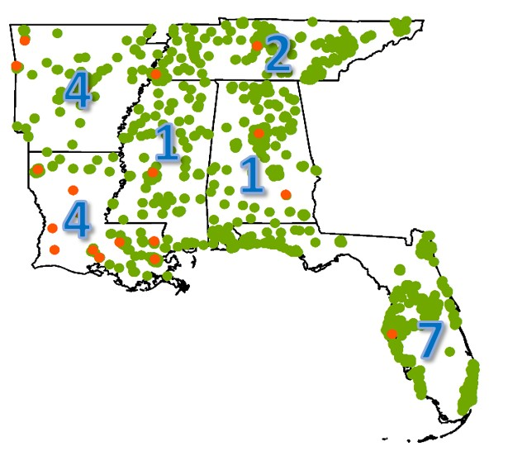
Strength of our markets
Market Rank
in Core States
High Market Share,
High Growth Markets
78%
78% of total deposits are in our core states Alabama - Mississippi - Florida Louisiana - Tennessee - Arkansas
6
15
5
Source: SNL Financial
As of 6/30/2016 FDIC summary

Slide 16
Career Opportunities
Bankers
  3,916 Entry Level Associates
Contact Center Associates
  846
Programmers
  388
16
Notes:
Keep your bullet points concise.
Use second level points sparingly.
If possible, avoid using more than two levels of bullet points.

Slide 17
Entry into the Bank
Apply on Line (Direct Hire)
  regions.com
Emerging Talent Program
  College Graduates with at least a 3.0 GPA
Internships
  College level sophomores and juniors
17

Slide 18
Preferred Skills
Team Player
Critical Thinking
Strong Written and Verbal Communication
Proactive—takes initiative
Curious
Credible
18

Slide 19
Why Regions?
Our mission is to make life better for our associates, customers, and communities. It is our roadmap to create strong consistent shareholder value.
Our effectiveness in being successful as a business is built on leveraging the diversity of our resources in terms of backgrounds, experiences, and ways of thinking.
Our fundamental belief is that doing what is right, putting people first, reaching higher, focusing on our customer and enjoying life are what define us as a company.
19

Slide 20
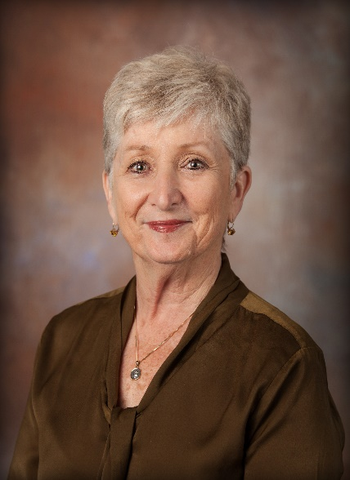

MAXIMUM EMPLOYMENT MATTERS:
Exploring Careers in Financial Services
Diane Christy
Vice President
Alabama Society of CPAs

Slide 21
Careers in Accounting
American Institute of CPAs:
75% of today’s CPAs will retire over the next 15 years.
21
https://www.accountingtoday.com/opinion/recruiting-and-succession-planning-across-cpa-generations

Slide 22
Careers in Accounting
U.S. Bureau of Labor Statistics:
Employment of accountants and auditors is projected to grow 10 percent from 2016 to 2026, faster than the average for all occupations.
Employment growth of accountants and auditors is expected to be closely tied to the health of the overall economy.
As the economy grows, more workers should be needed to prepare and examine financial records.
22
https://www.bls.gov/ooh/business-and-financial/accountants-and-auditors.htm#tab-1

Slide 23
Three main career buckets:
Public Accounting [CPA firms]
Corporate/Non-profit Accounting
Governmental Accounting
Many areas of specializations within each of these areas.
23

Slide 24
Public Accounting
Tasked with protecting the interests of individuals and businesses ranging from small, family-owned companies to large, international Fortune 500 companies.
Tax, audit, consulting, financial planning, forensic accounting, wealth management
24

Slide 25
Corporate and Non-profit Accounting
Covers the entire gamut of every kind of enterprise. Titles in corporate accounting include CFO, COO, CAO, controller, treasurer.
Every movie, athletic team, hospital, grocery store, professional service (doctor’s office or law firm), technology company or mom/pop convenience store needs a CPA’s expertise.
25

Slide 26
Non-profit Accounting and Education
Passion marries professional commitment.
Help a cause meaningful to you succeed financially.
Or impact the future by inspiring the next generation of CPAs.
26

Slide 27
Educational Path
Undergraduate degree in accounting
Students can sit for the Uniform CPA Exam at 120 hours.
Additional 30 hours plus work experience (1 year in public accounting, 3 years in other areas of accounting) are required for licensure.
Many students use the 30 hour requirement to obtain a graduate degree.
Other credentials increase skill sets and leverage greater salaries.
27

Slide 28
Earning Potential
Employer 0-3 years 4-6 years
Public Accounting (Lg. Firm) $63,250-83,250 $78,500-106,500
Public Accounting (Med. Firm) $56,500-67,750 $70,500-96,000
Public Accounting (Sm. Firm) $51,500-60,500 $63,750-81,500
Corporate Accounting (Lg. Co.) $53,750-69,500 $68,750-87,750
Corporate Accounting (Med. Co.) $49,250-65,250 $61,250-79,750
Corporate Accounting (Sm. Co.) $45,000-59,000 $57,500-70,000
28

Slide 29

Ask for Help
Every state has a society of CPAs with multiple resources for high school teachers.
You’ll hear from our next speaker about some of those resources.
Contact YOUR state society or a local CPA to learn more about accounting and the path for your students to become CPAs.

Slide 30
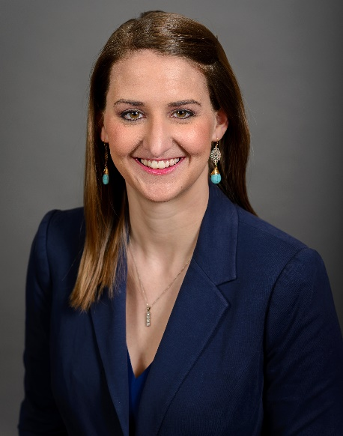


MAXIMUM EMPLOYMENT MATTERS:
Exploring Careers in Financial Services
Laura Hunt
Communications Associate
Tennessee Society of CPAs

Slide 31
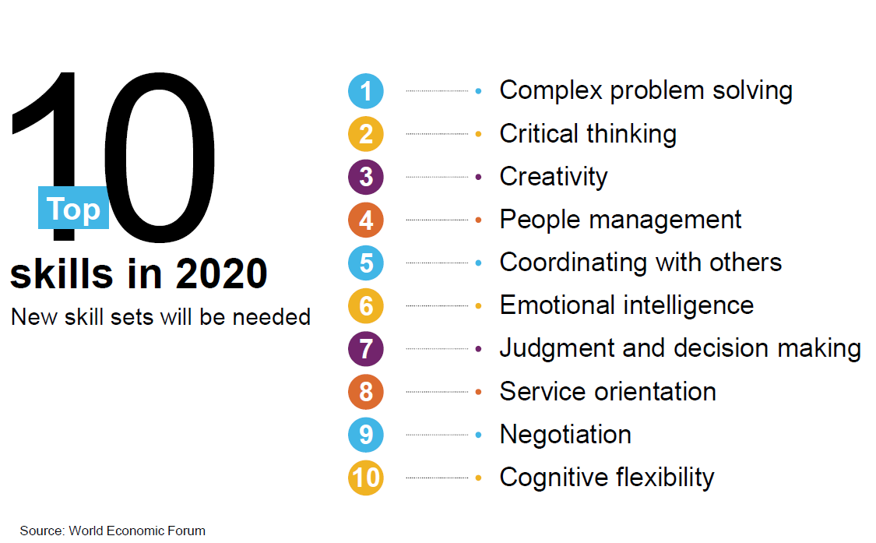
Having the Right Talent
31

Slide 32
Did you know...
Fewer than 40% of high schools in Tennessee offer an accounting course.
Fewer than 14% of all high school students in Tennessee will take an accounting course prior to college.
For those that do take accounting, the curriculum teaches basic bookkeeping and almost no accounting principals.
32
Notes:
There are 318 public high schools in Tennessee - 120 offer accounting classes

Slide 33

High School Outreach
Career Exploration
Field Trips
Educator Training for
Advanced Accounting Class
Speaker’s Bureau
Educator Resources for the Classroom
  ThiswaytoCPA.com
  StartHereGoPlaces.com
Bank On It Interactive Game

Slide 34
An interactive, touring field trip for high school students to explore a career in accounting
Held at local college campuses across the state
Receive college prep advice in addition to accounting
Notes:
This program was designed as a field trip for high school accounting and personal finance teachers. Bringing students onto a nearby college campus, we’ve created a program that utilized TSCPA members to shatter the stereotypes of CPAs, get the students engaged with online interactive sessions including an interactive gameshow of what they have learned, and incorporate the fundamentals of applying for financial aid and preparing for college, ending with a campus tour.
These programs are FREE and open to any student who is interested in learning more about the accounting profession.

Slide 35

College Outreach
Scholarship Programs
Student Ambassador Program
Meet the Firm
Student Night at Chapter Events
Career Resources
Mentorship Program

Slide 36
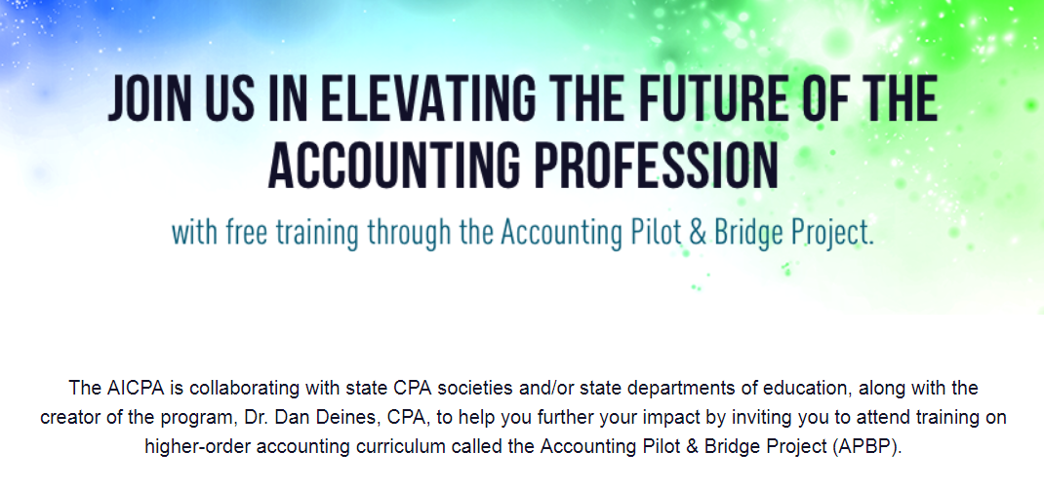

AICPA Acquires APBP Program
36
Notes:
19 Teachers Participated in this year’s training held on June 19-21. Attendees: 14 from TN; 1 WI; 1 MI; 1 IN; 3 KY. These accounting teachers are joining the additional 28 teachers that went through this program last year and are able to teach an advanced accounting level in their high schools. Currently, MTSU, ETSU and Northeast State Community College. Colleges interested in offering credit for students who take this course and pass the corresponding exam can offer credit through an articulation agreement with that school district. For more information, visit www.accountingpilot.com

Slide 37
Accounting Pilot and Bridge Project
1,000+
High school teachers that have been trained through the program in 42 states to date, and are able to teach the course in their schools.
52% vs. 9%
College accounting majors were significantly more likely to have taken an accounting class in high schools as opposed to non-majors.
37

Slide 38

Questions?
To Ask a Question:
Click the Ask Question button in the lower-left section of the webinar window.
38

Slide 39
Next in the Series
Exploring Minimum Wage Jobs
November 29, 2017 3:30 – 4:30 Central
Registration Coming Soon

Slide 40
Thank You For Participating
Federal Reserve Bank of Atlanta
Survey
Resources
Notification of Online Archive
Find information about other upcoming programs and classroom resources at:
https://www.frbatlanta.org/education

