Slide 1

Maximum Employment Matters
Exploring Careers in Manufacturing
February 6, 2017
Notes:
Welcome
Thank you for
What is in the folder
Recognize a few folks that have helped make today possible.
Lesley McClure – Regional Executive and
Amy Hennessy – Director of our program

Slide 2
Welcome
Logistics
Call-in number: 888-625-5230
Participant code: 9715 7820#
Webinar link: https://www.webcaster4.com/Webcast/Page/577/19027
You can listen through your PC or dial in to the phone.
  The webinar experience depends on your connection. If at any time you’re experiencing problems, please dial the toll-free number.
This call is being recorded and will be available at a later date.
Click the Materials button to access a pdf version of this presentation.
How we’ll take questions
Click the Ask Question button
(Located in the lower-left section of the webinar window)
Disclaimer:
The views expressed in this presentation do not necessarily reflect official positions of the Federal Reserve Bank of Atlanta or the Federal Reserve System.

Slide 3


Maximum Employment Matters
Exploring Careers in Manufacturing
Julie Kornegay
Senior Economic and Financial Education Specialist
Federal Reserve Bank of Atlanta – Birmingham Branch

Slide 4
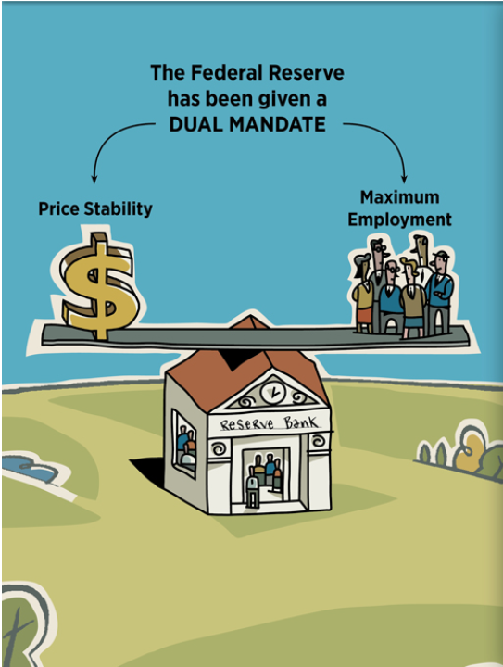
Why is the Federal Reserve Bank hosting a webinar on careers in manufacturing?
  Dual mandate of price stability and maximum employment

Slide 5
Developing Human Capital
Produces
Skilled Labor
Attracts
New Industry
Creates High- Paying Jobs
Increases Standard of Living

Slide 6
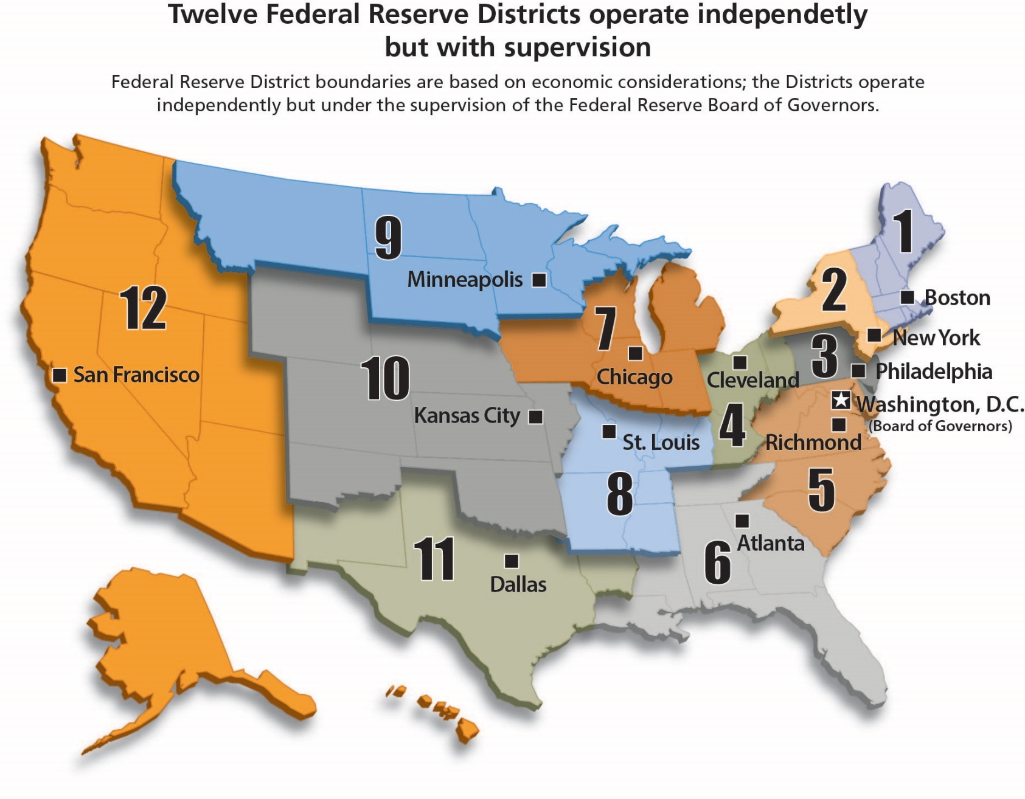
The Fed offers education outreach programs that are economics and personal finance oriented.
Notes:
The Fed Today Infographic

Slide 7

Maximum Employment Matters
Exploring Careers in Manufacturing
Troy Balthrop
Senior REIN Analyst
Federal Reserve Bank of Atlanta – Nashville Branch

Slide 8
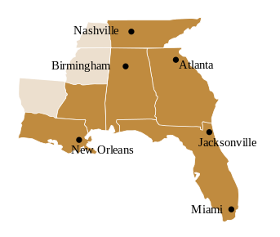
The Sixth District

Slide 9
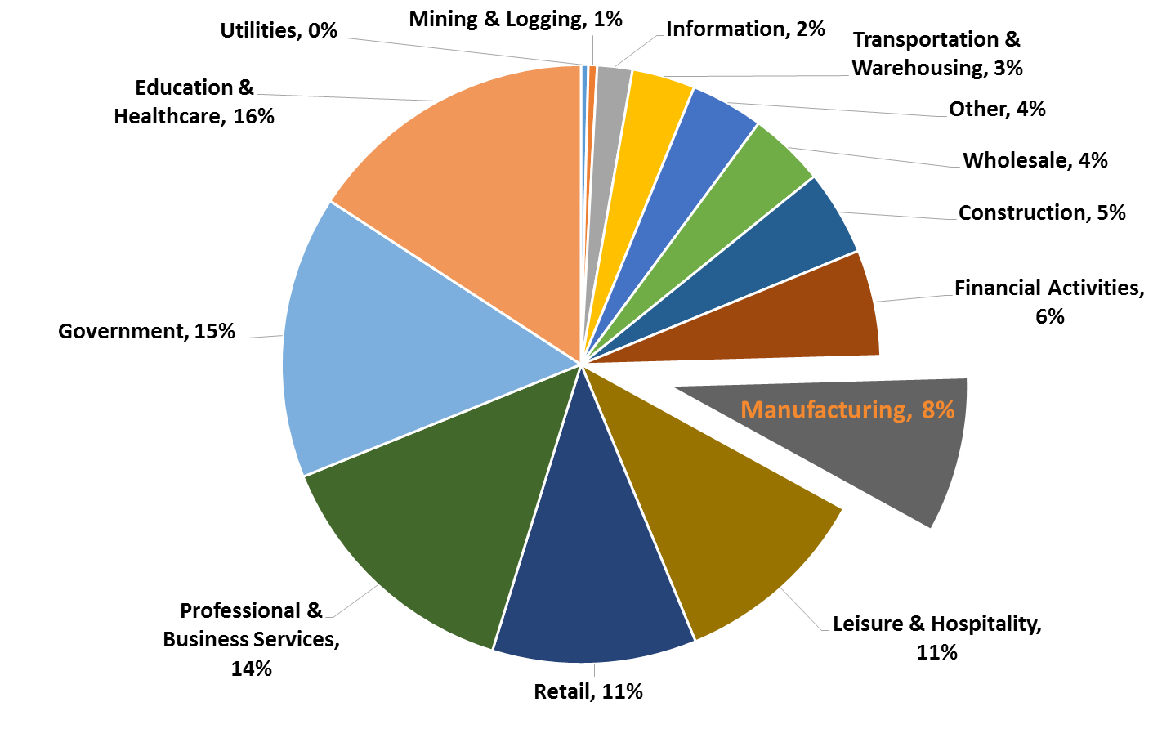
The manufacturing sector accounts for eight percent of U.S. employment
Source: Bureau of Labor Statistics
December 2016

Slide 10
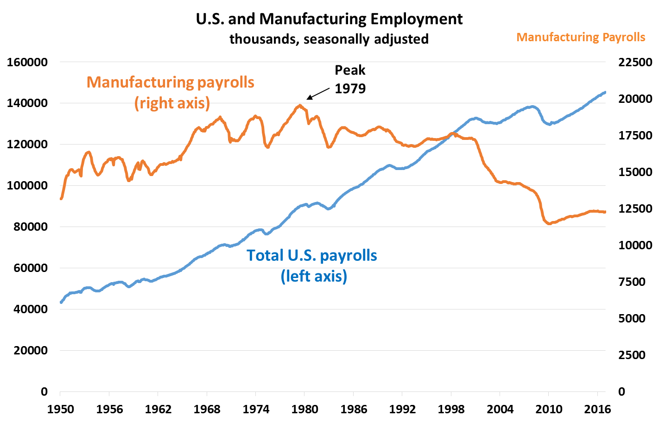


Manufacturing jobs have been on the decline for years
Source: Bureau of Labor Statistics
through December 2016
Notes:
The U.S. manufacturing industry lost close to eight million jobs between 1979 and 2010.

Slide 11

Establishment (or Payroll) Survey
A few facts
Administered by telephone
Roughly 146,000 businesses and government agencies contacted
Agencies report their number of payroll additions or losses
https://www.bls.gov/ces/

Slide 12
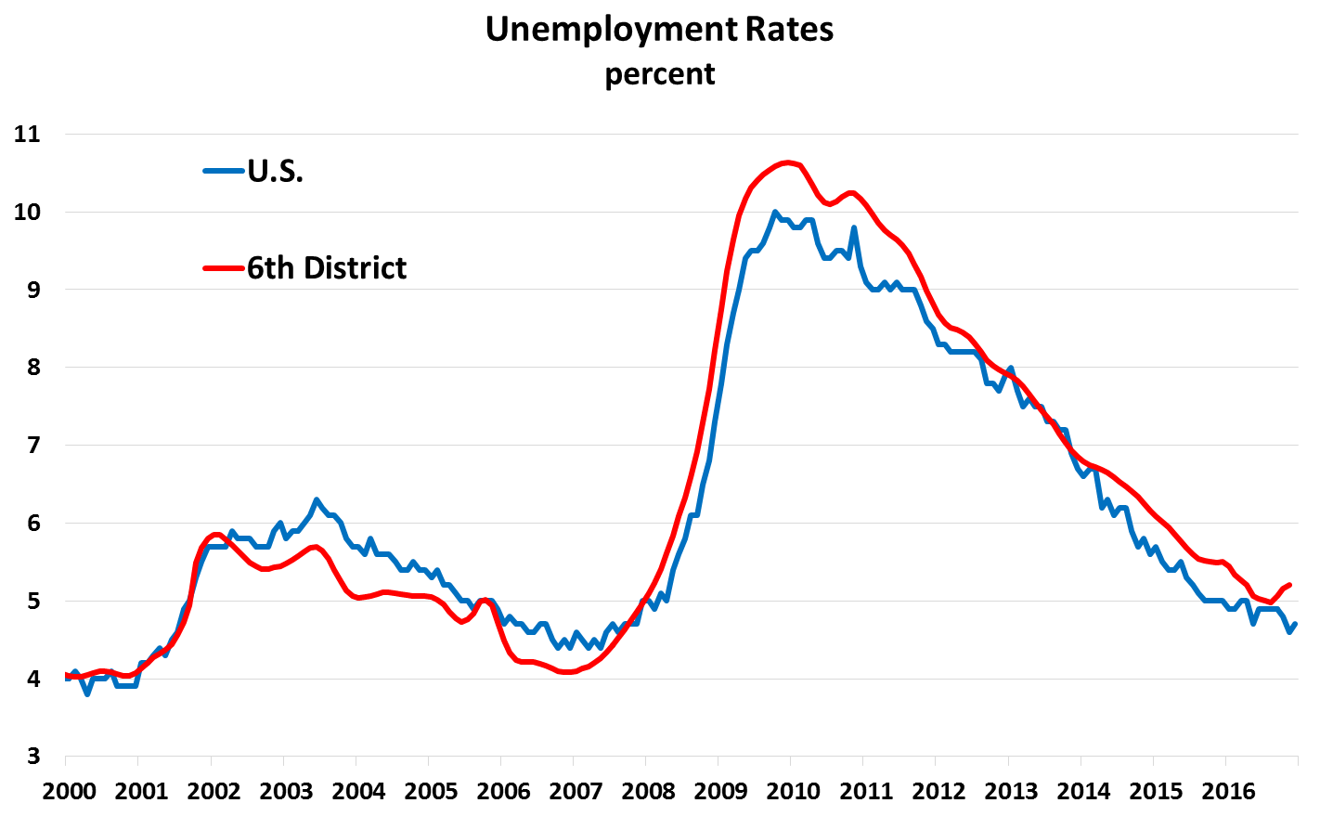
Unemployment rates
Source: Bureau of Labor Statistics
through December 2016
12

Slide 13
Unemployment Rate: How is it calculated?
Household Survey: a few facts
Administered by telephone
Roughly 60,000 households are contacted
Asked a series of questions pertaining to their employment status
https://www.bls.gov/
Unemployment rate = number of unemployed / civilian labor force
Example: December 2016
Unemployed = 7,529
Civilian Labor Force = 159,640
7,529 / 159,640 = 4.7% December unemployment rate
https://www.bls.gov/cps/

Slide 14
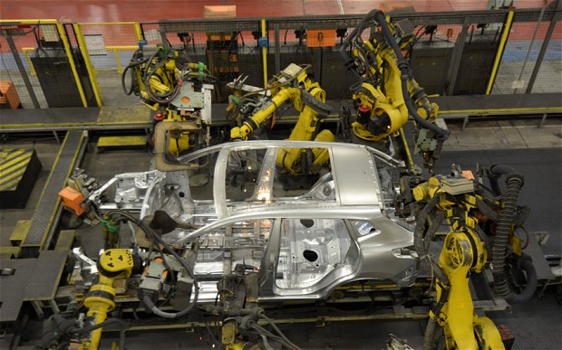
Manufacturing plays an important role in the Southeast
Automobile manufacturing has a large footprint.
General Motors
Hyundai
Kia
Mercedes
Honda
Nissan
Volkswagen

Slide 15









Other major manufacturing industries in the Southeast
Aerospace & Defense
Food
  Soft Drinks
  Poultry
Homebuilding
  Carpet
  Doors and Windows
Healthcare
  Surgical Instruments
  Pharmaceuticals
Petroleum Processing
Shipbuilding

Slide 16

Factors that are changing the industry
Advancements in technology
  Higher skills, fewer positions
Global environment
  Onshoring / Offshoring
Labor shortage and demographics
Skills mismatches

Slide 17

A career in manufacturing….hmm
Skills?
Less education / more training
Cutting edge technology
Educators & Employers
Types of jobs?
Industrial Mechanics
Engineers
Machinists
Robotics Operators

Slide 18




Manufacturing Myths
  It’s Dirty
  It’s Dark
  It’s Dingy
  It’s Dangerous
  It’s Dumb (only low skilled tasks)
  It Doesn’t Pay Well
  It’s Monotonous

Slide 19
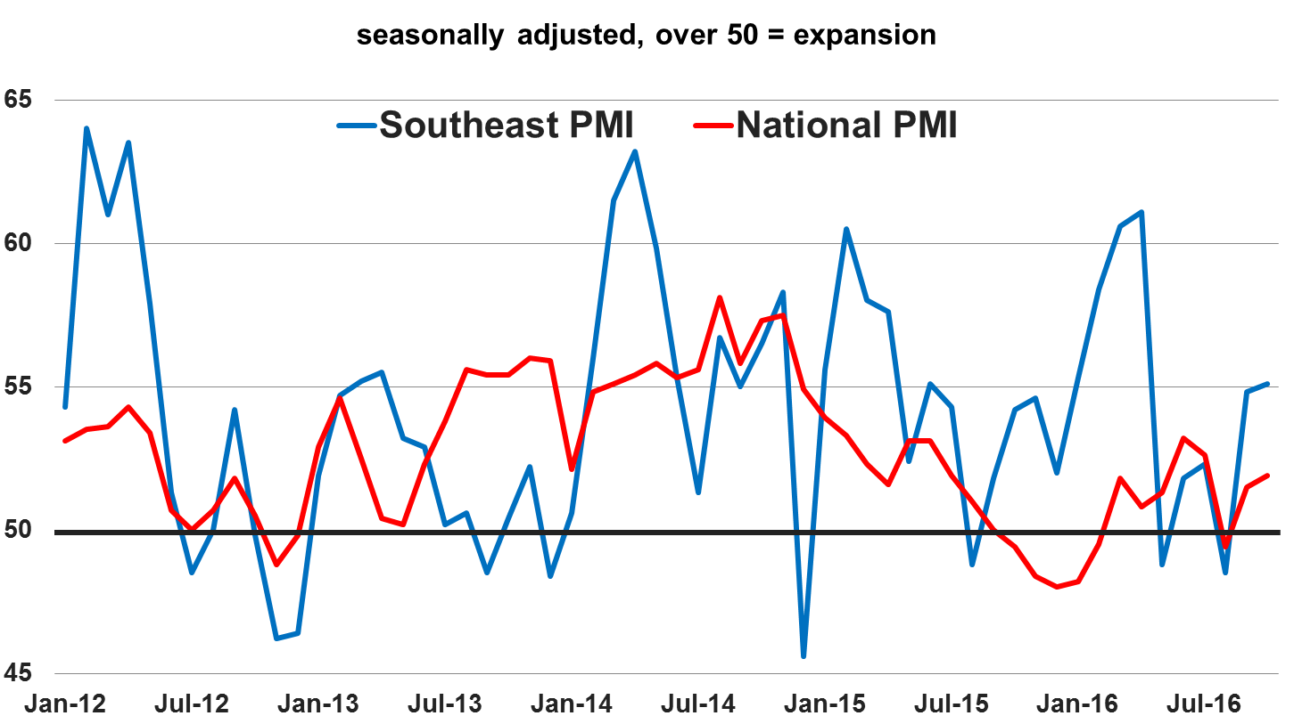
Purchasing Managers Index (PMI)
Note: The PMI is the first economic data released every month and provides a snapshot of overall manufacturing activity. The index measures new orders, production levels, employment levels, inventory levels, supplier delivery times, and prices paid for materials. https://www.instituteforsupplymanagement.org/index.cfm?SSO=1
Source: Institute for Supply Management; Kennesaw State University through December 2016

Slide 20

Manufacturing Forecast
Short-term
Micro data indicates that activity is picking up
Macro data also suggests the industry is gaining some traction
The dollar will weigh on firms with international exposure
Long-term
Demand and export growth will be a concern
Labor shortages
Moderate capital investment
Growth expectations are modest

Slide 21


Maximum Employment Matters
Exploring Careers in Manufacturing
Mike Stockard
Executive Vice President
Elwood Staffing

Slide 22

Adapting to a tight labor market
EMPLOYER FLEXIBILITY
MORE LENIENT HIRING CRITERIA
QUICKER TEMP-TO-HIRE CONVERSIONS
EDUCATION AS A DIFFERENTIATOR

Slide 23

Current manufacturing labor trends
KEY TRAITS OF SUCCESSFUL HIRES.
  Work well in teams
  Mutual respect for coworkers
  Follow directions
  Learn new processes
COMPENSATION TRENDS.
  Increases of 10-20% since 2015

Slide 24

Manufacturing IN THE SOUTHEAST
TRENDS, OPPORTUNITIES, & PERCEPTIONS.
  High growth industry
  Consistent experience and management potential in demand
  Solid workers for reasonable pay
  Auto manufacturers are asking their suppliers to locate closer to their facilities

Slide 25

Skill mismatch
OPEN JOBS AREN’T OPEN TO EVERYONE.
  Unemployment rate is a little deceptive
  Available workers aren’t compatible with available jobs
  Learning a skill, or trade, is an immense benefit in manufacturing

Slide 26

opportunities in manufacturing
CAREERS. NOT JUST JOBS.
  Skilled Labor
  Accounting/Budgeting/Procurement
  Marketing/Public Relations
  Information Technology
  Supply Chain Management

Slide 27

HIRING AND EDUCATION
WHAT EMPLOYERS WANT.
  Most manufacturing companies require high school diploma, or GED for skilled labor
  Those that don’t may require it for advancement/promotions
  Trade schools and colleges in the southeast now offer many more specialized degrees to meet the growth of the manufacturing industry

Slide 28

Maximum Employment Matters
Exploring Careers in Manufacturing
Lesley Mace
Senior Economic and Financial Education Specialist
Federal Reserve Bank of Atlanta – Jacksonville Branch

Slide 29
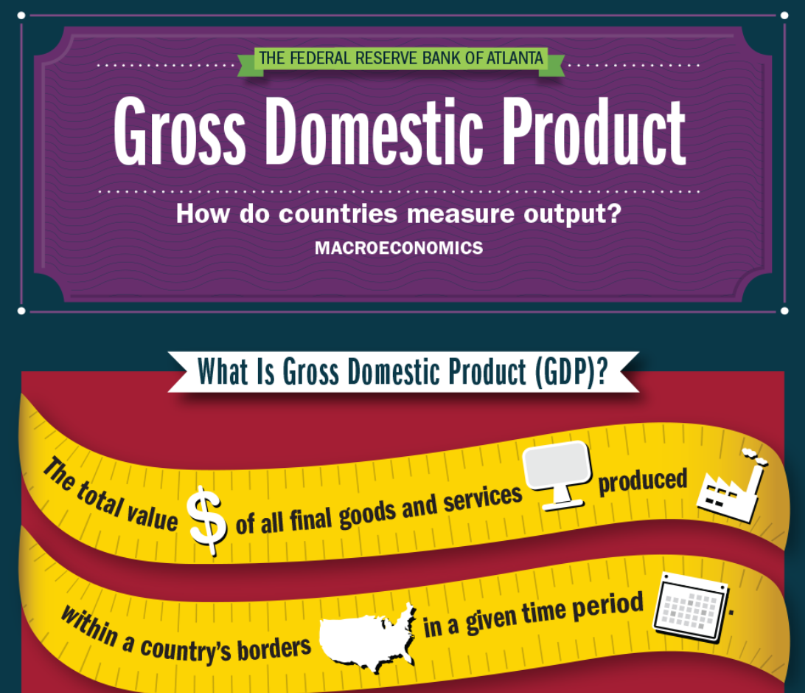
Federal Reserve Bank of Atlanta
Infographics: GDP
Topics:
Definition
Expenditure Model:
C+I+G+NX
What’s Included and Excluded
Formulas:
Nominal GDP
Real GDP
GDP Deflator
Per capita GDP
https://www.frbatlanta.org/education/classroom-tools/infographics.aspx

Slide 30
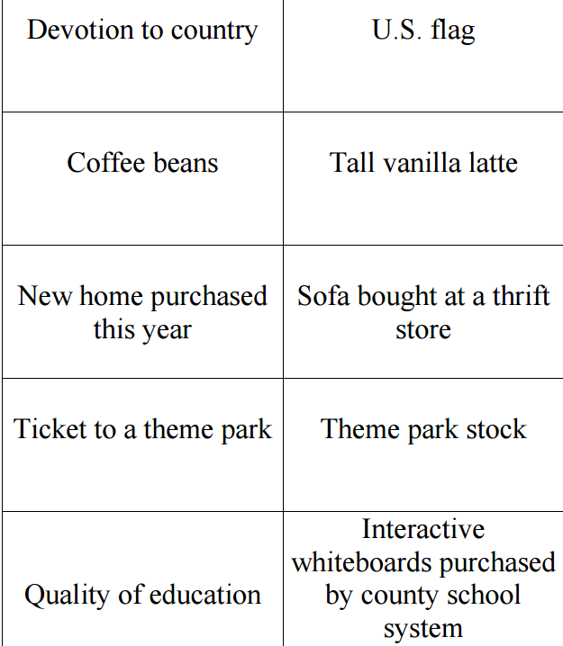
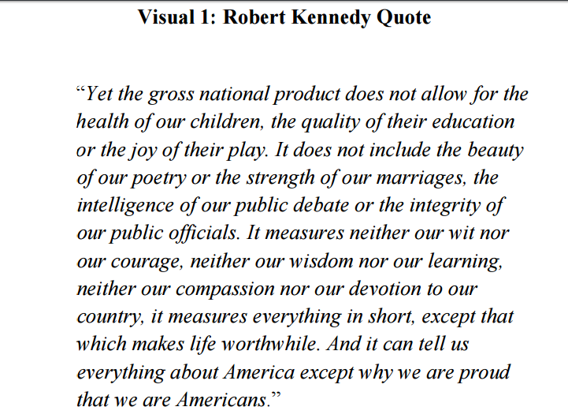
Infographic Activity
https://www.frbatlanta.org/education/publications/extra-credit/2016/fall/lessons-and-activities/middle-school/macroeconomics/gdp-infographic-activity.aspx

Slide 31
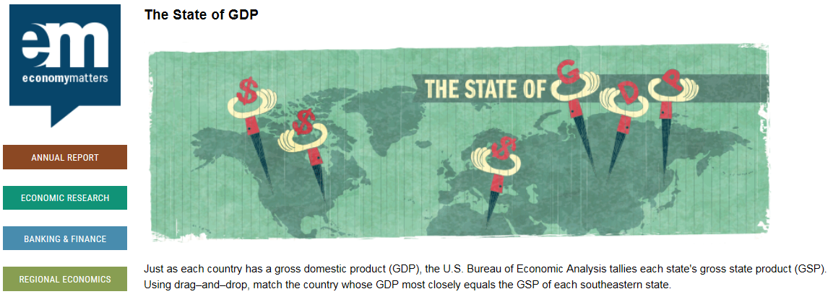
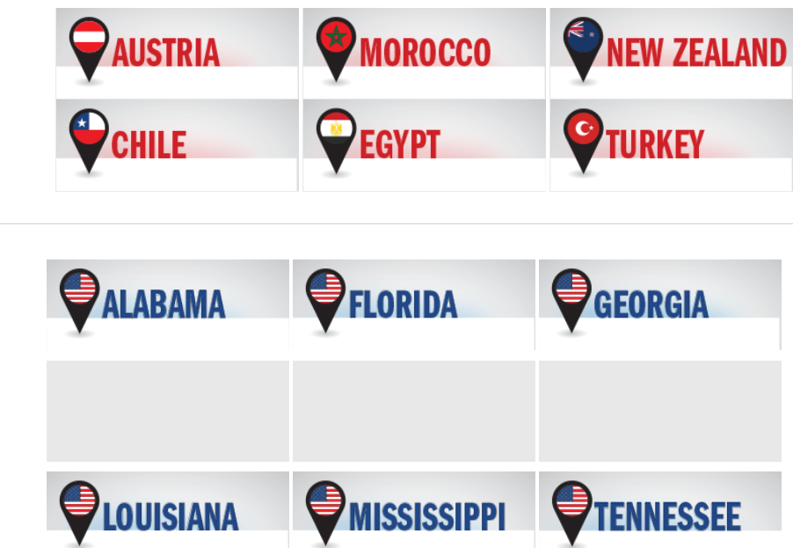
Economy Matters Quiz
https://www.frbatlanta.org/economy-matters/quiz/2015/0917-states-gdp-and-country-counterparts

Slide 32
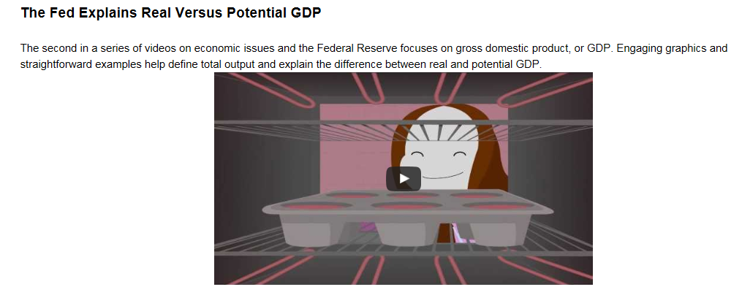
The Fed Explained
https://www.frbatlanta.org/about/fed-explained

Slide 33
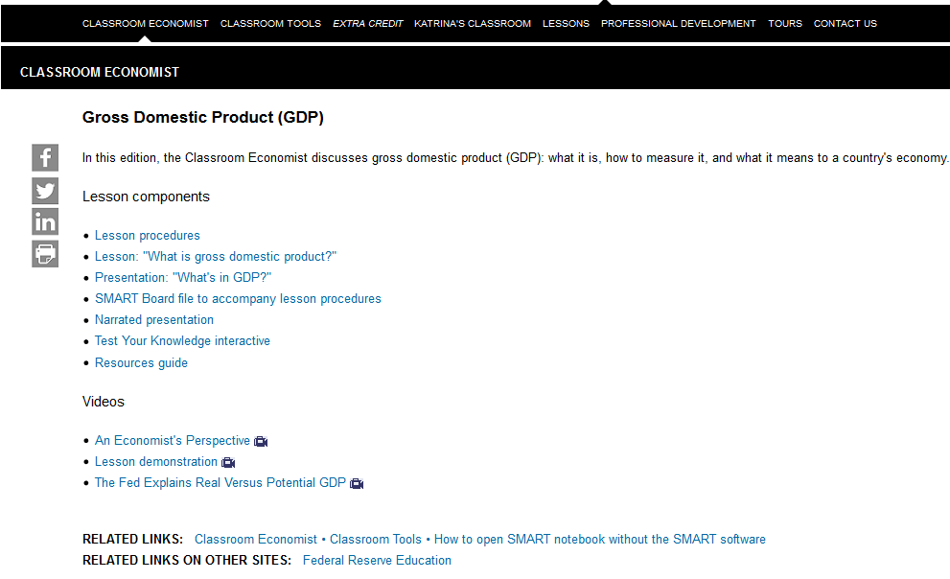
Classroom Economist
https://www.frbatlanta.org/education/classroom-economist/gdp.aspx

Slide 34
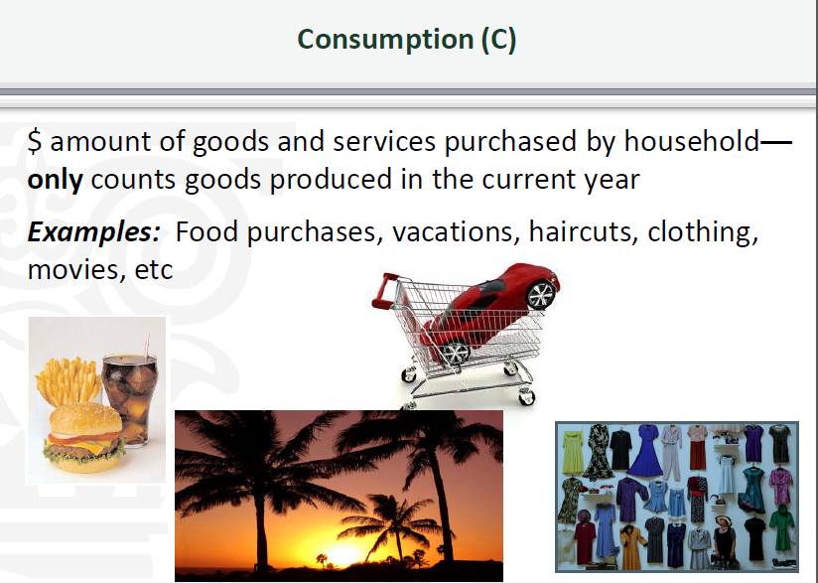
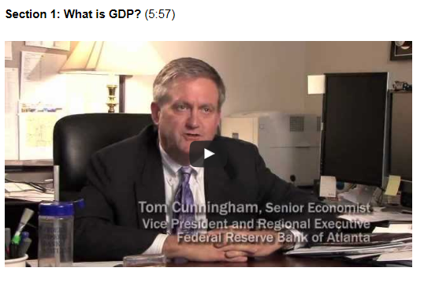
Classroom Economist
PowerPoint and Lesson
An Economist’s Perspective
https://www.frbatlanta.org/education/classroom-economist/gdp.aspx
Econ Lowdown Online Learning: https://www.stlouisfed.org/education/econ-lowdown-online-learning

Slide 35
Questions?
How We’ll Take Questions:
Click the Ask Question button in the lower-left section of the webinar window

Slide 36
Maximum Employment Matters
Exploring Opportunity Occupations and Careers in Healthcare
Save the Date
April 10, 2017
Notes:
Welcome
Thank you for
What is in the folder
Recognize a few folks that have helped make today possible.
Lesley McClure – Regional Executive and
Amy Hennessy – Director of our program

Slide 37

Thank You For Participating
Survey
Resources
Notification of Online Archive
Find information about other upcoming programs and classroom resources at:
https://www.frbatlanta.org/education

