Slide 1
Jekyll Island and the Creation of the Federal Reserve

Slide 2
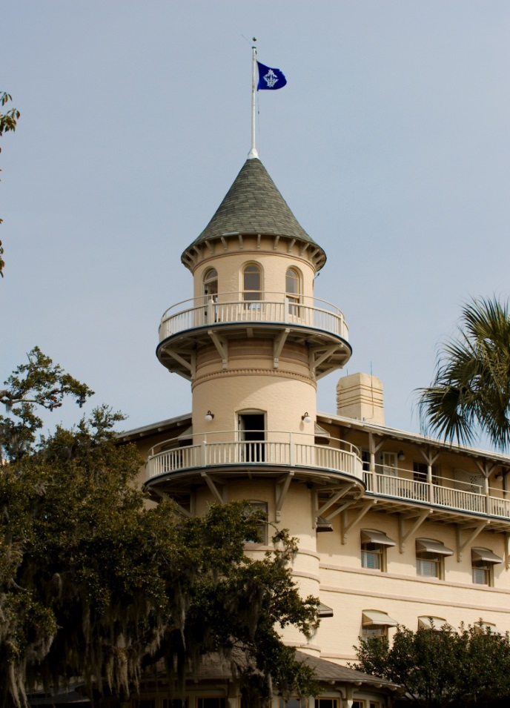
Topics Covered
The history of Jekyll Island
Banking panics and the Panic of 1907
The Aldrich-Vreeland Act and the National Monetary Commission
The historic meeting on Jekyll Island
The Aldrich Plan
The Federal Reserve Act

Slide 3
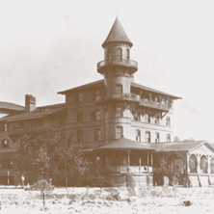
History of Jekyll Island
First explored by Europeans in the 16th century
Transferred to English control in the 18th century
Purchased in 1790 by the DuBignons, who then sold it to the Jekyll Island Club in 1886
Served as an exclusive, members-only winter retreat for prominent families (as the Jekyll Island Club)

Slide 4
Banking Panics
A series of banking panics plagued the nation in the late 18th century, culminating in the Panic of 1907.
The downfall of one prominent New York City investor led to a series of bank runs and failures that spread to the stock market and created a severe liquidity crisis.
No central bank existed to serve as a lender of last resort when banks ran out of money.

Slide 5
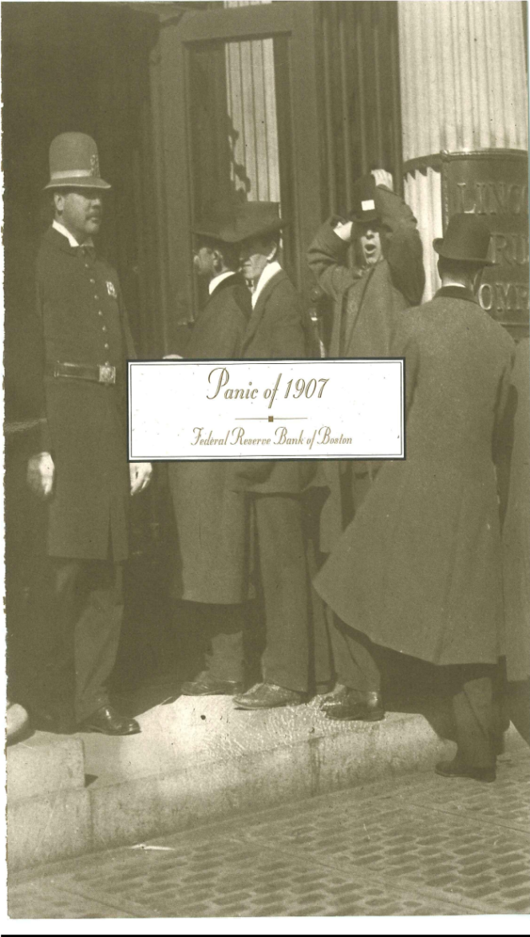
Ending the Panic of 1907
The US Treasury intervened.
John D. Rockefeller committed his own funds.
J.P. Morgan persuaded solvent New York City financial institutions, including his own, to extend emergency funds to less-than-solvent New York City banks.
The Panic of 1907 led to calls for currency and banking reform and resulted in the passage of the Aldrich-Vreeland Act in 1908.

Slide 6
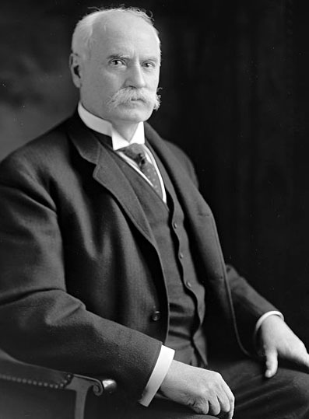
The Aldrich-Vreeland Act
The Act established the National Monetary Commission.
This 18-member commission was charged with drafting a plan to reform the nation’s monetary system.
It was chaired by Rhode Island Senator Nelson Aldrich, who traveled across Europe to study models of central banking.

Slide 7
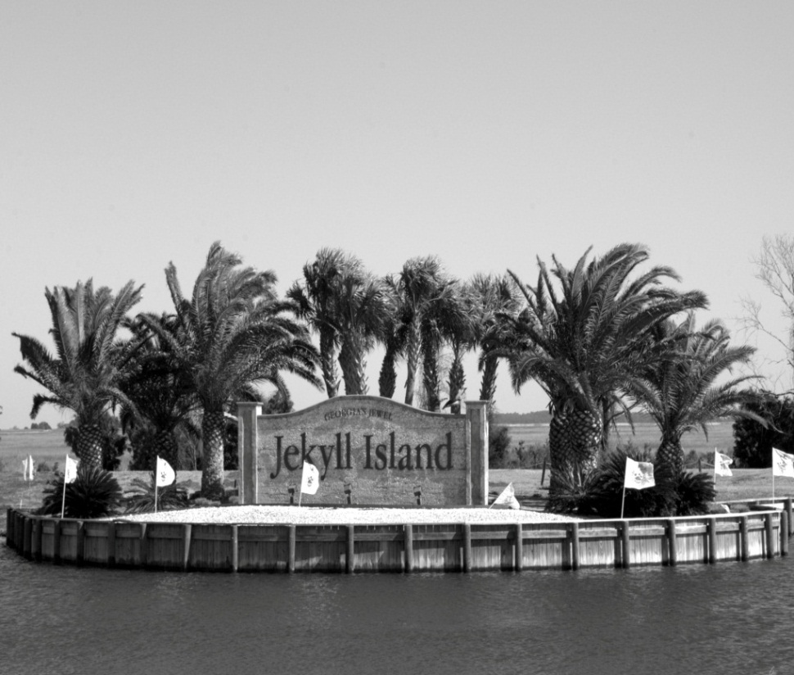
Gridlock
After two years, the commission still had not drafted a proposal to reform the banking system.
Senator Aldrich called a private meeting on Jekyll Island to break the gridlock and come up with a plan.

Slide 8
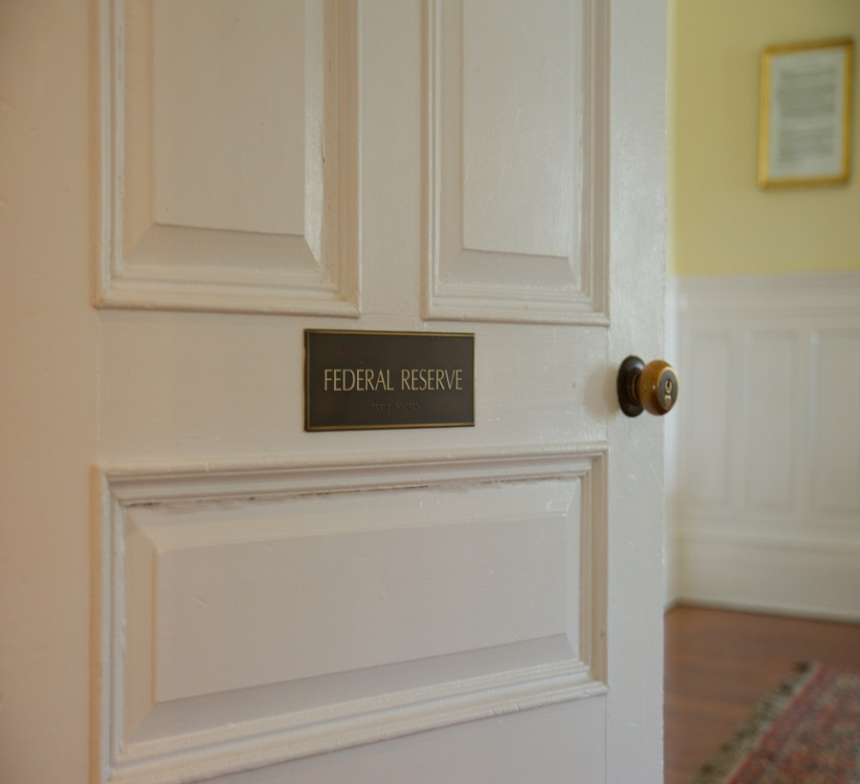
Attendees
Paul Warburg
Henry Davison
Frank Vanderlip
Benjamin Strong
A. Piatt Andrew

Slide 9
Details of the Aldrich Plan
Regional Banks, known as reserve associations
Directed by a national board of commercial banks
The Reserve Associations’ functions would include:
  Emergency loans to member banks
  The creation of an elastic currency
  Serving as the fiscal agent for the federal government
  The bill did not pass when sent to Congress

Slide 10
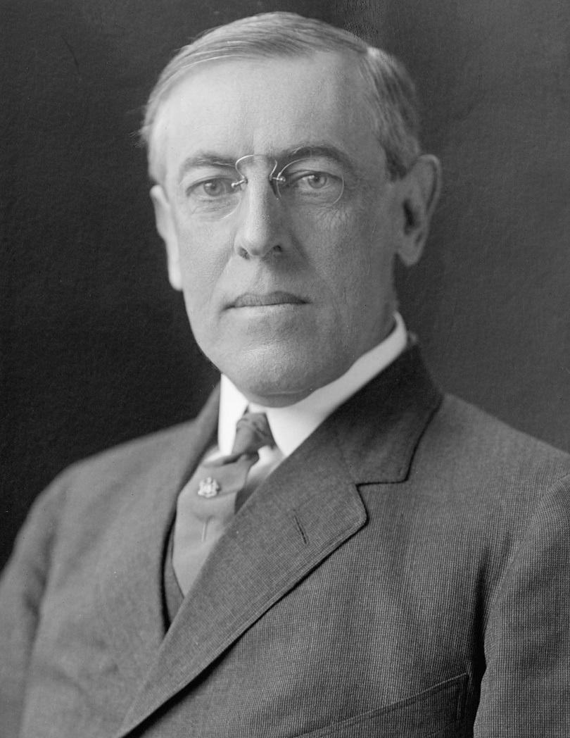
The Federal Reserve Act of 1913
Although the Aldrich Plan failed to pass, it was used as a blueprint for the Glass-Owen bill.
This bill, which would become known as the Federal Reserve Act, was signed into law by President Woodrow Wilson in 1913.

Slide 11
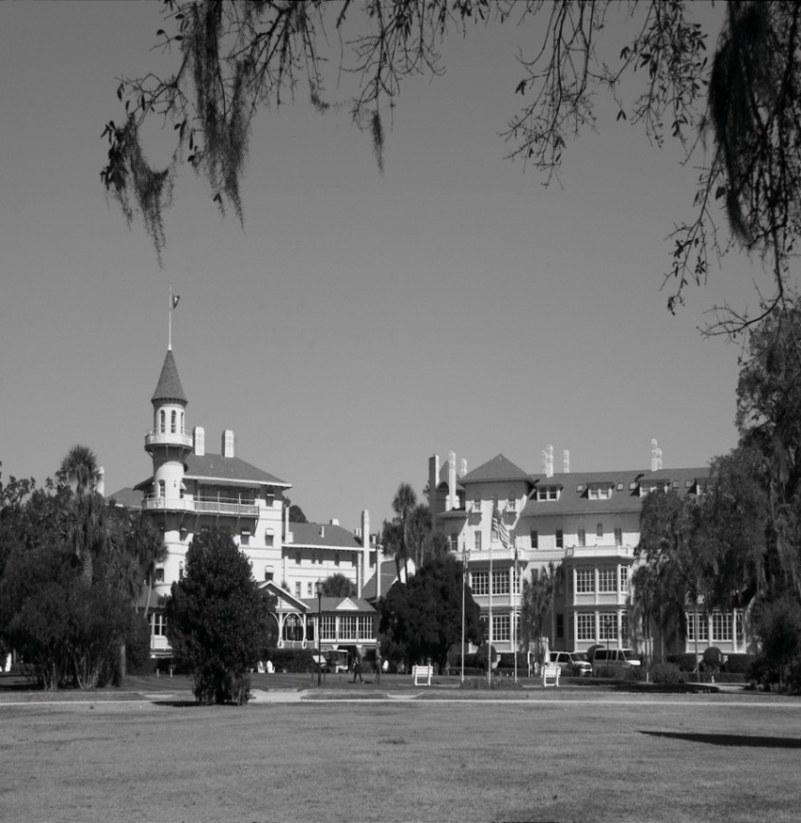
End of the Jekyll Island Club
The Club’s last “season” was in 1942.
The state of Georgia purchased the island five years later.
In 1972, Jekyll Island was named to the National Register of Historic Places.
In 1979, the grounds were designated a National Landmark and the island became the Jekyll Island Historic Landmark District.
Restoration began and the club-house reopened as a resort in 1985.

Slide 12
Jekyll’s Legacy
More executive retreat than secret meeting
A blueprint for today’s central banking system
Photos on slides 2, 7, 8, and 11 courtesy of Corporal Rene Perez, K-9 handler with the Law Enforcement Unit of the Jacksonville Branch of the Atlanta Fed.

