Slide 1
From Raw Materials to Riches
Mercantilism and British North America

Slide 2
OBJECTIVES
Define key terms such as mercantilism, market, raw materials, finished goods, exports, imports, trade barriers, balance of trade, Navigation Acts, tariffs, and imperialism.
Simulate trade in a free market economy.
Simulate the mercantilist system that existed between Britain and the North American colonies.
Compare and contrast the trade in a free market with trade under the mercantilist system.
Explain how the mercantilist system worked and why some European powers pursued these policies.
Read and interpret a variety of primary sources on the topic of mercantilism.
Evaluate the strengths and weaknesses of mercantilism as an economic system.
Describe how markets are affected by changes in government trade policies.

Slide 3

MONEY

Slide 4
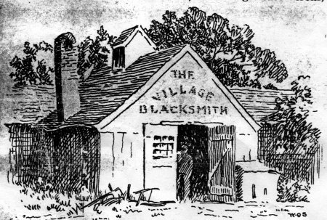
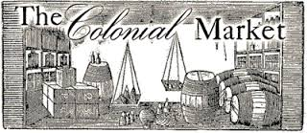

MARKETS
CAPITAL

Slide 5
GAME ROLES ROUND 1
Households have RESOURCES—they want GOODS.
  Trade resources for money and buy goods!
Businesses have MONEY—they want MORE MONEY than they had at the start.
  Buy resources, make goods, sell goods for a profit!

Slide 6
DEBRIEF
Which businesses were successful? Why?
Which households were successful? Why?
What caused some households and businesses to be less successful than others?
How well did everyone follow the rules? Did anyone have to go to jail?
Why did the markets work even though there were few rules to follow?

Slide 7
T-CHART FOR MERCANTILISM
Dividing the world’s resources IS like dividing a cookie because: | Dividing the world’s resources IS NOT like dividing a cookie because:

Slide 8
MAP OF EUROPEAN COLONIES CIRCA 1700
This map is under copyright. Please access it from the following URL:
http://courses.wccnet.edu/~jrush/map%20early%20colonization.jpg

Slide 9
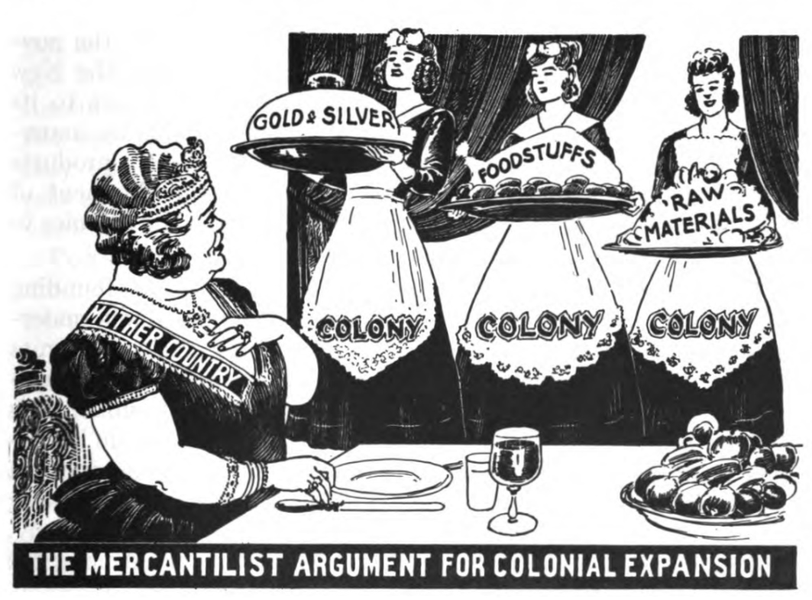
MERCANTILISM POLITICAL CARTOON
Public domain as per:
#297 - Our early heritage, a visualized text in ancient and medieval ... - Full View | HathiTrust Digital Library

Slide 10
TRADE RESTRICTIONS
Act/Regulation | Date | Significance/Features
Navigation Act | 1651 | Favored British ships and sailors Limited Dutch trade
Navigation Act | 1660 | Required all colonial trade to be on English ships Master and three-quarters of crew must be English "enumerated goods"
Staple Act | 1663 | Land in England first
Plantation Duty Act | 1673 | English customs house in colonies
Navigation Act | 1696 | Courts to enforce trade regulations and punish smugglers Right to board ships

Slide 11
GAME ROLES ROUND 2
Households have RESOURCES—they want GOODS.
  Trade resources for money and buy goods!
Businesses have MONEY—they want MORE MONEY than they had at the start.
  Buy resources, make goods, sell goods for a profit!
  All businesses, except the British, must pay a tax to get a manufactured good.

Slide 12
DEBRIEF
Which businesses were successful? Why?
Which businesses were hurt the most? Why?
Which households were successful? Why?
Which households were hurt the most? Why?
How do you think these experiences affected how people felt about Great Britain?

Slide 13
ASSESSMENT
You will read informational text about British North America and the mercantilist system.
You will use your simulation experience as well as the informational text to decide whether a person from the time period in the role you played in the simulation would have supported or opposed mercantilism.
You must support your position using evidence from the reading and the simulation experience.

