Slide 1
Are You up to the Test?
A look at employment tests, following directions, and teamwork

Slide 2
Having a career is an important part of earning income and becoming independent.
What is the difference between a job and a career?

Slide 3
By going to school, you are developing human capital.
Human capital is the skills, knowledge, and training people possess, measured by their economic value.
Learning new skills can increase a person’s human capital and productivity.
What is a skill you have learned that has made you more productive?

Slide 4
Career paths are groups of jobs within a career cluster.
What are factors that might lead to someone’s career path choice?

Slide 5
What human capital did I have to develop to be qualified as a teacher?
Does a teacher need to have high productivity?
Why would an employer want to hire people who continuously develop their human capital and have high productivity?

Slide 6
What do the experts say?
What are some of the characteristics of successful hires?
Work well in teams
Mutual respect for coworkers
Follow directions
Learn new processes (therefore, continuously developing human capital)

Slide 7
What are staffing agencies, and why would a company use one?
What does skills mismatch mean?
What are some of the careers mentioned in the webinar other than “skilled labor” jobs?

Slide 8
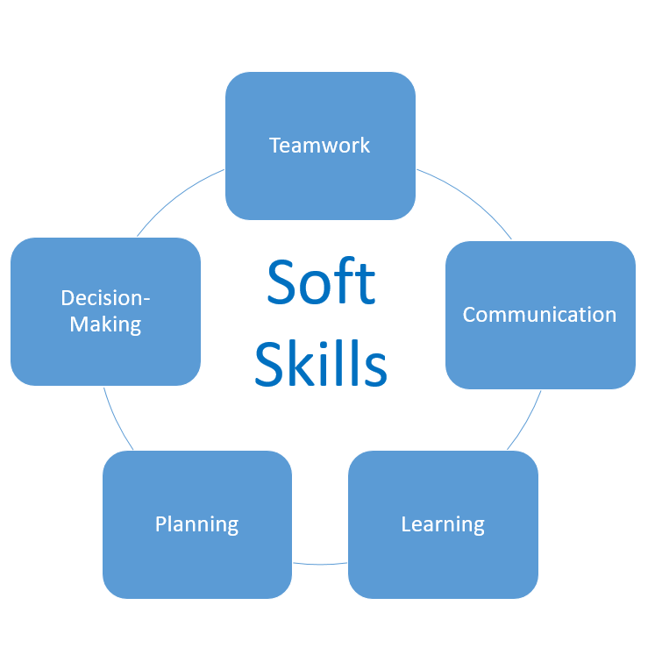
What are soft skills?
What does the speaker mean by process or employment testing?
Why do you think an employer would test a candidate before making a job offer?

Slide 9
Assessment
Students are all candidates for a job. They have been called into the staffing agency to take an employment test.

Slide 10
You will have 10 minutes to create a chain using the following instructions.
You should have two sheets of a primary color and two sheets of an accent-colored paper.
Fold the paper in half so the top and bottom of the page meet.
Using a ruler, measure and mark two-inch columns across the paper.
Cut the paper into two-inch strips for a total of four strips. Then cut the strips in the center where they were folded for a total of eight strips per piece of paper.
To assemble the chain, take a strip of paper and join the ends with tape, creating a circle. Take the next strip and insert it through the middle of the circle and join the ends with tape. Continue this process using the following sequence.
1. Six strips of primary
2. Four strips of accent
3. Two strips of primary
4. Six strips of accent
5. Four strips of primary
6. Two strips of accent

Slide 11
You will now work in teams of four to complete your chains.
Teamwork is a crucial part of a business. It is often necessary for colleagues to work well together to be successful.
You will have another 10 minutes to work as a team to create the longest chain. You may use your work from the last round, but you must keep the original sequence.
1. Six strips of primary
2. Four strips of accent
3. Two strips of primary
4. Six strips of accent
5. Four strips of primary
6. Two strips of accent

Slide 12
What are some of the differences between working by yourself and working with your team?
Did any of the teams divide up the tasks?
Division of labor is the assignment of different parts of a process to different people who may specialize.
Through specialization, workers become more efficient and productive.

Slide 13
What are some of the soft skills you used?
Was communication important when working with your team?
What are some of the things you and your team talked about?
Did you see an increase in productivity?
Common Soft Skills
Strong work ethic
Positive attitude
Working well under pressure
Flexibility/adaptability
Ability to accept and learn from criticism
Self-confidence
Good communication skills
Time management abilities
Problem-solving skills
Team player

Slide 14
Closure
Each group should write down:
Three things you learned about developing human capital and/or productivity
Two things you have questions about when it comes to determining a career path
One thing students feel was most valuable from this lesson.

