Slide 1
How Many Workers Should I Hire?
The profit-maximizing quantity of labor in a perfectly competitive labor market.
Instructor’s note:
These slides contain multiple steps of animation. While in slide show mode, you will need to click multiple times to view all aspects of each slide. Please familiarize yourself with the slides before using in your class.

Slide 2

What Are We Producing?
CORN!
(Lots and lots of corn! Consumers like corn!)

Slide 3



How Are We Producing CORN?
Field 1
Field 2
FIXED
FIXED
Seed Drill 1
Seed Drill 2
CORN
CORN
CORN
CORN
CORN
CORN
CORN
CORN
FIXED
FIXED
Team 1 Farmworkers
Team 2 Farmworkers
Variable
Variable
LOAN
LOAN
Work Period = 30 seconds

Slide 4
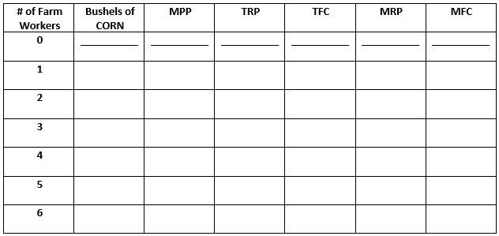



EQ: How many farmworkers should we hire to maximize profits?
What Do We Want to Know?
Wage = $5 per farmworker
Price = $8 per bushel of corn
The number of workers up to the point where MRP=MFC!
The additional amount of CORN produced by each additional farmworker.
Marginal Factor Cost = Wage per Worker X number of additional farmworkers hired each round.
Total Revenue Product = Price per Bushel X Number of Bushels of CORN.
The number of times CORN is written in 30 seconds.
Total Factor Cost = Wage per Worker X Number of farmworkers.
Marginal Revenue Product = Price per Bushel X MPP.

Slide 5
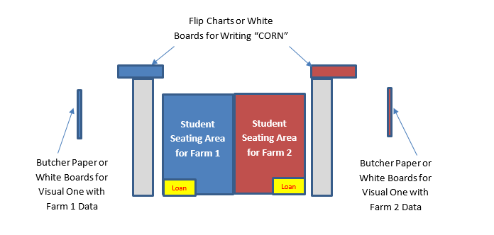
What Do We Need?
Ready?
Let’s go!
Team One
Worker
Recorder
Mathematician
Team Two
Worker
Recorder
Mathematician

Slide 6
Time for Math! Sample Calculation…
Wage = $5 per farmworker
Price = $8 per bushel of corn
10
10
$80
$5
$80
$5
Time for round 2!
Each team picks an additional farmworker.

Slide 7
Time for Math! Sample Calculation…
Wage = $5 per farmworker
Price = $8 per bushel of corn
10
10
$80
$5
$80
$5
14
4
$112
$10
$32
$5
Time for round 3!
Each team picks an additional farmworker.

Slide 8
Time for Math! Sample Calculation…
Wage = $5 per farmworker
Price = $8 per bushel of corn
10
10
$80
$5
$80
$5
14
4
$112
$10
$32
$5
15
1
$120
$15
$8
$5
Time for round 4!
Each team picks an additional farmworker.

Slide 9
Time for Math! Sample Calculation…
Wage = $5 per farmworker
Price = $8 per bushel of corn
$5
$80
$5
$80
$5
10
10
$80
$5
$80
10
10
14
4
$112
$32
14
4
$112
$32
$5
$10
$5
$10
15
1
$120
$15
$8
>
$5
0
$120
$20
<
15
$0
$5
Do we need to run round 5?

Slide 10


Determining Returns to Scale
Round 2
Field 1
Round 1
Field 2
Seed Drill 1
Seed Drill 2
CORN
CORN
CORN
CORN
CORN
CORN
CORN
CORN
Team 1 Farmworkers
Team 2 Farmworkers
LOAN
LOAN
Labor and capital increased by 100% in round 2. Did output increase by 100%, more than 100%, or less than 100%?
Work Period = 30 seconds

Slide 11
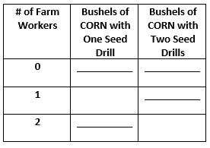
Returns to Scale
Essential Question Two: Are the returns to scale for a firm increasing, decreasing, or constant when doubling the quantity of labor and capital used in production?
Wage = $5 per farmworker
Rent per seed drill = $10
15
34
It is increasing; output more than doubles when labor and capital are doubled and average total cost falls from $1.00 per bushel to $0.88.
ATC = (Wage X # of workers) + (Rent X # of drills)
# of units of output

