Slide 1
Federal Reserve Bank of Atlanta
Center for Human Capital Studies
Employment and Education Conference
September 29-30, 2011
Community Colleges during Periods of Economic Crisis:
Miami Dade College a Case in Point
Presented by Rolando Montoya, MDC Provost

Slide 2
The Economic Contribution of Miami Dade College
Enrollment in Academic Year 2008-09
Credit students 88,387
Non-credit students 79,206
Total 167,593

Slide 3
Investment Analysis: Student Perspective
Average income at career midpoint with associate degree: $44,300
35% higher than individuals with a high school diploma
Discounted lifetime income increases by $5.80 for every $1 invested in MDC
Average annual ROI to students: 19% (including all costs and forgone wages)
Payback period: 7.8 years

Slide 4
Investment Analysis: Social Perspective

Slide 5
Investment Analysis: Taxpayer Perspective
State and local government investment in FY 2008-09: $239 million
Cumulative return to taxpayers over the course of students’ working careers: $4.00 per $1 invested
Average annual ROI to state and local governments: 13.4%

Slide 6
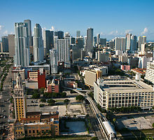
Economic Growth Analysis: Annual Added Income
College operations effect $256,942,000
Non-local students spending 22,898,000
Total spending effect $279,840,000
Alumni productivity effect $3,673,483,000
Total effect $3,953,323,000

Slide 7
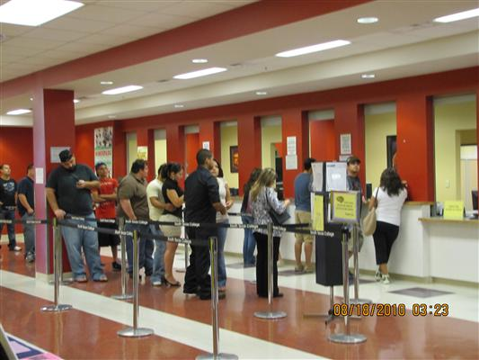
Inverse Relationship Between Employment and Enrollment
Unemployed and dependents eligible for federal financial aid
Increased headcount
Increased credit load
Increase in high-school direct entry
Preference for the local community college option
Enrollment as an economic indicator

Slide 8
Enrollment at Community Colleges as Economic Stimulus
Service to low income population
Open access
Economic effect of federal financial aid on local economy
Employment of adjunct faculty
Employment of part-time staff
Reduction of structural unemployment due to workforce development programs

Slide 9
Workforce Development Programs
Applied baccalaureate degrees
Advanced training diplomas
Associate in arts
Associate in science
College credit certificates
Vocational certificates
Non-credit workforce development programs

Slide 10
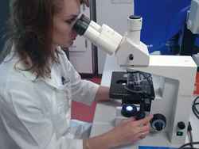
Baccalaureate Degrees Responsive to Industry Needs
Biological Sciences Early Childhood Education
Electrical Engineering Technology Exceptional Student Education
Film and Video Production Mathematics Secondary Education
Nursing Physician Assistant
Public Safety Management Science Secondary Education

Slide 11
Non-Credit Workforce Development Programs
Traditional (Accounting, Management, Computer Applications)
Career Success Boot Camp
Casino Gaming (dealers, tellers, security & surveillance, pit boss/management, slot machine technicians)
Certified Nursing Assistant
Customer Service for Taxi Drivers and Airport Personnel
Home Health Aide
Insurance Claim Adjuster
Logistics, Distribution, Warehousing Management, Custom Brokerage
Photovoltaic Technology
Social Media
Weatherization

Slide 12
Partnerships with External Institutions
Florida Power & Light: Nuclear Energy Program
South Florida Workforce Board and University of Miami Hospital: Nursing
South Florida Workforce Board and University of Miami: Lab Technicians
Baptist Hospital: Nursing
Center for Financial Training: Banking
Overtown Community Redevelopment Agency: Hospitality Institute
Telemundo: Soap Opera Script Writers
City of Miami: Computer Literacy Program

Slide 13
