Slide 1
EMV Impacts On Fraud 15th October 2012 Atlanta Federal Reserve

Slide 2
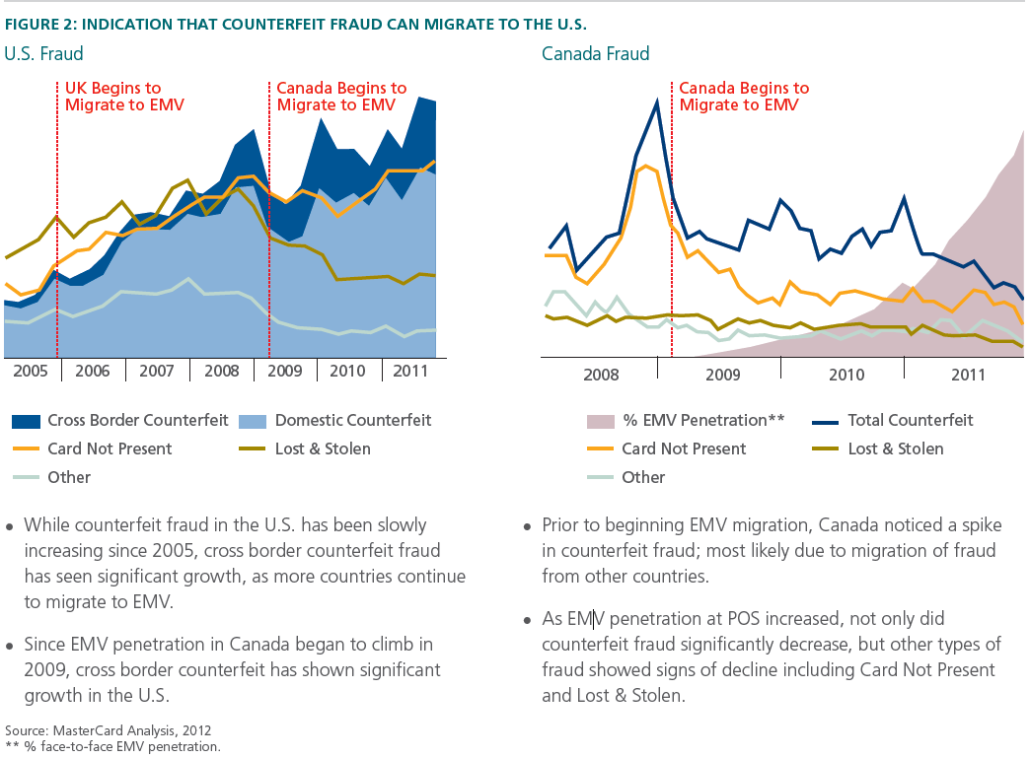
Counterfeit Card Fraud Migrating to the United States

Slide 3
European Union ATM Fraud Migrating to United States
European
ATM Security Team Study
ATM Related Fraud Down 7%
2009
13,269 Incidents
2010
12,383 Incidents

Slide 4
United Kingdom Counterfeit Fraud Reduced 21% (2000 – 2010)

Slide 5
Canada Counterfeit Fraud Down Since National Rollout

Slide 6
Brazil Counterfeit Visa Fraud Reduced 17% (2007 – 2010)

