Slide 1
What is EMV?
A joint effort between Europay, MasterCard and Visa
It is a security framework that defines the payment interaction at the physical, electrical, data and application levels between the chip cards and the payment device. These interactions are often referred to as EMV Type Level 1 and 2 requirements.
EMV is also known as “Chip and PIN” in the U.K.. Domestically EMV maybe implemented as Chip and PIN, Chip and Signature or other variations.

Slide 2
EMV Fundamentals
What is EMV?
Global Standard for the implementation of chip cards for the purpose of facilitating an electronic payments transaction
Born out of transit payment programs based in Europe
An effective technology to protect against duplicate card fraud
How does EMV Protect against Duplicate Card Fraud?
If an EMV Card is presented at an EMV Terminal, the terminal forces it to be inserted.
Once card is inserted, PAN and Dynamic CVV are presented to be used in authorization request.
This Dynamic CVV (changes for each transaction) is validated against what is expected at the host.
Result -> PAN is static yet data changes on each transaction!
EMV is not…
Chip and PIN – PIN as a cardholder validation method is only one implementation option of EMV
A Silver Bullet for PCI Compliance – PAN data is still presented in the clear and valuable for card not present transactions
Cure All for Chargebacks – The programs put in place will help with duplicate card fraud chargebacks, but will not impact others

Slide 3
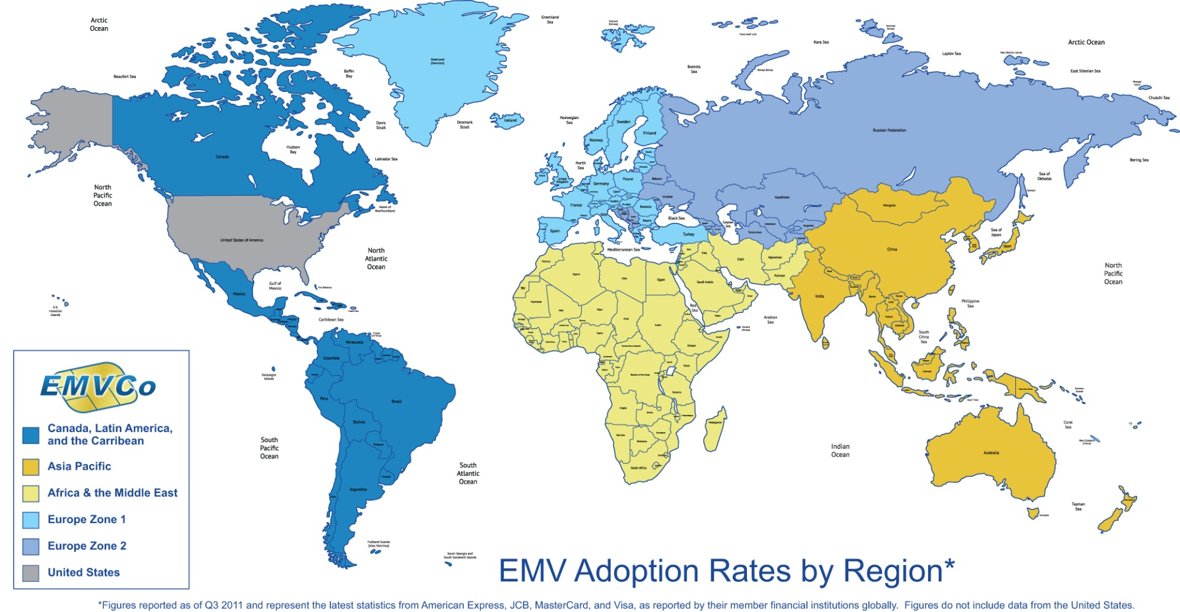
EMV worldwide
The U.S. is the laggard in the global adoption of EMV payment technology
13.3% of cards 71.1% of terminals
80.6% of cards 93.8% of terminals
38% of cards 80% of terminals
25.6% of cards 49.5% of terminals
20.2% of cards 66.4% of terminals

Slide 4
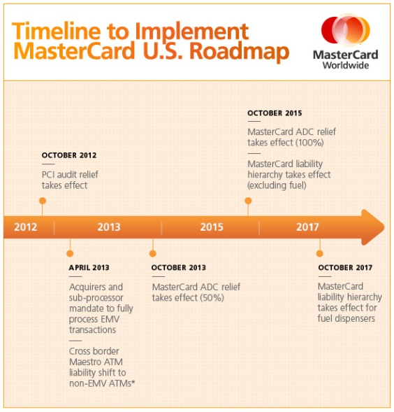
Consolidated EMV Timeline
All Brands (Visa, MC, Amex, & Disc) mandated processor compliance in April 2013
Liability shift (while defined uniquely) is Oct. 2015.
Liability shift for Automated Fuel Dispensers is 10/17
Incentives
Visa allows for merchants to skip submission of ROC if 75% of transactions are initiated from a dual interface terminal
MC allows for ACD relief of either 50% or 100% if 75% or 95% of transactions are initiated through dual interface terminals.
AMEX allows for merchants to skip submission of ROC if 75% of transactions are initiated from a dual interface terminal

