Slide 1
The Threatscape is evolving rapidly
Prove capabilities?
Exact revenge?
Erode our confidence?
Perpetrate fraud in the background via the contact center?
All of the above?

Slide 2
“Industrialization of Hacking”
Innovation drives efficiency and productivity
→ Hacking, once a hobby, is now highly mechanized and process driven
Transportation opens new markets and shrinks the world
→ Hackers now access potentially anything…from anywhere
Communication connects far-flung parties
→ Personal information is shared through web applications and social media
2

Slide 3
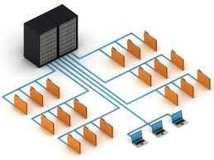
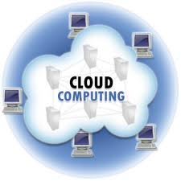
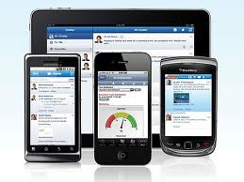
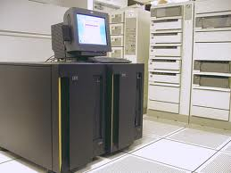
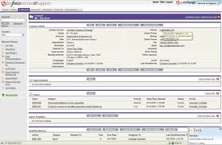
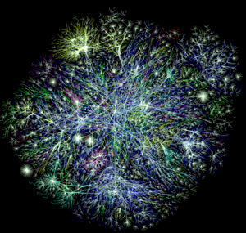
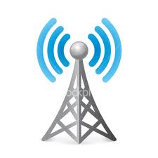
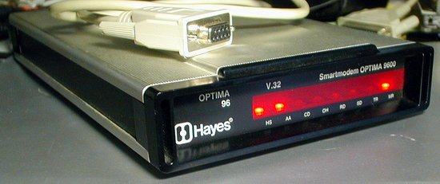
The vulnerable surface area continues to increase
Network Boundaries
Application Access Ubiquity
Connectivity
WiFi
4G LTE
NFC
Blue Tooth

Slide 4
Speaking of connectivity…
Approaching 10 billion Internet-connected devices (IMS Research)
Forecasting 28 billion Internet-connected devices by end of 2020
Mobile Internet devices outnumber humans this year (Cisco)
Transition from IPv4 (4.3 billion unique addresses) to IPv6 (340 trillion trillion trillion unique addresses)
Hacking moves beyond traditional computers
Printers
Video conferencing systems
Mobile devices

Slide 5
The hacking community has changed complexion
Hobbyists/Techies
Small-Time Criminals
Gangs/Organized Crime
Training courtesy of YouTube!
Hacktivists
State-Sponsored Entities
5

Slide 6
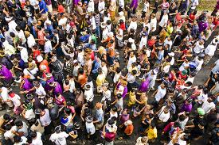
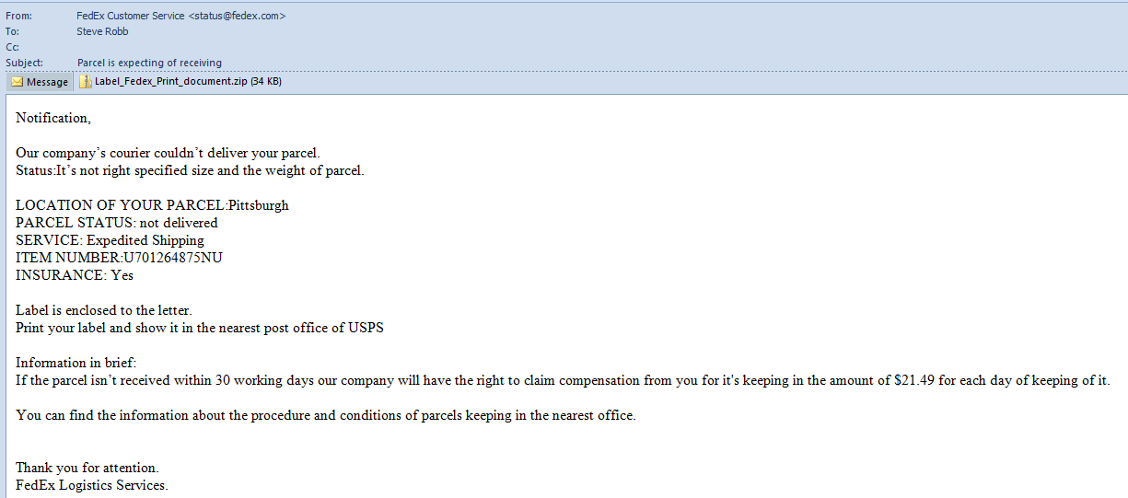
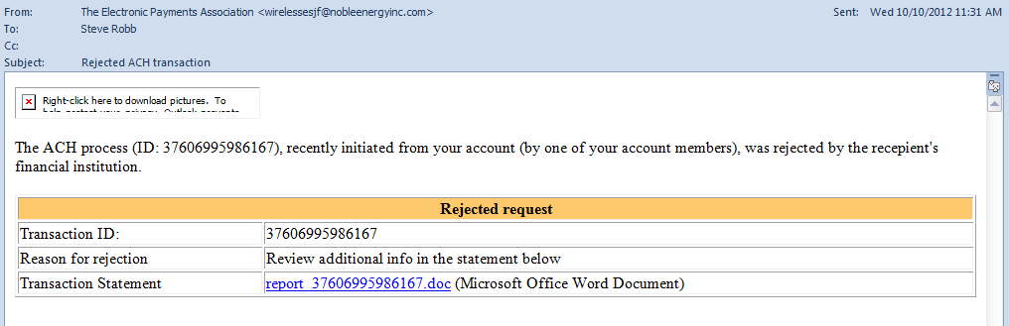
What’s the most serious threat?
6

Slide 7
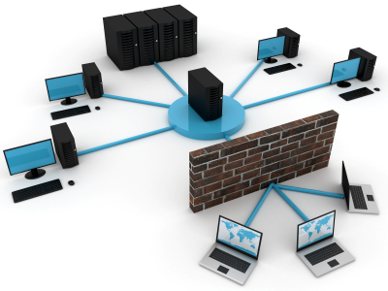
Infiltration
APTs
Malware
Insider Threats
(Spear) Phishing
Drive-By Downloads
Watering Holes
SQL Injection
Cross-Site Scripting
Remote Code Execution
7

Slide 8
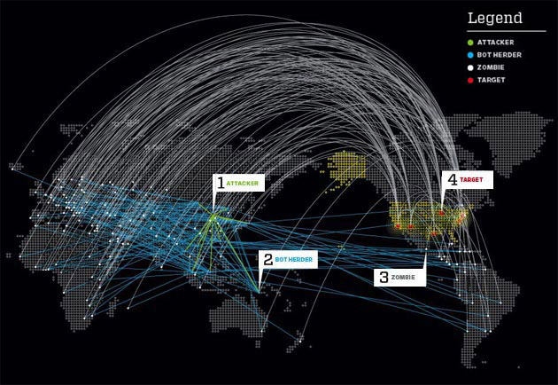
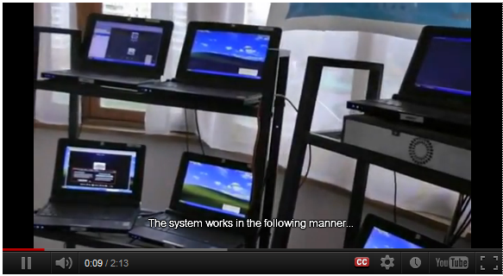
Diversion and disruption
BotNets
Media Floods
Email
Phone
SMS
8

Slide 9
What do we do?
Basic blocking and tackling
Default credentials
Default settings (e.g., on databases)
Basic web app vulnerabilities
Vulnerability patching
Security awareness training
Let’s dig a bit deeper in the panel discussion…
9

