Slide 1
The Blessing and the Curse
Technology in Retail Payment Innovations
Retail Payments Risk Forum
October 16, 2012
Murray Walton
Chief Risk Officer
Fiserv, Inc.
Notes:
To print, use this title slide instead of the previous orange one to save toner.

Slide 2
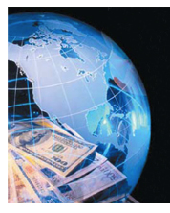
Retail Payments Innovations – The Revolution
Retail Payments Then
Bank-dominated
Paper-based
Batch-processed
Retail Payments Now
Diverse providers
More channels, devices
Network-based
Real-time
Notes:
Bullet slide exampleTechnology has leveled the playing field among financial institutions
Retention: Multi-product relationships are more sticky. to be Reduces attrition of snowbirds, business travelers, students and others who may be frequently out-of-market
Economics: Manages pressure on staffing, hours, and branch footprint, potentially less expensive than brick-and-mortar
Resilience: Provides a viable short-term workaround to outages in other key systems, supporting effective DR

Slide 3
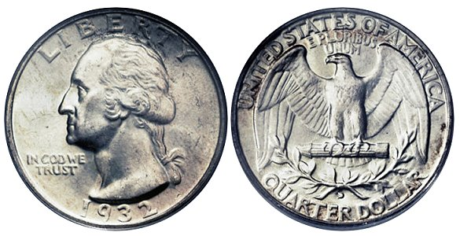
Retail Payments Innovation Drivers
Three Big Drivers, One Big Outcome
Competitiveness
…and self-defense
Economics
…and bragging rights
Resilience
…and complexity
The price of progress is risk, more and different than before
Notes:
Bullet slide exampleTechnology has leveled the playing field among financial institutions
Retention: Multi-product relationships are more sticky. to be Reduces attrition of snowbirds, business travelers, students and others who may be frequently out-of-market
Economics: Manages pressure on staffing, hours, and branch footprint, potentially less expensive than brick-and-mortar
Resilience: Provides a viable short-term workaround to outages in other key systems, supporting effective DR

Slide 4
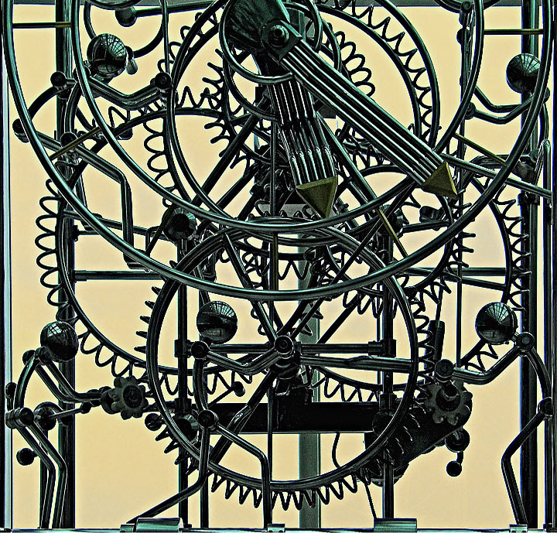
Impacts of Payments Innovation
Delivery Complexity: More parties involved, and greater dependence on those we don’t control – but whose performance determines reliability and security
Democratization: Then vs. now, there is pervasive access to a truly global payments system – including by those whose motives or capacity may not make them responsible participants in the ecosystem
Notes:
Delivery Complexity: More parties involved, greater dependence on those we don’t control (or even know)
New Expectations: Value prop of greater speed and convenience also accelerates velocity of fraud and loss
Law and Regulation: Not evolving as fast as payment technology and innovation

Slide 5
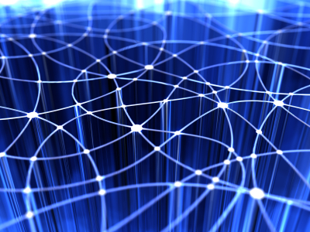
Impacts of Payments Innovation
De-Personalization: Then vs. now, service is delivered machine to machine, not face to face, increasing the potential for deception
Higher Velocity: Then vs. now, greater convenience and speed, and less time to detect fraud by conventional human scrutiny
Law and Regulation: Not evolving as fast as technology and innovation
Notes:
Delivery Complexity: More parties involved, greater dependence on those we don’t control (or even know)
New Expectations: Value prop of greater speed and convenience also accelerates velocity of fraud and loss
Law and Regulation: Not evolving as fast as payment technology and innovation

Slide 6
Risk Impacts of Payments Innovation
Potential risks of payments innovation distill down to:
Stability. How to operate with levels of availability that meet user expectations?
Fraud. How to manage loss levels to meet owner and regulator expectations?
Redress. How to solve issues that arise?
Technology is an ally in two of the three dimensions, although it is only part of the answer – solid process and sharp people are also indispensable to effective risk management
Notes:
Bullet slide exampleTechnology has leveled the playing field among financial institutions
Retention: Multi-product relationships are more sticky. to be Reduces attrition of snowbirds, business travelers, students and others who may be frequently out-of-market
Economics: Manages pressure on staffing, hours, and branch footprint, potentially less expensive than brick-and-mortar
Resilience: Provides a viable short-term workaround to outages in other key systems, supporting effective DR

Slide 7
Technology as a Driver of Stability
Resilience contributors:
Application Integrity
Platform Architecture
Network Reliability
Security Depth
Resilience is verifiable through due diligence and vendor management, and can be validated against third party standards such as FFIEC and PCI
Notes:
Bullet slide exampleTechnology has leveled the playing field among financial institutions
Retention: Multi-product relationships are more sticky. to be Reduces attrition of snowbirds, business travelers, students and others who may be frequently out-of-market
Economics: Manages pressure on staffing, hours, and branch footprint, potentially less expensive than brick-and-mortar
Resilience: Provides a viable short-term workaround to outages in other key systems, supporting effective DR

Slide 8
Technology as a Weapon Against Fraud
Complexity, democratization, de-personalization, and velocity increase the number of fraud vectors and complicate the task of fraud detection.
Compensating technologies:
User authentication
Device authentication
Transaction validation
Notes:
Bullet slide exampleTechnology has leveled the playing field among financial institutions
Retention: Multi-product relationships are more sticky. to be Reduces attrition of snowbirds, business travelers, students and others who may be frequently out-of-market
Economics: Manages pressure on staffing, hours, and branch footprint, potentially less expensive than brick-and-mortar
Resilience: Provides a viable short-term workaround to outages in other key systems, supporting effective DR

Slide 9
Technology as a Weapon Against Fraud
User Authentication:
Strong passwords, changed regularly
Tokens, including out-of-band and biometrics
Strong challenge questions
Device Authentication:
Device profile/PC fingerprint
Health check
Certificate
Geo-location (IP address)
Proxy-Anonymizer detection
Strong challenge questions
Notes:
Bullet slide exampleTechnology has leveled the playing field among financial institutions
Retention: Multi-product relationships are more sticky. to be Reduces attrition of snowbirds, business travelers, students and others who may be frequently out-of-market
Economics: Manages pressure on staffing, hours, and branch footprint, potentially less expensive than brick-and-mortar
Resilience: Provides a viable short-term workaround to outages in other key systems, supporting effective DR

Slide 10
Technology as a Weapon Against Fraud
Transaction Validation: Two levels…
Enforcement of rules and limits – straightforward administration of rules about periodic limits on number and value of transactions
Detection and management of fraud – where the network effect accelerates identifying and resolving suspect transactions, and utilizes accumulated learning for the common benefit
Notes:
Bullet slide exampleTechnology has leveled the playing field among financial institutions
Retention: Multi-product relationships are more sticky. to be Reduces attrition of snowbirds, business travelers, students and others who may be frequently out-of-market
Economics: Manages pressure on staffing, hours, and branch footprint, potentially less expensive than brick-and-mortar
Resilience: Provides a viable short-term workaround to outages in other key systems, supporting effective DR

Slide 11
Technology as a Weapon Against Fraud
Transaction Validation: Our experience…
35% of detected frauds involve a payee already on our negative list due to prior network experience
New Payees Represent Heightened Risk: New payees represent <20% of transaction volume but >90% of fraud
New Customers Represent Heightened Risk: First 60-90 days pose the greatest fraud risk – lower limits are justified, as are strong Know-Your-Customer rules
Notes:
Bullet slide exampleTechnology has leveled the playing field among financial institutions
Retention: Multi-product relationships are more sticky. to be Reduces attrition of snowbirds, business travelers, students and others who may be frequently out-of-market
Economics: Manages pressure on staffing, hours, and branch footprint, potentially less expensive than brick-and-mortar
Resilience: Provides a viable short-term workaround to outages in other key systems, supporting effective DR

Slide 12
Technology as a Weapon Against Fraud
Transaction Validation: Our experience…
Remitter behaviors (payment timing, payee industry mix, overall payment volume) evolve very slowly – any change is a red flag
Changes to customer profile correlate closely enough to fraud to justify heightened scrutiny of transactions following any change
This is real science – over 12 months and $32.8 billion in payments, we experienced total loss of $96 thousand (0.03%)
Notes:
Bullet slide exampleTechnology has leveled the playing field among financial institutions
Retention: Multi-product relationships are more sticky. to be Reduces attrition of snowbirds, business travelers, students and others who may be frequently out-of-market
Economics: Manages pressure on staffing, hours, and branch footprint, potentially less expensive than brick-and-mortar
Resilience: Provides a viable short-term workaround to outages in other key systems, supporting effective DR

Slide 13
Technology is a Blessing and a Curse
Payments innovation must be embraced for its many benefits: Competitiveness, Economics and Resilience
Payments innovation must be managed for its potential downsides: Stability, Fraud and Legal/Regulatory Issues
The Network Effect and the Power of Big Data that empower payments innovation are also the key to managing its risks
Notes:
Bullet slide exampleTechnology has leveled the playing field among financial institutions
Retention: Multi-product relationships are more sticky. to be Reduces attrition of snowbirds, business travelers, students and others who may be frequently out-of-market
Economics: Manages pressure on staffing, hours, and branch footprint, potentially less expensive than brick-and-mortar
Resilience: Provides a viable short-term workaround to outages in other key systems, supporting effective DR

