Slide 1



International Mobile Top-Up

Slide 2
215 million migrants transfer US$ 325 billion
42.8
38
12.3
32
10.8
27
7.3
16
7.2
9
7.0
8
6.9
7
6.7
6
Sources: UN International Migration 2009

Slide 3
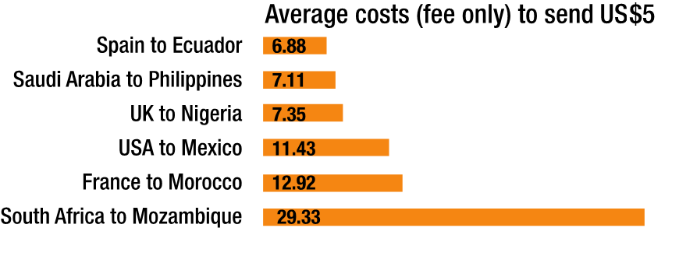
Airtime, a natural complement to cash remittances
Money transfer fees not suited for small value transfers
6.88
7.11
Sources: Top diagrams UN International Migration 2009
Lower Diagrams World Bank - Migration & Remittances Factbook 2011
7.35
11.43
12.92
29.33
75% mobile users are prepaid
• Out of 6 billion mobile users 4.5 billion are prepaid.
• Prepaid market penetration 80—100% in developing countries
Prepaid Top-Ups are a valued gift
• P2P Airtime Share, Airtime Gifting are common practices in emerging markets
• Direct Top-Up is possible for amounts as low as $1
• Airtime transfer solves a problem, making cost effective small value gifting possible

Slide 4


The next best thing after cash
Sending airtime is a great gift
Service Penetration: 10 to 50% of addressable immigrant communities within 12 months from launch
Average Amount sent per transaction (in US$)
Receiving Country
High Value
Low Cost
Sending Country
* Estimated . Source Strategy Analytics

Slide 5






A natural complement to cash remittances
Traditionnal Remittance benefits only one trusted and close recipient (mother, wife, husband)
Airtime Remittance benefits multiple recipients (cousin, brother, sister, uncle, friends)
Brother
Cousin
Aunt
Uncle
Mother
Recurrence 3 times a month on average
Stickiness highest returning user rate in the mobile service industry (70%)

Slide 6
Phone to Phone User Experience

Slide 7


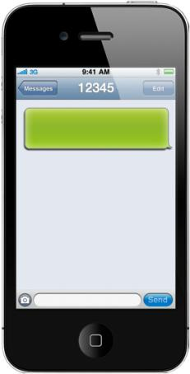
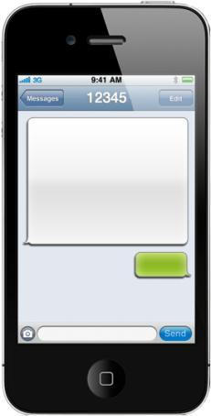
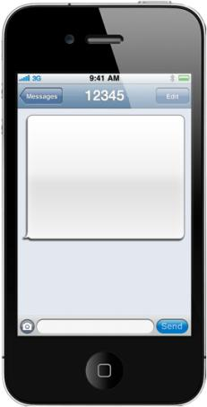
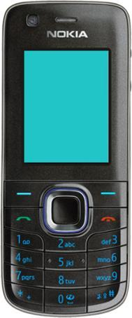
Phone to Phone End User Experience
Example USA– Digicel Jamaica corridor
Congratulations
You have
received
300 HTG
Airtime Credits
from
+14035789124
+150912345678
Chose Airtime Option:
1. 100 HTG Airtime = $3
2. 300 HTG Airtime = $9
3. 500 HTG Airtime = $15
Reply with 1,2 or 3
You are about to send
300 HTG to
+150912345678
You will be charged
$ 9 Please reply Y
to confirm, N to cancel
You have successfully
sent 300 HTG to
+150912345678 You
have been charged $9
<Ref: 123456B>
2
Y
Send Top-Up request & number
User replies with chosen amount
Transaction and amount confirmed
SMS notification confirms Top-Up
Recipient notified by

Slide 8
POS to Phone User Experience

Slide 9
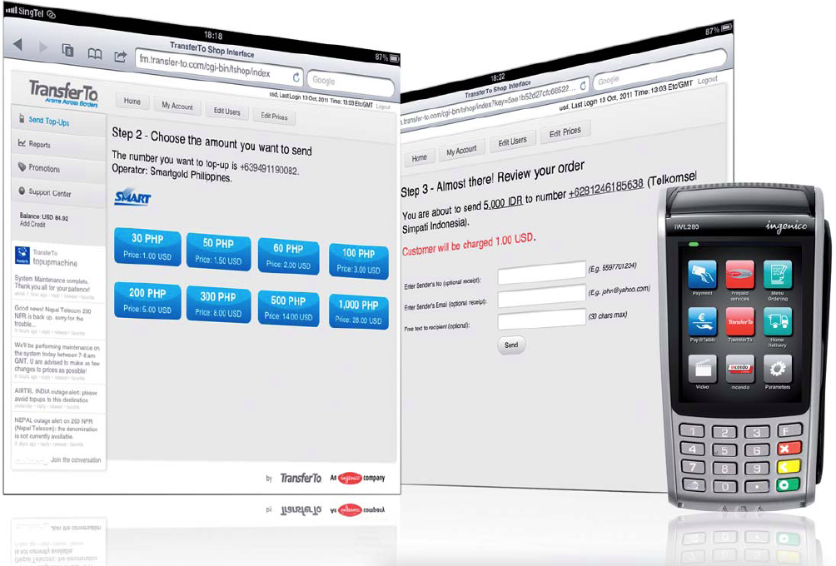
TransferTo Shop – Retail Solutions
WebPOS or POS Payment Terminal based Real Time Top-Up

Slide 10
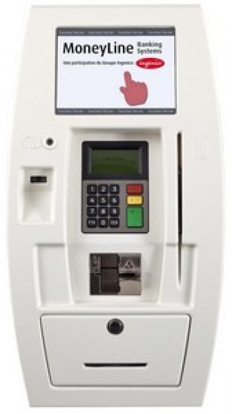
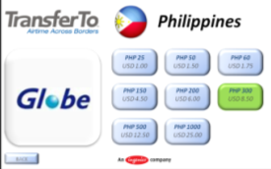
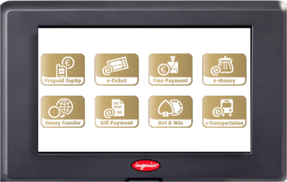
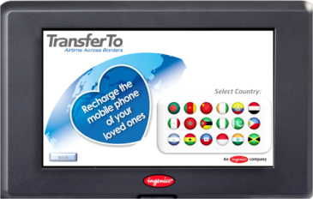
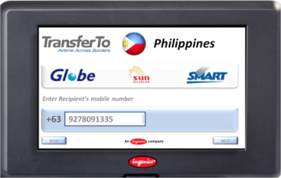
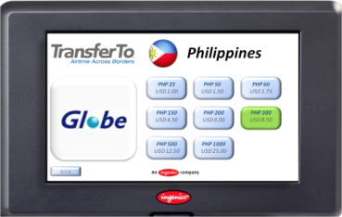
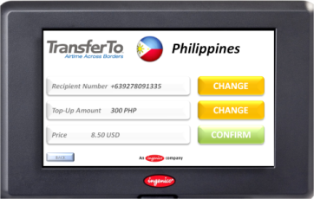
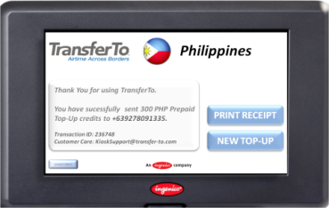
Self Service Kiosk

Slide 11
TransferTo Coverage Q3 2012
Over 30 countries are sending to over 230+ Mobile Operators in 85+ countries

Slide 12


















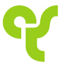










TransferTo Partners

Slide 13

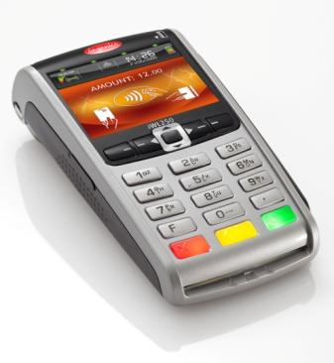

TransferTo - an Ingenico Company
Ingenico - World Leader in Payment Solutions
• Leading Payment Terminal provider by market share
• Over 1 billion EUR revenue in 2011
• Publicly listed on NYSE-Euronext (ING)
• 15 million payment terminals in service worldwide
• Market presence in over 125 countries
• Over 3,500 employees
• 2010: TransferTo acquisition
TransferTo – Global Airtime Remittance Hub
• World leading provider of international top-up transfer services
• 230+ partner mobile operators in 85+ countries
• Reaching 3.6 billion prepaid mobile users
• Founded in 2005

Slide 14
Thank You!
Name
Title name@transfer-to.com
CellPhone Number

Slide 15






Phone to Phone Transaction Flow
Sender
Recipient
Request
Send amount and mobile number
Confirmation
mobile number top-up amount & charged amount
OK
Reserve credit
Charging Gateway
Top-Up Request
Direct Top Up Platform
Debit
OK
You have successfully loaded
amount to mobile number you
have been charged amount
Congratulations you
have just received amount
from mobile number

Slide 16






WebPos / Self Service Kiosk Transaction Flow
Roamer
Prepaid Account
Submit mobile number
Submit Destination Mobile Number
Show available Operator &
Top-Up denominations
Inform sender on available
Top-Up denominations & Prices
Choose Top-Up Denomination & Pay
Submit Top-Up Request
Top-Up Request
Top-Up
Tx confirmation Transaction ID
OK
Congratulations you
have just received amount

Slide 17
Why TransferTo
Reach
• 230+ operators in 80+ countries
• Continuously growing network in both sending and receiving countries
• Carrier Grade Platform & Network
• Multiple Payment Channels: Phone to Phone, Web to Phone, POS to Phone
• Non Intrusive Solutions adapted to existing technical environment
Carrier Grade
• Pricing models adapted to existing distribution channels and constraints
• Transparent: amount recharged known prior to transaction
• No hidden costs
Transparent Pricing
Proven Solution
• Proven solution and unmatched track record with Tier One Mobile Operators
• AT&T, Vodafone, Orange, STC, SFR, Q-Tel, China Mobile, DiGi …trust TransferTo
• Benefit from Ingenico’s global presence and capability that comes with:
• 3500 employees worldwide
• 1 billion EUR revenues (2011)
Financial Strength
• White Label: Solution can be rebranded under the partner’s brand
• Partnership approach, TransferTo does not compete with its partners
• Committed to partner’s long term business success
White Label

Slide 18
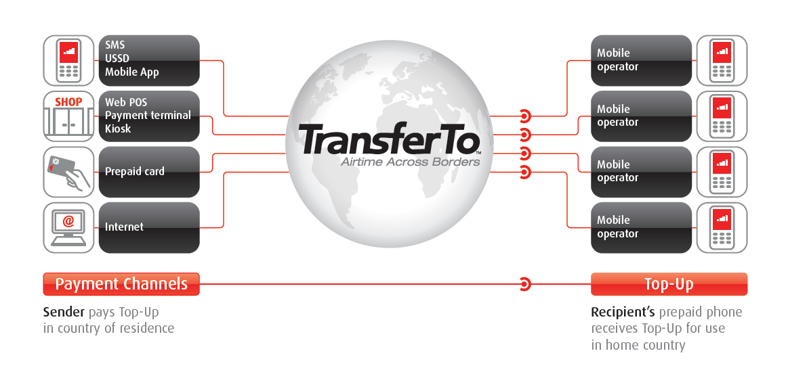
Global Airtime Remittance Hub
Enabling the transfer of small amounts of value in the form of prepaid mobile credits
• Single connection / Single agreement
• Multiple payment / distribution channels.
• Instant Access / Global Reach
• Transaction processing ,clearing and settlement.

