Slide 1
Road to Compliance
A Closer Look at FedGlobal ACH Payments
Presented By:
  Azba Habib
  Associate Counsel, Federal Reserve Bank of Atlanta
  September 6, 2012

Slide 2
The Really Big Disclaimer
The views presented are those of the individual presenter and do not reflect the views of the Federal Reserve Bank of Atlanta, the Retail Payments Office, the Board of Governors, or any person or entity.
The content of this presentation is intended to serve as general information and not as legal counsel or as expert advice about IT. If the issues in this presentation interest you, you should consult your own legal counsel and/or IT professional.

Slide 3
FedGlobal – Overview
International ACH payments service offered by the FRBs to FIs
Relies on open bank-to-bank system
Allows for cross-border ACH credit payments to 35 countries and debits to Canada
No inbound debits
FRBs ≠ RTPs
Regions | Countries
North America | Canada
Europe | Austria, Belgium, Cyprus, Czech Republic, Denmark, Finland, France, Germany, Greece, Ireland, Italy, Luxembourg, Malta, Netherlands, Poland, Portugal, Slovakia, Slovenia, Spain, Sweden, Switzerland, and United Kingdom
Latin America | Argentina, Brazil, Colombia, Costa Rica, El Salvador, Guatemala, Honduras, Mexico, Nicaragua, Panama, Peru, and Uruguay

Slide 4
FedGlobal – Service Options
Delivery Choices
  Account to Account (A2A) – between two bank accounts
  Account to Receiver (A2R) – between a bank account and receiver at a financial institution or a trusted third-party provider
Foreign Exchange Options
  Fixed to Variable (FV) – converts U.S. dollars to a variable amount of destination currency
  Fixed to Fixed U.S. Dollars (FF-USD) – allows payments to be sent and received in U.S. dollars
  Fixed to Fixed Foreign Currency (F3X) – allows payments to be sent and received in the same foreign currency; USODFI manages FX conversion and settlement with foreign correspondent

Slide 5
FedGlobal – Counterparty Relationships
Services | USGO | FGO | Service Provider | Clearing and Settlement System
Canada | FRBA | Bank of Nova Scotia (“Scotiabank”) | n/a | ACSS
Mexico | FRBA | Banco de Mexico (“Banxico”) | n/a | SPEI
Panama | FRBA | Banco Nacional de Panama | Telered | ACH Directo
Europe | FRBA | DZ Bank | Equens | Multiple
Latin America | FRBA | Banco Rendimento | MFIC | Proprietary

Slide 6
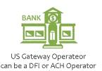



Settlement – FF & FV
IAT
FX
$USD
FedGlobal
Local currency
Local
IAT
U.S. Correspondent
$USD
USD account of Originator
Account of Receiver

Slide 7
Settlement: F3X
$0
IAT
FedGlobal
$0
IAT
Foreign currency
USODFI’s Foreign Correspondent
FX
USD account of Originator
Account of Receiver

Slide 8
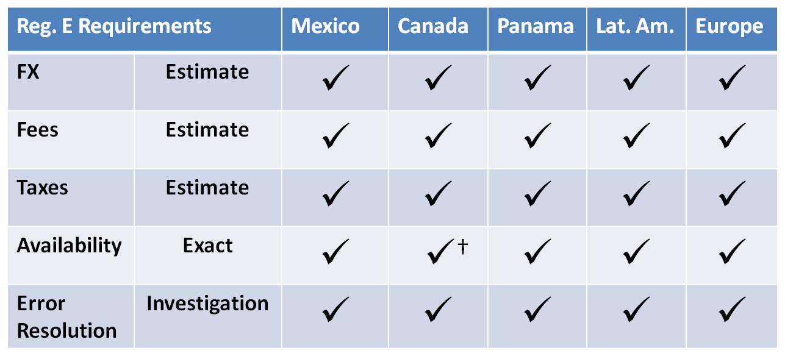
Compliance Posture
†Exact date of availability is unable to be disclosed for 16 of the 18,000+ bank branches in Canada.

