Slide 1
Bancomer Transfer Services, Inc.
Presentation for the
Federal Reserve Bank of Atlanta
Retail Payments Risk Forum
Atlanta, Georgia September 6, 2012
Notes:
1

Slide 2
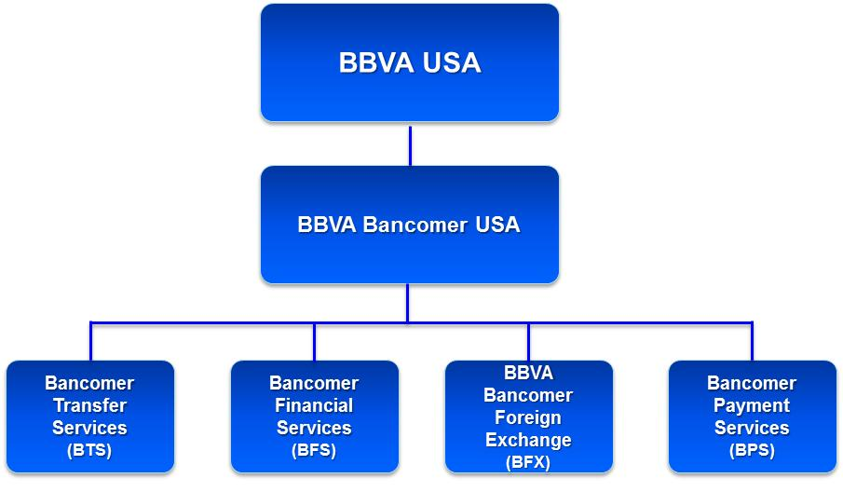
Corporate structure
BBVA Compass
BBVA NY

Slide 3
Bancomer Transfer Services, Inc.
2008
Strategic alliance increases distribution network in Mexico and reaches over 4,000 points of payment
2001
Exceeds 1 million transactions in a year
1995
BTS is incorporated in California to serve the USA-Mexico corridor through the Bancomer network by offering family remittance services
2003
Expanded the payment network in Central and South America through the BBVA network and other payment agents
2010
BTS-Visa Alliance Established
1995
1996
2000
2001
2003
2006
2007
2008
2009
2010
$50
Cost to Sender for a USD $360 txn.
$10
2000
Launched the wholesale remittance program by offering the service to third parties
2007- Pilot program for retail agent network within the US
2009 -Compliance & System Enhancements (GP & GCS) – Online & Historical Monitoring
1996
Alliance with the US Postal Service (USPS)
2006
Pilot program for expansion into Asia

Slide 4
Bancomer Transfer Services, Inc.
Bancomer Transfer Services, Inc. (BTS) is a BBVA subsidiary, that provides a fully compliant & turn-key solution to participate in the Family Remittances and EFT Market
BTS offers a EFT engine, allowing the participating entity to provide their consumers with a reliable, secure, and affordable alternative to transfer funds
BTS’ mission is to provide high quality payment services for Family Remittances and EFT
The platform incorporates one of the most stringent compliance programs and a state-of-the art AML monitoring system
Claims ratio is only 0.01%
BTS services are supported by a proprietary technology platform

Slide 5
BTS’ Compliance Program has provided a leading role in its value added proposition…
Compliance
State of the art, stringent compliance model, due diligence process and AML monitoring play a leading role in the industry
Real-time online processing, monitoring, reporting and settlement management
Streamlined
Operational Processes
Processes millions of transactions per month from thousands of points of sale & payment worldwide
Technological Platform
5

Slide 6
BTS serves 60,000+ Third Party Origination Points and provides access to Paying Entities in 23 countries
Mexico
Central America & Caribbean
South America
Europe
Africa
Asia
BBVA Bancomer
HSBC
Scotiabank
Banorte
Bansefi
Telecomm
BanCoppel
& more…
BAC
HSBC
Banco Agricola
Elektra
Banrural
Banco Industrial
Ficohsa
& more…
Itau
Banco Paulista
Banco Davivienda
Bancolombia
Banco Bolivariano
BBVA Continental
& more…
Romanian Int. Bank
Smith & Smith
Russlavbank
Dirham Express
MEA Finance
Money Express
Bank of China
ICICI Bank
Bank Philippine Island
Vietnam Intl Bank

Slide 7
Transaction Model…
Transactions
Online
Transaction
Monitoring
SENDERS
BTS
Retail System
REC I P I ENTS
WHOLESALE
ENVIRONMENT
OTHER
BANKS
Third Party
Originating
Entity
BTS Payment
System
Third Party
Originating
Entity
Retail System
BTS
System
Interface
Payment Agent
System
Interface
OTHER
BANKS
BTS
Retail System
(Sales)
BTS Sale
System
BBVA
Platform
BBVA
BANKS
BTS
Agents
7

