Slide 1
Remit2India.com
Avijit Nanda
President, TimesofMoney

Slide 2
Remit2India - Ecosystem
Sponsor
Bank
Direct Debit (e.g. ACH)
Demand Draft
Internet
ACCESS CHANNELS
Wire Check
DISBURSEMENT
Direct Bank Debit
Bank Transfer
Mobile
Remit2india
Product
interface
Operations
Compliance
Customer Service
Stored Value Card

Slide 3
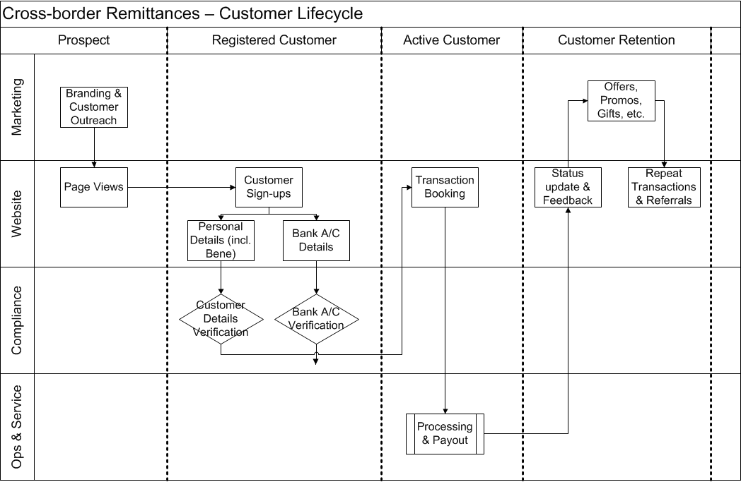
Customer Lifecycle

