Slide 1
Visa Personal Payments: Overview
What is it? A “transaction railroad” that supports delivery of funds to a Visa account issued by any of 10,000+ financial institutions worldwide
Benefits:
  Global reach
  Authorization system
  Potential for real-time funds availability
  Risk management tools inherent with VisaNet

Slide 2

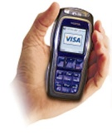
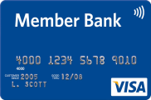

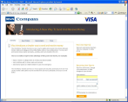

Visa Personal Payment Solution
Channel
Source of Funds
Transaction
Destination of Funds
Defined by Originator / MTO
Core Visa Capability
Bank Branch / Agent
Bank Account
Visa Debit
Mobile
Originator
Recipient
Visa Issuer
Visa Account
  Credit
  Debit
  Prepaid¹
Original Credit Transaction (OCT)
Visa Prepaid
Internet
Cash
[$2,500 txn limit²]
Other
Other
> 1 Billion
Only personalized, reloadable prepaid cards can receive OCTs
Certain non-U.S. domestic country limits may be higher

Slide 3
Compliance Considerations
Visa can provide US originator with information to meet some of the disclosure requirements to senders
Originator Fees: By definition, originator has this information
Exchange Rate: US originator can submit OCT to VisaNet in recipient card currency (e.g., send 10,000 MXP to Mexican-issued Visa card). Recipient issuer will post same amount to recipient account
Recipient Bank Fees: Visa considering rule to prohibit Visa issuers from assessing incremental fee for receiving OCTs and posting funds to recipient accounts
Recipient Jurisdiction Taxes: Visa does not have access to this information
Transaction Cancellation: Originator can hold transaction for 30 minutes before submitting to VisaNet, effectively giving sender 30 minutes to cancel request before transaction is processed

