Slide 1
Dodd-Frank 1073: key insights

Slide 2
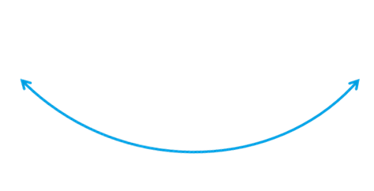
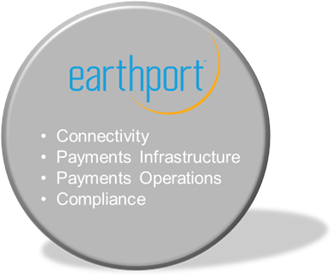
Hybrid closed loop model for Global ACH
Channels
Segregated Accounts
Phone
Branch
Online
FI: EUR
NO:NOK
UK: GBP
No FX process
Funding in SGD
US: SGD
SG: SGD
FX process
Funding in USD
US:USD
US: USD
Payment Instructions
ZA: ZAR
PL: PLN
JP: JPY
PH: PHP
1. Pre-advice.
2. Fee disclosures.
3. FX rates. 4. Delivery dates.
5. Tax data.
AU: AUD
Notes:
CONFIDENTIAL – DO NOT DISTRIBUTE
Client whether a bank, FX house or corporate payment aggregator funds Earthport segregated currency accounts. Virtual accounts per customer.
Client funding accounts can be held with any bank and moved to Earthport account.
Any major currency can be used via Earthport to pay locally in any country served.
Earthport receives instruction to pay beneficiary. Earthport processes the payment which involves validation, formatting subject to there being sufficient cleared funds in the merchant account.
Earthport routes through SWIFT in those countries where we don’t have a local bank account

Slide 3
What have we learned so far?
For the Financial Services Industry
Challenges
There is no panacea to 1073 but a range of different changes (closed; open loop; hybrid).
Some elements proving challenging (e.g. tax disclosures and liability / repudiation).
Significant distraction in times of tight resources / multiple conflicting priorities.
Unintended degradation of service to consumers.
Opportunities
Driving innovation in payments: global low-value payments one of fastest growing segments.
Forcing new partnership and relationship models across payments ecosystem.
Increasingly being seen as a potentially significant incremental revenue creator.
For Earthport and our Customers
Most DFS1073 requirements similar to those laid-down in the 2009 European Payments Services Directive.
Core Earthport capability and further strengthening our functionality to meet DFS1073.
Complex multi-stakeholder projects for our clients with constrained resources.
Seeing different market approaches (compliant by January 2013 deadline; on-going optimisation with global ACH).
Judge that DFS1073 is likely to be the catalyst for greater transparency in global B2B payments over the coming years.
Repurpose DFS1073 from a threat to an opportunity.

Slide 4
Impact of DFS1073 on a hybrid closed loop model
DFS1073 Requirement | Global ACH | Wires
Full fee-disclosure at the point of origination.
No correspondent fees. FX fees are ‘fixed on send’ | ✓ ✓ | ✗ ✗
2. Guarantee on final principal settled*
No beneficiary landing fee. No ‘incoming credit’ posting fee. Disclosure of any tax deductions. | ✓ ✓ tbc | ✗ ✗ tbc
3. Guarantee on when funds will be delivered*
Known/ predictable delivery schedules. | ✓ | ✗
4. Right to cancel a transaction.
30 min cancellation right from origination. | ✓ | ✓
* No payment system provides any inherent guarantee.
Earthport’s Global ACH solution however provides the highest possible degrees of predictability.

