Slide 1
Remittances Under UCC Article 4A: Unintended Consequences
A Symposium on 1073:
Exploring the Final Remittance Transfer Rule and the Path Forward
Federal Reserve Bank of Atlanta
September 6, 2012
Stephanie Martin
Associate General Counsel
Board of Governors of the Federal Reserve System
Duncan Douglass
Partner, Payment Systems
Alston & Bird LLP

Slide 2
The Practical Problem Beginning in 2013: What happens when a remittance transfer is also a funds transfer under UCC 4A?
A bank’s customer initiates a remittance transfer (that is subject to EFTA 919) to a recipient in a foreign country
The bank initiates the U.S. leg of that transfer by debiting the customer’s account and sending a payment order via Fedwire or CHIPS
What law applies to that payment order?
Customer has rights under EFTA 919 (disclosure/cancellation/refund)
What happens under UCC 4A, Regulation J, and/or CHIPS rules? What governs the inter-bank part of the transaction?

Slide 3
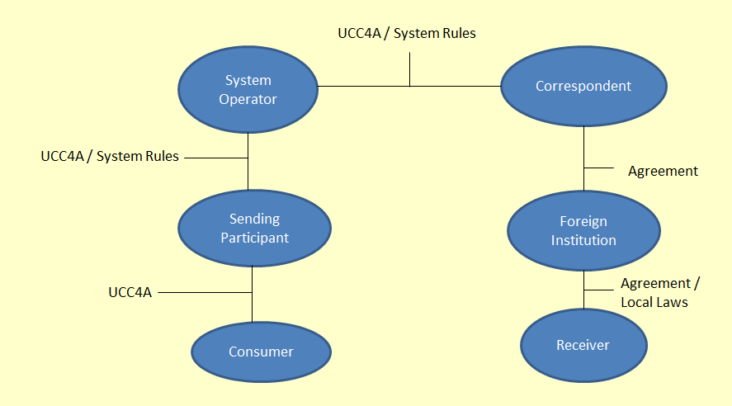
Current Legal Regime Governing Cross-Border Consumer Wire Transfers
UCC 4A, individual agreements and applicable payment system rules (e.g., Reg. J or CHIPS Rules) govern rights and responsibilities of participants, including between consumer and sending bank

Slide 4
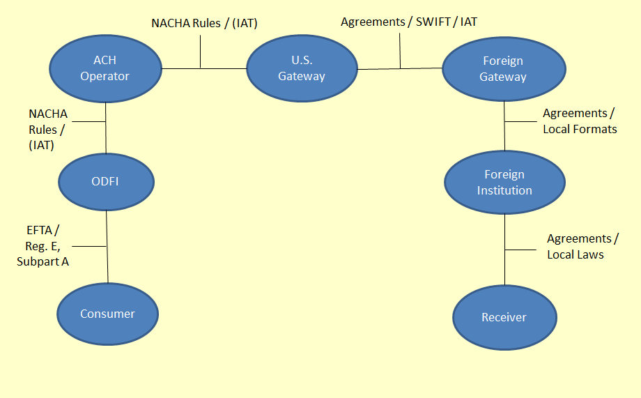
Current Legal Regime Governing Cross-Border Consumer EFTs (ACH Credits)
EFTA governs rights/responsibilities between consumer and ODFI
NACHA Rules (IAT) and separate agreements govern rights of participants other than consumer-ODFI

Slide 5
New Remittance Transfer Rules Create EFTA § 919 and UCC 4A Overlap and Gap
Consumer-initiated cross-border wire transfers are remittance transfers under EFTA § 919
EFTA § 919 does not include the same exception as applies to traditional EFTs under EFTA 906(3)(b), which excludes from coverage “any transfer of funds, other than those processed by automated clearinghouse, made by a financial institution on behalf of a consumer by means of a service . . . which is not designed primarily to transfer funds on behalf of a consumer”
UCC 4A-108 provides that UCC 4A does not apply “to a funds transfer any part of which is governed by the [EFTA]”
Consumer cross-border wire is not subject to UCC 4A and is subject to EFTA § 919, but EFTA § 919 only applies to relationship between consumer and remittance transfer provider

Slide 6
The Regulation J Problem
Regulation J (subpart B) governs funds transfers through Fedwire
Like Article 4A, Regulation J had a cross-reference problem
Former Regulation J excluded from coverage any portion of a funds transfer that is governed by the EFTA
EFTA 919 created an anomalous result, because a Fedwire funds transfer could be part of an EFTA remittance transfer and therefore not governed by Regulation J
If Regulation J did not apply to those funds transfers, then a gap in coverage would result with respect to inter-bank rights and responsibilities

Slide 7
The Regulation J Fix
The Board revised Regulation J to address the gap (77 FR 21854, April 12, 2012)
Effective July 12, 2012, Regulation J applies to a funds transfer sent through Fedwire, even though a portion is governed by EFTA 919
Any portion of a funds transfer that is governed by EFTA other than 919 is not governed by Regulation J
In the event of an inconsistency between EFTA 919 and Regulation J, EFTA 919 governs
Example: A consumer initiates a remittance transfer at a bank, and the bank initiates the transfer by sending a Fedwire funds transfer
The consumer subsequently exercises the right to cancel and obtain a refund under EFTA 919
The bank must comply with EFTA 919 even if it does not have a right under Regulation J to reverse the Fedwire payment order it sent

Slide 8
The CHIPS Rules Fix
The CHIPS Rules were similarly affected by the “gap” created when EFTA § 919 defined remittance transfers to include wire transfers, thereby precluding applicability of UCC 4A
The Clearing House amended the “choice of law” provision of the CHIPS Rules to provide that New York law (including NY UCC 4A) applies to system Participants “regardless of whether the payment message is part of a funds transfer that is a remittance transfer governed by Section 919 of the [EFTA]”
The CHIPS Rules were also amended to provide that NY law would govern the rights and obligations of all other parties (i.e., other than system Participants) to a CHIPS payment message, but that the EFTA would control in the event of a conflict between it and NY law

Slide 9
The Continuing UCC 4A Conundrum
Unamended, UCC 4A does not apply to remittance transfers subject to EFTA § 919, so long-standing risk allocation under UCC 4A “security procedure” agreements no longer applies, including to alleged fraudulent consumer cross-border wires
Notably, EFTA § 919 and the CFPB’s implementing regulations (Regulation E, Subpart B) do not define unauthorized remittance transfers as errors that are subject to the remittance transfer error resolution procedures
NY recently amended Article 4A of NY UCC to provide that it applies to a funds transfer that is a remittance transfer under EFTA but not an EFT under EFTA (but EFTA controls when in conflict with UCC 4A)
Where NY law applies, amendment allows UCC 4A to once again govern alleged fraudulent transfers, even a consumer-initiated wire remittance transfer
ULC has recommended that states adopt a similar amendment

Slide 10
All is Well Once We Have UCC 4A and Reg. J/CHIPS Rules Fixes, Right? Not Exactly.
Amendments to Regulation J and CHIPS Rules, incorporating and applying UCC 4A to remittance transfers, do not ensure that UCC 4A applies to all parties to a remittance transfer processed through Fedwire or CHIPS
Funds transfer system rules (and Reg. J) may establish the law that governs participants in the system and other parties to a transfer on the system if the other parties have notice both that the funds transfer system might be used and of the choice of law provision
Senders/providers using Fedwire/CHIPS for remittance transfers may need to update customer (consumer and correspondent) agreements to provide requisite notice
For a payment order to be effective as that of the sender under UCC 4A, bank must adhere to any written agreement or instruction from the customer restricting acceptance of payment orders issued in the name of the customer.
Does remittance transfer disclosure constitute a new customer instruction?
May a consumer recover under both EFTA and UCC 4A where both provide remedies for the same event and those remedies are not in conflict (e.g., interest under UCC 4A and refund of fees under EFTA for delayed remittance transfer)?

Slide 11
BSA Rules
There is a similar cross-reference issue in the “travel” and “record-keeping” rules under the Bank Secrecy Act that apply to “funds transfers” and “transmittals of funds”
The issue is under review at the Federal Reserve and FinCEN

Slide 12
Questions/Discussion

