Slide 1
The Future of Mortgage Finance:
QM, QRM and Basel III
Jay Brinkmann*
Chief Economist and
SVP, Research & Education
*Comments and opinions are solely those of the presenter and do not necessarily represent official positions of the MBA or its members.

Slide 2
Components of Mortgage Finance Industry
Borrowers
Originators/Loan Officers
Institutions, charter-type and size
Secondary market execution versus portfolio
Servicing
Each is being impacted in a major way, but by far more than just QM, QRM and Basel III .

Slide 3
Borrowers
Credit tightened because big increases in loss severity make any defaults very expensive.
Current and future drivers of severity
  Liability under ability to repay provisions of QM for non-safe harbor loans. Legal costs plus potential legal damages.
  Defaulted loan servicing costs under new guidelines.
  Greatly increased foreclosure timelines in some states.
  Pattern of buy-back demands from GSEs and other investors.
  Due to 150 bp over APR limit on risk-based pricing, few high risk loans will be made to avoid going above the QM safe harbor trigger.

Slide 4
Credit Scores on Completed Transactions
Still Well Above Normal
In addition:
Fannie Mae Weighted Average FICO on Acquisitions (Q3 2012): 761
Freddie Mac Weighted Average FICO on Acquisitions (Q3 2012): 762
Last Sequoia Deal: 771
Sources: FHA Monthly, Fannie Mae and Freddie Mac Credit Supplements, S&P

Slide 5
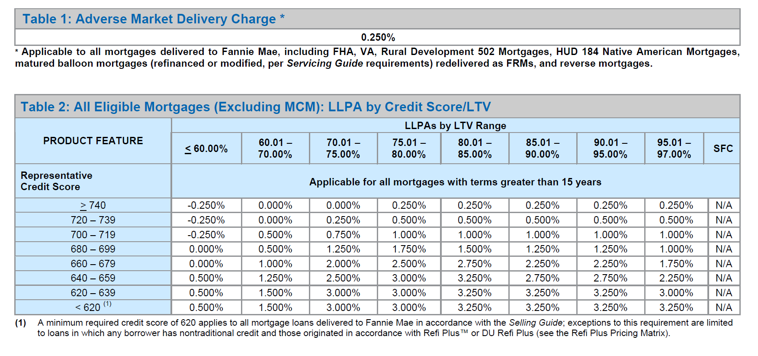
Credit Pricing vs. Underwriting
Source: Fannie Mae LLPA Matrix

Slide 6
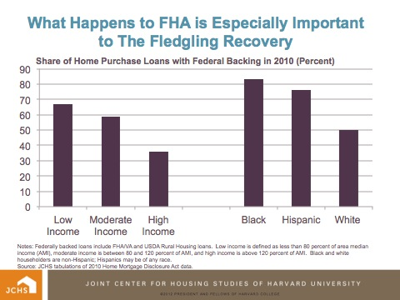
Homebuyers Predominantly Served by Government Housing Programs

Slide 7
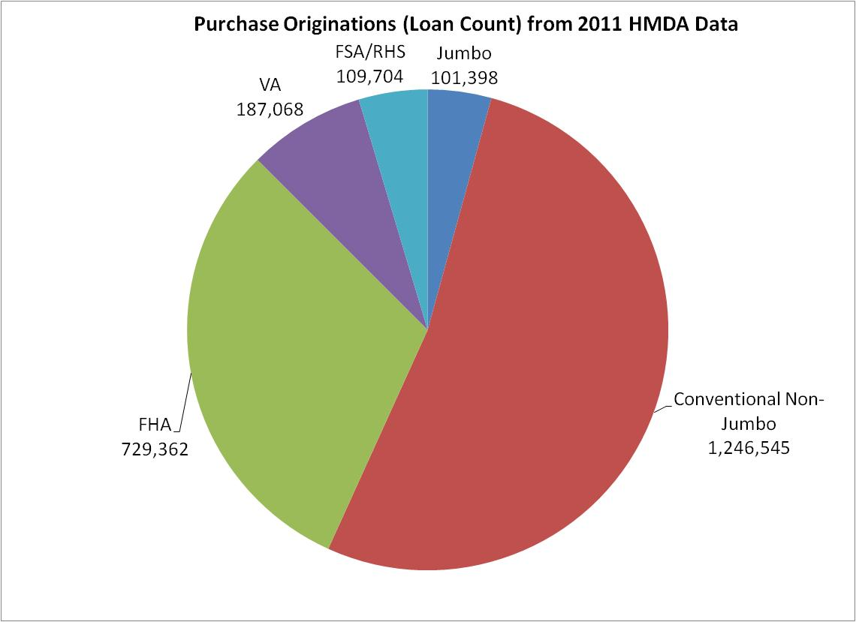
2011 HMDA Data – Purchase Originations
Source: FFIEC, MBA
NOTE: Retail/Broker Originations for Home Purchase and Refinance – Secured by A First Lien Only, No Multifamily,
Notes:
BRZ: This is the new Product Mix chart – for easy viewing.

Slide 8
Challenges for Institutions
Higher operating costs driving out smaller lenders and reducing economies of scale for larger lenders
Effectiveness of different business models in a market dominated by purchase mortgages
Regulatory and liability risks to bank business caused by mortgage business
Reputation risks from disparate impact claims and other discrimination allegations
Basel III

Slide 9
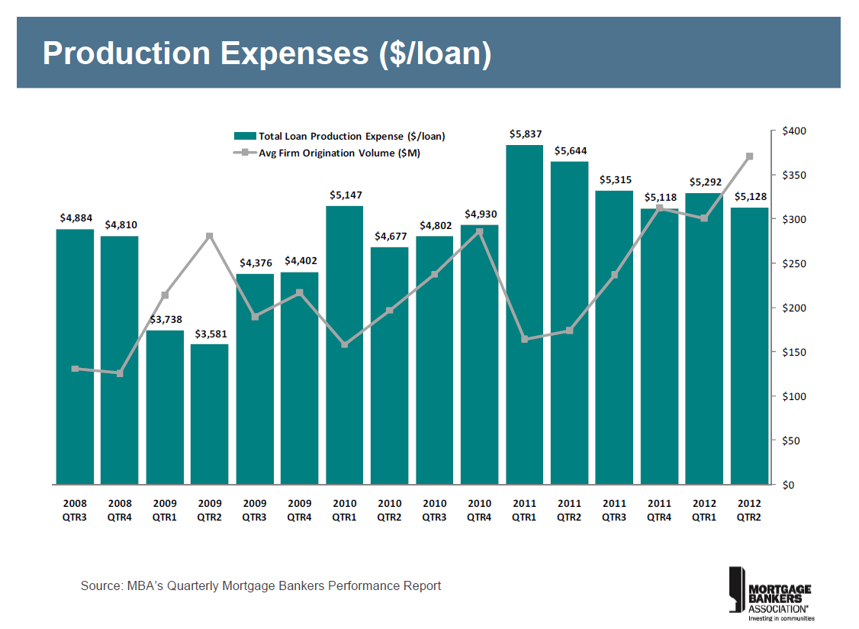

Slide 10
Retail Apps per Underwriter per Month
Source: MBA/STRATMOR Peer Group Survey

Slide 11
2011Data Show Net Exit from Business
Source: FFIEC

Slide 12
Basel III Overview
Main Issues
  Increased capital requirements
  Increased risk weights
  Treatment of MI
  Treatment of mortgage servicing rights

Slide 13
Basel III Risk Weights for Residential Mortgages

Slide 14
Basel III Impact on Mortgages Held in Portfolio

Slide 15
Impact of Basel III on Mortgage Servicing Rights
Basel III will make it very expensive for banks to hold mortgage servicing rights:
MSRs more than 10% of Tier 1 capital must be deducted from equity. Given fluctuations in MSR values due to interest rates, the size of this deduction is unknown from quarter to quarter.
Remaining MSRs carry a 250% risk weight.
MSRs plus most deferred tax items are limited to 15% of Tier 1 capital.

Slide 16
Impact of Basel III on Banks with MSRs

Slide 17
QRM/Risk Retention
QM is designed to protect borrowers, QRM is designed to protect investors.
The retained risk requirements are still to be determined but will be based on the investors (Fannie, Freddie and FHA loans are exempt) and the credit risk of the loans.
Strong industry push to make QM and QRM guidelines the same.
The big problem with QRM is that investors set the credit criteria and originators will have to hold capital against risk models and risk appetites they do not control.
The result will be a further narrowing of credit and significant impediment to the resumption of a private label market for mortgage-backed securities.

Slide 18
Conclusions
Increasing operational and compliance complexity favor big banks, BUT
Smaller independents have been better at originating purchase mortgages, BUT
The regulatory complexities and potential QM liabilities and increased GSE &FHA fees point toward putting more loans into portfolio, BUT
The increased Basel III capital requirements (and interest rate risk of long-term, fixed rate mortgages) make that expensive, BUT
Basel III requirements on MSRs and potential QRM retained risk requirements make securitization a problem, BUT
The Justice Department and HUD will sue you if you don’t make the loan.

