Slide 1
Shadowy Banks and the
Interbank Amplifier
During the Great Depression
Kris James Mitchener, University of Warwick and NBER
Gary Richardson, Federal Reserve Bank of Richmond

Slide 2
How do banking crises influence the real economy?
Look back to the Great Depression
Period of massive global banking distress
  Roughly 10,000 bank suspensions in U.S. alone
Those that suffered banking crises fared significantly worse (Bernanke and James, 1991)
Seen as one of the major reasons for the depth and duration of the Depression
Notes:
A period when output, prices, and money fell by more than a third, unemployment peaked at more than 25%, and the commercial banking system’s collapse culminated in President Roosevelt’s declaration of a nationwide banking holiday in March, 1933.

Slide 3
Friedman and Schwartz’s (1953) channel
Emphasized banking panics led to a “contagion of fear” and withdrawals of panicked depositors
Bank runs reduced the currency-deposit ratio and monetary aggregates. This monetary deflation led to economic contraction
Federal Reserve inaction prolonged the U.S. depression

Slide 4
Bank Lending Channel
Bernanke (1983) further suggested failures of banks led to loss of credit information
Bank failures raise cost of credit
Lending contracts and output falls

Slide 5
Debt Deflation
Fisher (1932, 1933), Minsky (1982), and Kindleberger (1978) suggest bank failures contributed to debt-deflation process and therefore decline in economic activity

Slide 6
What about network linkages?
Contagion and systemic risk during 2008-9 financial crisis associated with linkages across financial firms
“Shadow banks” (financial institutions outside regulatory purview) feature prominently
  Like banks: short-term liabilities & long-term assets
  Linked to commercial banks through credit intermediation chains and correspondent networks
  Ability to leverage seen as important for fueling housing bubble

Slide 7
Our research
What role did interbank networks play in:
(1) propagating the banking distress?
(2) magnifying the credit contraction?
Focus on one possible network channel
  Linkages arising from interbank deposits
  Like the modern crisis, we examine the role of financial institutions outside the purview of the Fed, “shadowy banks”:
    Non-Fed member commercial banks held deposits in Fed member banks, but were not regulated by the Fed and did not have access to the Fed’s discount window
Notes:
Interbank deposits are largely an afterthought in the Monetary History because, as Friedman and Schwartz point out, precisely where deposits were held within the system is not important for establishing that aggregate changes in the money supply influenced the real economy. However, the location of deposits within the system may be important for understanding financial contagion and systemic stability.

Slide 8
Reserve Pyramid before founding of Fed
Central Reserve
City Banks
Reserve City Banks
Country
Banks
Notes:
As the U.S. expanded during the 19th century, correspondent networks evolved to satisfy interior banks’ demands for funds and desire to invest beyond their geographical proximity. In the 1860s, the National Banking acts cemented this structure, permitting country banks to meet their legal reserve requirements by keeping a large portion of their legally required reserves (originally up to 60%) as deposits in banks in reserve and central reserve cities. By the early twentieth century, central reserve city banks in New York held roughly two thirds of all required reserves, much of which was invested in the call loan market. Even though the national banking system’s reserve requirements created a large potential pool of reserves that could be used in a banking crisis, no central coordinating mechanism existed to deploy them. Rather, individual banks, wary of being run, hoarded reserves and feared paying penalties if they fell below the legal requirement. As a consequence, the national banking systems’ reserves, though large in aggregate, were effectively unavailable for meeting the demands of panicked depositors in crisis periods (Beckart, 1922).Inverted pyramid structure left the banking system vulnerable to interregional contagion, counterparty cascades, and network-based runs (James 1978, Sprague 1910).

Slide 9
Interbank deposits after Fed’s Founding
Federal Reserve System
Central Reserve
City Banks
Reserve
City Banks
Country
Banks
Fed member banks
“Shadowy Banks”
Notes:
After 1913, however, it was believed that the Federal Reserve System had resolved these problems by introducing an elastic currency and acting as a lender of last resort (Friedman and Schwartz 1963, Miron 1986). Scholars have not explicitly assessed whether the reserve pyramid, which remained in place, and linkages between non-member and member banks propagated the financial crisis of the early 1930s or magnified its effects on the real economy.
59 reserve cities

Slide 10
“Shadowy Banks” were significant part of overall banking system
Non-Federal Reserve member banks were:
  2/3rds of all commercial banks
  Held 1/2 of all deposits
How significant were connections to member banks?
  June 1929: 96% of all interbank deposits were those of non-member banks

Slide 11
The Interbank Amplifier
  Bank runs (“liquidity shocks”) induce shadowy banks to withdraw their (liquid) interbank deposits from reserve & central reserve city banks
  Reserve city banks in turn draw down their balances in central reserve city banks
  Money center banks respond to deposit outflows by reducing their lending to firms and households
Notes:
Reaction function
Micro particles make up the amplitude of the wave. David Attwick

Slide 12
Key questions for the interbank amplifier
  Is there evidence of a link between interbank deposits and banking distress, in particular liquidity shocks?
  Did reserve-city and central-reserve-city banks change balance sheets change in response to bank runs in country banks?
    If so, how did they respond?
  Did the network’s reaction affect real economic activity?
  How large was the overall effect on the economy?
Notes:
Aims of our research. Making headway in these, but may not be all the way there yet. Constrained by how fast we can process the data. It’s a large data set that requires time to clean. Quarterly across districts. 15 years*4qtrs*12 districts

Slide 13
New panel data set
Balance sheets for different tiers of the banking system (country banks and reserve and central reserve cities), in each of the 12 Federal Reserve districts
Data at call report dates: 1920-33
  Roughly quarterly in frequency
Supplemented it with information on banking distress and economic activity

Slide 14
On eve of Great Depression
Interbank deposits account for:
  20% of all demand deposits
  60% of aggregate reserves in reserve and central reserve cities
“Excess Reserves” (above legal requirements) were low
  Interbank deposits multiples greater
  Member banks could thus meet unexpected declines in interbank balances only by liquidating investments or borrowing reserves from the Fed.
Notes:
We don’t mention, but it’s important, that the Fed did not dramatically increase discount window lending (per F&S), so this means they had to liquidate investments

Slide 15
Interbank deposits fall after banking panics of 1930
Notes:
First line is stock market crash October 1929
Second line is Caldwell & Co. banking panics.
Some variance of inflows and outflows – local banking panics/local shocks. Aggregate is dropping rapidly. 2nd last call in 1932 only period.

Slide 16
Volatility of interbank deposits rises in 1930s
Standard Deviation of Interbank Deposits
In Millions of Dollars Per Day
 | Central Reserve | Reserve | Entire US
1924 Dec. - 1929 Oct | 2.0 | 1.6 | 3.2
1929 Dec. - 1932 Dec. | 3.3 | 2.6 | 5.6

Slide 17
Little Correlation in 1920s
Notes:
Interbank deposits in Chicago. Bank distress in Minneapolis and KC

Slide 18
Correlated with distress of 1930s
Notes:
For 1929-32, however, a positive correlation exists between banking distress and interbank deposit flows of reserve city banks.

Slide 19
Even more pronounced for NYC
Notes:
Liquidations for entire US. Terminal suspensions of nonmember banks for each call.

Slide 20
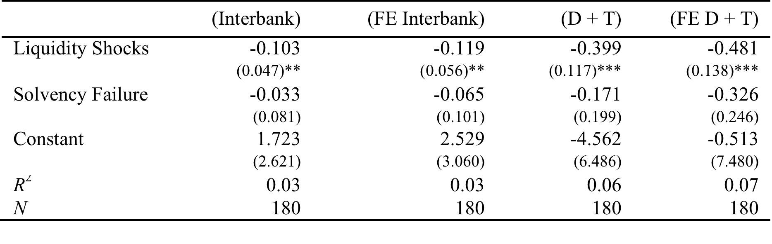
A run on a country bank (“liquidity shock”) is associated with ~$100,000 decline in reserve city interbank deposits
Notes:
Liquidity shocks are identified as temporary bank suspensions (where banks closed their doors to due illiquidity but then later re-opened and survived the Great Depression) and banks whose failure was caused by runs or by the closure of a correspondent. “Solvency failures” include the failures of banks for reasons other than runs and correspondents. Examiners attributed almost all of these failures to the decline in the value of the bank’s investments. These measures are defined at the Fed district level, so at any given point in time, we can observe differences in the intensity of these two types of shocks, and in any given region, we can observe differences in intensity of the two types of shocks over time.
Fixed effects are for Federal Reserve district. The variation over time is what we are interested in, i.e. differences over quarters likely matters.
A run on country banks that triggered its suspension (either temporary or permanent) resulted in an outflow of about $100,000 dollars from the reserve city banks within its district. Consistent with our hypothesis, illiquidity events appear to lead to outflows of deposits. Solvency shocks are also associated with interbank deposit outflows, but the size of the effect is half of liquidity shocks and not precisely measured (i.e., statistically insignificant). Consistent with Friedman and Schwartz’s view that liquidity shocks and bank runs induced depositors to withdraw funds from banks, the third and fourth columns of Table 4 shows that the public’s deposits in reserve city banks (time deposits plus demand deposits) are negatively associated with liquidity shocks.

Slide 21
Key Question 1: some findings
Interbank deposit flows for central reserve cities uncorrelated with banking distress in 1920s, correlated in 1930s. Why?
  Failures in 1920s primarily due to insolvency
    Country banks insolvent due to farm failures after WWI
  In 1930s, deposit-driven runs as well as insolvencies
  Time series results suggest correlation becomes stronger after banking panics begin
Liquidity shocks appear to be associated with movements in interbank and “public” deposits
  Consistent with both F&S and network channel
Notes:
Many of small, country banks failed as a result of lending to farmers who had expanded production and capacity when prices were rising during World War I, but the defaulted on loans when agricultural prices declined in the 1920s. Insolvencies of small banks spread across space and over time seldom triggered large flows of liquid funds from financial centers.

Slide 22
Key Question 2: How did central reserve city and reserve city banks respond to outflows of interbank deposits?
Examine changes in asset composition:
(1) Loans
(2) Corporate bonds
(3) Government bonds
(4) reserves (the sum of the cash in banks’ vaults and the deposits at the Fed)
(5) Interbank deposits (“due from”)

Slide 23
SUR Estimates
System of equations
  Changes in deposit flows and asset composition in reserve & central reserve cities
  Allows us to control for correlation of errors across reserve & central reserve cities
Notes:
Control for key threat to inference, correlation of error terms across central reserve cities

Slide 26
For a single “liquidity suspension” in 1931-32, how much did assets change?
($1000s)

Slide 27
Putting the pyramid together
Reserve city banks acted as the conduit (-69), transmitting the run of the shadowy non-member bank to the center of the system
  Respond to distress by removing their liquid assets from New York and Chicago Fed member banks
Central reserve city banks have no where to turn
Should have been able to go to the Fed if it had acted as a LOLR
Instead, they rebalance assets in response
Notes:
Linkages between country banks (primarily non-Fed members or “shadowy banks”) and reserve city banks appear to have magnified the real effects of the banking crisis

Slide 28
Net decline in lending working across the network
When shadowy bank suspended, it induced a $75,000 reduction in lending
  Roughly 10% of the contraction in lending from reserve cities and 90% in central reserve cities.

Slide 29
How big was the macroeconomic effect of reduction in lending?

Slide 31
How big was the macroeconomic effect of the interbank amplifier?
$311 million reduction in loans & investments (loans & all bonds)
  In comparison to the “contagion of fear” F&S: $1.05 billion
  In comparison to all banks entering liquidation: $3.59 billion
May be an underestimate since there are large flows of interbank deposits within certain call reports, e.g. Sep 1931
Too big not to be discussed, especially when we still exclude panic of 1933!
Notes:
Concentrated in New York and Chicago

Slide 32
Example, New York, 1933
Jan 4 to Mar 1, 1933
  Interbank deposits fell precipitously
  Regular deposits declined slightly
  Business lending fell $410 million
  Government bonds declined $164 million
  (Episode is missed in call report data)
March 1-8
  Sold $152 million in government securities
  Borrowed $449 million from NY Fed
Notes:
To examine this episode, we utilize higher-frequency data collected from banks in New York City that reported their conditions weekly, and in sum held roughly 75% of the assets of all member banks in New York. From January 4 through March 1, interbank deposits at weekly reporting banks fell rapidly, while regular deposits drifted downward by a few percentage points.
To finance these outflows, New York’s weekly reporting banks called $410 million business lending and sold $164 million in government bonds. The banks retained almost their entire portfolios of corporate bonds and also held on to their portfolios of loaned secured by securities. These actions raised over $550 million in cash, which the banks used to meet interbank outflows, along with $183 million borrowed from the New York Fed. The last week of the crisis, from March 1 through 8, witnessed the final scramble for cash. The weekly reporting banks appear to have no loans worth calling or liquidating. Instead, they turned to mass sales of U.S. government securities ($152 million) and even greater borrowing from the New York Fed ($449 million). The Banking Holiday ended the panic, but afterwards, business lending remained depressed for several years, and did not return to the level of 4 January 1933 until well into the year 1935.

Slide 34
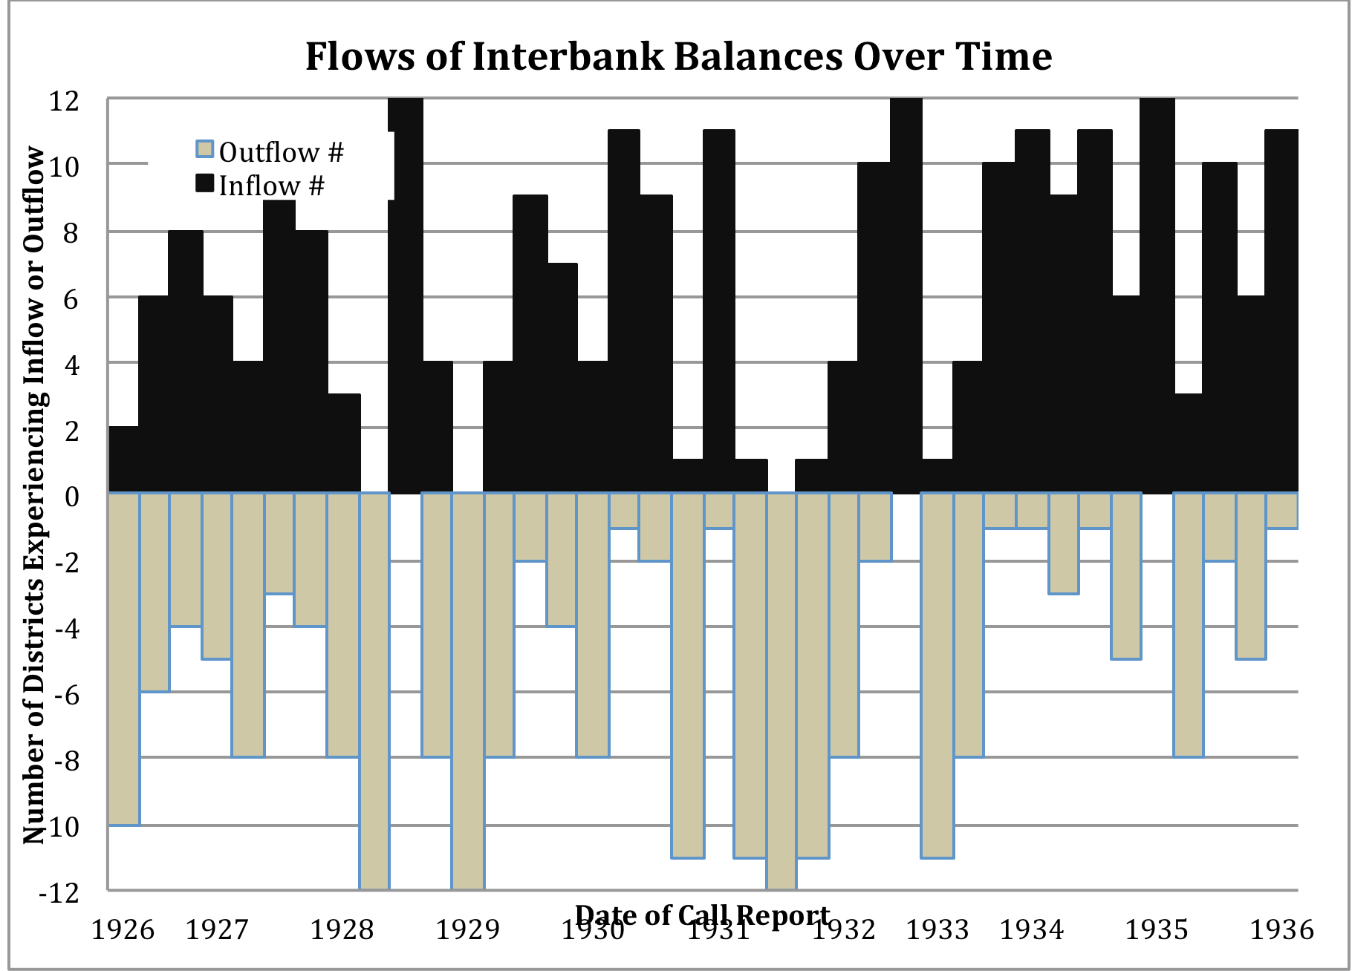
Notes:
Figures 1 and 2 illustrate that, even during the Depression, there is significant variation across Districts, with at least some of the Fed districts still experiencing inflows of interbank deposits into their reserve city banks. Figure 1 depicts the number of districts experiencing increases and decreases of interbank deposits from one call date to the next between 1926 through 1936. Each column represents a call date.

Slide 35
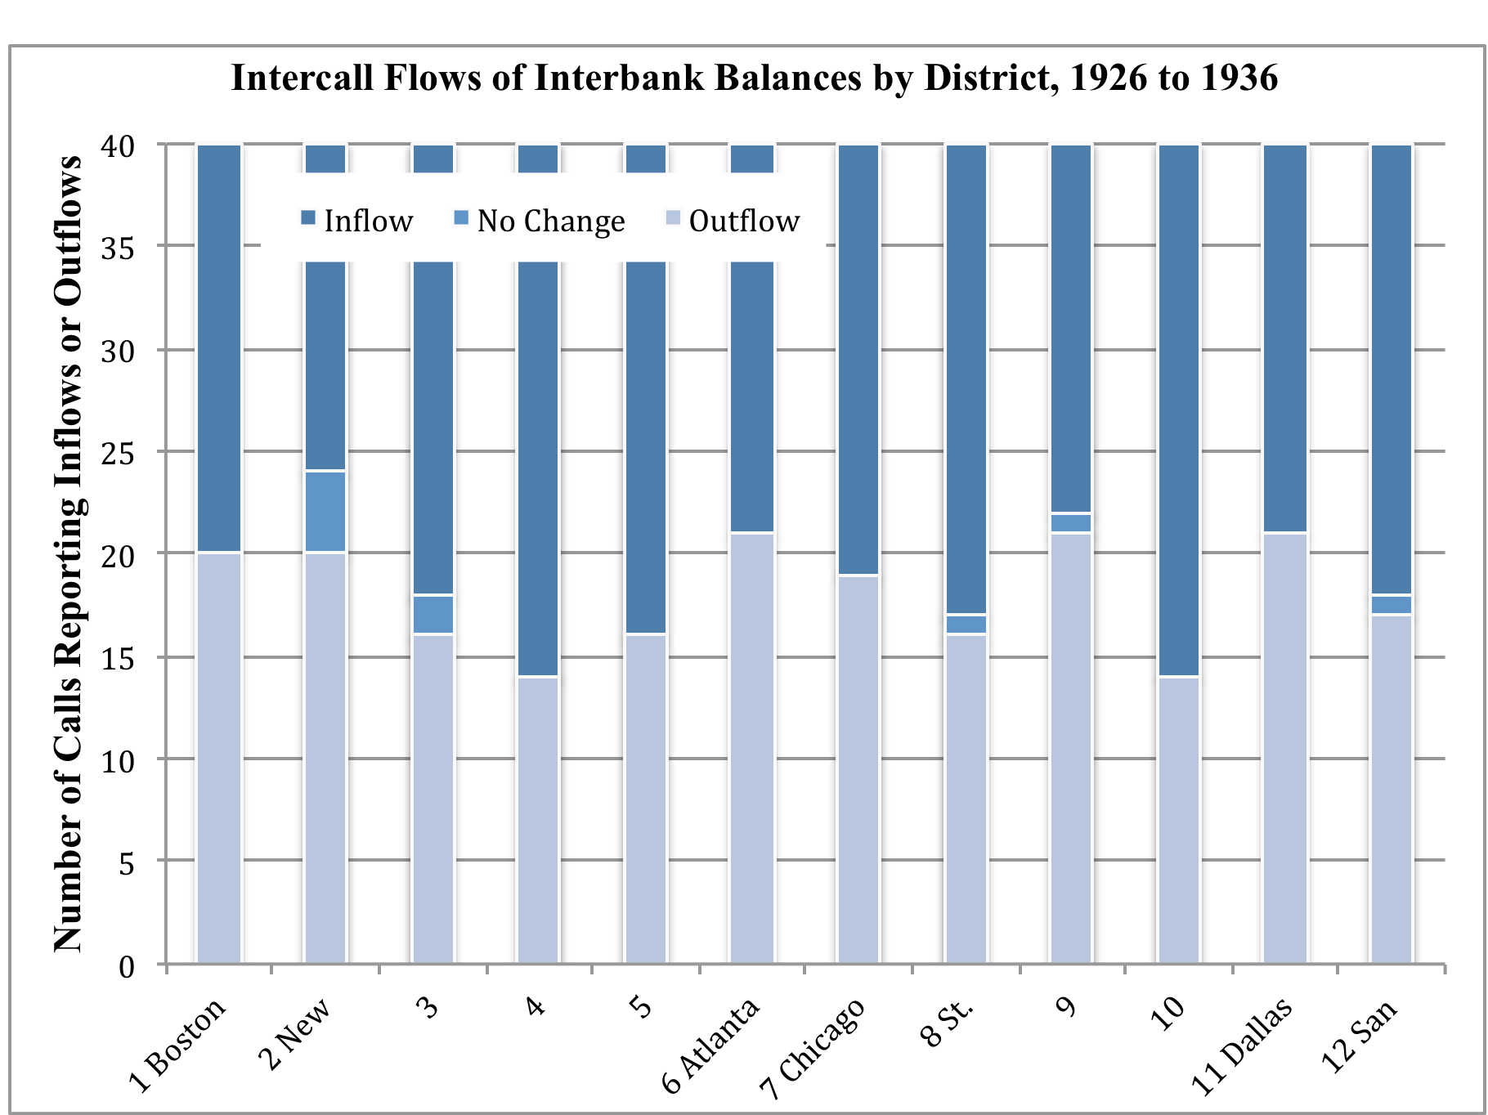
Notes:
Figure 2 depicts the same data by district. The figure indicates the number of calls for which a districts’ reserves cities experienced increases or decreases of interbank deposits. All districts experienced inflows and outflows, but the districts experienced these flows at different points in time.

Slide 36
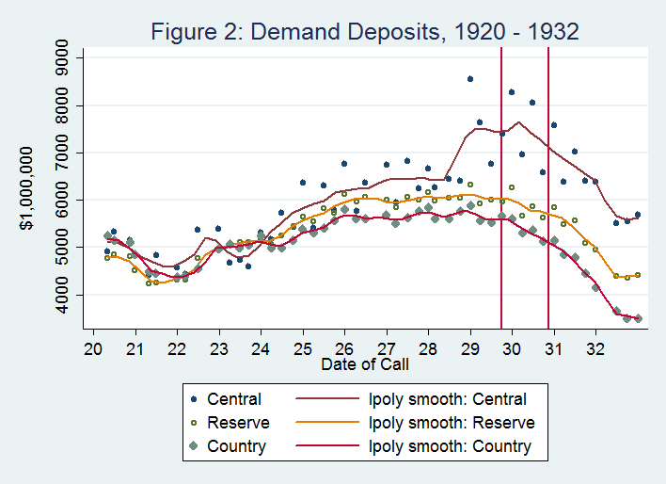

Slide 37
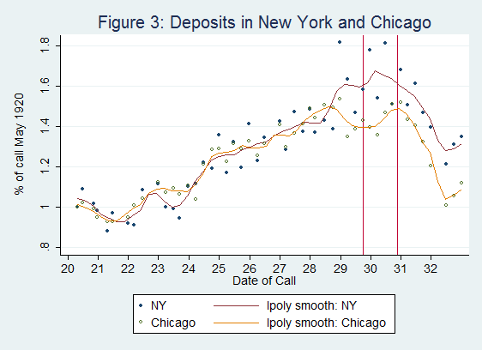

Slide 38
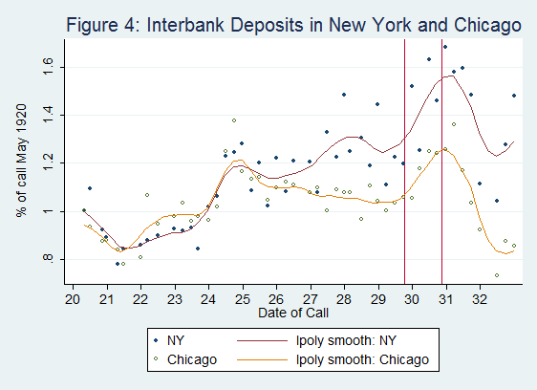

Slide 39
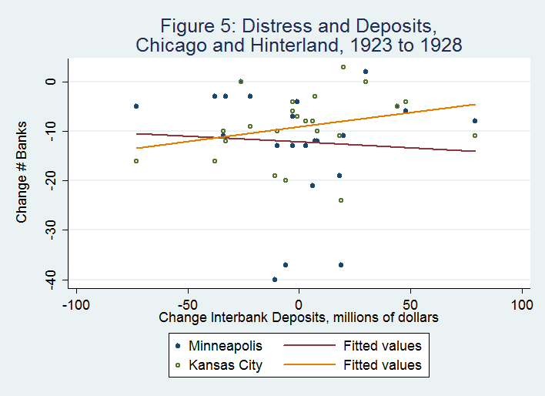

Slide 40
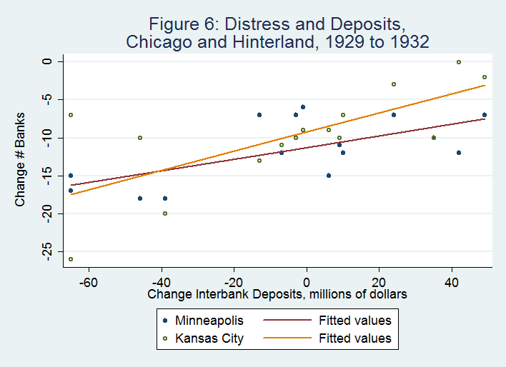

Slide 41
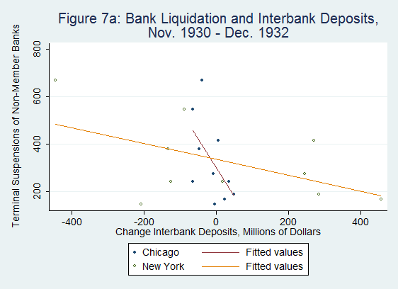

Slide 42
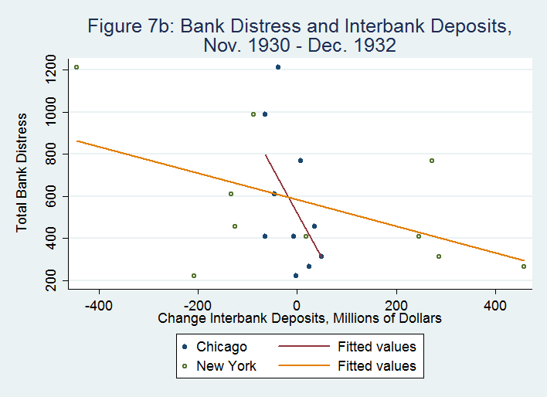

Slide 43
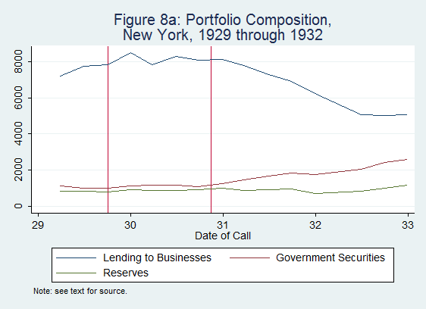

Slide 44
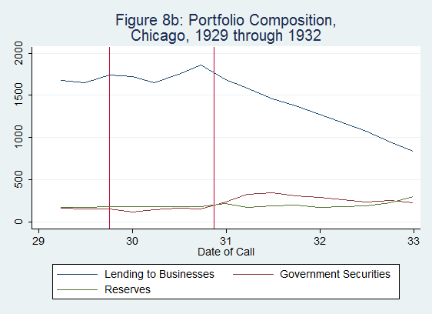

Slide 45
Focus
Did interbank deposit flows contribute to the collapse of commercial banking during the Great Contraction from 1929 through 1933?
Focus on
  Reserve pyramid
  Central reserve cities, New York and Chicago
  How financial crises on the periphery affected the operation and stability of the financial core.

Slide 46
Literature Review
Before Federal Reserve estimated in 1913, reserve pyramid linked periphery and core
  James 1978, Meyers 1931, Sprague 1910, Bordo and Wheelock 2011, Beckart 1922
During Great Contraction, interbank deposits had little influence on national events. Excluded from analysis.
  Friedman and Schwartz 1963
Regional panics and policies significantly influenced course of contraction
  Elmus Wicker 1996. Richardson and Troost 2009. Carlson, Mitchener, and Richardson 2011. Calomiris and Mason 1997. Meltzer 2003. Wheelock 1991.

Slide 47
After Fed
Interbank deposits largely
  From non-member banks
  Into member banks in reserve or central cities
  Depositors receive correspondent services
Member banks
  Deposited in Federal Reserve banks and branches
  Deposits with Fed became principal reserve
  Fed served as members principal correspondent

Slide 48
Empirical Challenge
Task: construct a panel of data across time, regions, and levels of the reserve pyramid
Data imperfect
Data collection difficult and time consuming

Slide 49
Outline
Historical Background
Data
Methods and Results
Interpretation

Slide 50
Data
Bank Balance Sheets
  Call Reports for Fed Member Banks … Banking and Monetary Statistics, 1914 to 1941
  Call Reports for State Commercial Banks … All Bank Statistics, 1896 to 1955
Bank Distress
  Richardson 2007a, 2007b, etc…
  Federal Reserve Bulletin 1937
Economic Activity by Federal Reserve District
  Retail Trade by Federal Reserve District, Park and Richardson 2012

Slide 51
Data (1) – Member Call Reports
Aggregated by
  District (1, …, 12)
  Level (country, reserve, Chicago, New York)
Advantages. Entire population, Detailed Data.
Disadvantages. Data generating process varies.

Slide 52
Data (2) – Bank Distress
For 1921 to 1928
  Fed member bank changes by call date, district, and reserve level
  Bank suspensions by state, month, membership, and charter (must be converted to district/call date)
For 1929 to 1933 (Bank Holiday)
  Detailed microdata
Bank Holiday and thereafter
  No data and/or no failures

Slide 53
Outline
Historical Background
Data
Methods and Results
Interpretation

Slide 54
Methodology (1)
Constraints
  Few observations in critical periods
    Stock market crash to end of 1932 = 12
    Banking panics to end of 1932 = 8
    Final panic and banking holiday = 0
  Data generating process violates assumptions underlying many popular statistical procedures
Benefits
  Comprehensive coverage of entire population
  Detailed data during critical periods

Slide 55
Methodology (2)
Use transparent methods
Control for other threats to inference with a series of robustness checks

