Slide 1
Death of a Reserve Currency
Stephen Quinn, TCU
William Roberds, Atlanta FRB

Slide 2
Motivation
Quasi-fiscal activities can create substantial negative capital positions for central banks.
When, and how, does this undermine monetary credibility?

Slide 3
Methodology
We generalize negative central bank capital into two states: potentially recoverable through internal means, or not so.
We reconstruct the balance sheet of the Bank of Amsterdam in the 1780s to see how, and when, the Bank lost its potential to recover and lost the credibility of its price stability goal.

Slide 4
Why Amsterdam?
The Bank of Amsterdam’s florin was a dominant international currency.
Amsterdam was a top financial center built on merchant banks and a deep market for international acceptances.

Slide 5
Conclusion
In 1782, the Dutch East India Company dragged the Bank of Amsterdam over the edge of monetary credibility.

Slide 6
Before 1782
Bank of Amsterdam operated for decades with modest negative capital.
The Bank enjoyed substantial market funding.
The Bank’s money maintained a stable value.

Slide 7
During 1782
The troubles of the Dutch East India Company degraded the quality of loans held by the Bank.
Markets withdrew wholesale financing.
Open market operations maintained the quantity of bank money.

Slide 8
After 1782
It was no longer feasible for the Bank to recapitalize itself.
Market funding remained limited, and the value of bank money declined.

Slide 9
Outline
Negative Central Bank Capital
Bank of Amsterdam Capital
1782
The Fallen Regime

Slide 10
1. Negative Capital

Slide 11
Modern Central Bank Balance Sheet
Assets |  | Liabilities
Government Bonds |  | Money
Under Repo |  | Banknotes in Circulation
Outright Purchases |  | Central Bank Accounts
Other |  | Capital
Discount Window |  | Assets less Liabilities
GSE Bonds

Slide 12
Negative Capital
Shock to asset values:
Exchange Rate Risk
Interest Rate Risk
Credit Risk
Can create technical insolvency:
Capital < 0

Slide 13
Problem?
NO
Unlike commercial banks, a central bank can create money to meet obligations.
MAYBE
Empirical observations suggest a threshold.
Why might negative capital matter?

Slide 14
Intangibles
Unrecognized Assets
Franchise value
(the discounted stream of future monopoly rents)
Unrecognized Liabilities
Future claims
(Treasury expectations of siegniorage and quasi-fiscal operations)

Slide 15
Policy Insolvency
Inflationary Monetary Policy
Loss of credibility
Insufficient Revenue relative to Negative Capital
Derived from Stella 1997: 9-10.

Slide 16
Policy Insolvency
When a central bank cannot, “meet its policy commitments given its financial situation (Stella and Lonnberg 2008: 11).”
Can a central bank fund itself without resorting to destabilizing policies?

Slide 17
Metrics
TIME: The years it will take a central bank to recapitalize itself back to zero.
NET WORTH: What a risk neutral investor would pay for the central bank.
Net Worth = Franchise Value + Capital
Threshold when Net Worth = 0
Net Worth ≠ Capital because of unrecognized assets and liabilities

Slide 18
Central Bank Independence
Is the treasury creating policy insolvency by reducing retained earning (seigniorage demands) or depleting capital (quasi-fiscal operations)?

Slide 19
Mission Creep
If the [central bank’s] seigniorage is regularly turned over to the treasury, and if the revenue grows very large, the treasury is likely to come to depend on it and to apply pressure to avoid its shrinking. In defense, the central bank is likely to be tempted to expand its mission, for example by undertaking to be a backup source of liquidity for a growing list of types of financial institutions. But such “mission creep” exposes the bank to new risks and therefore again to limitations on its ability to control the price level.
Sims (2004, p. 105)

Slide 20
Bottom Line
Whether the demands of a treasury harm a central bank’s other policies depends on the central bank’s net revenue relative to its capital.

Slide 21
2. Bank of Amsterdam

Slide 22
Table 1. Balance Sheet in 1780
In Bank Florin
Assets |  | Liabilities
Silver and Gold |  | Accounts
Under Receipt | 16,186,210 | Under Receipt | 16,186,210
Unencumbered | 3,817,229 | Unencumbered | 7,005,331
Loans
East India Co. | 2,600,000
Amsterdam | 482,000
Holland | 227,264 | Capital | 121,162
 | 23,312,703 |  | 23,312,703

Slide 23
The Receipt
When an account holder deposits a trade coin into the Bank, he receives
Account credit for the coin at its official value
A receipt which is an option to repurchase the exact same coin after six months’ time, at a cost of ⅛-½ percent (depending on the coin)

Slide 24
Bank Accounts
Accounts cannot be directly redeemed for coin without a receipt.
However, a daily secondary market for current versus bank money exists.
Bank money customarily trades at a premium (“agio”) over current money of 4-5%.

Slide 25
Table 1. Bank Balance Sheet in 1780
In Bank Florin
Assets |  | Liabilities
Silver and Gold |  | Accounts
Under Receipt | 16,186,210 | Under Receipt | 16,186,210
Unencumbered | 3,817,229 | Unencumbered | 7,005,331
Loans
East India Co. | 2,600,000
Amsterdam | 482,000
Holland | 227,264 | Capital | 121,162
 | 23,312,703 |  | 23,312,703

Slide 26
Table 1. Bank Balance Sheet in 1780
In Bank Florin
Assets |  | Liabilities
Silver and Gold |  | Accounts
Under Receipt | 16,186,210 | Under Receipt | 16,186,210
Unencumbered | 3,817,229 | Unencumbered | 7,005,331
Loans
East India Co. | 2,600,000
Amsterdam | 482,000
Holland | 227,264 | Capital | 121,162
 | 23,312,703 |  | 23,312,703

Slide 27
City of Amsterdam
Owns and administers the Bank of Amsterdam.
Takes each year’s operating profits as seigniorage.
Occasionally “borrows” from the Bank, but the city does not pay interest nor repay the principal.

Slide 28
Table 2. Negative Capital
In Bank Florin
Assets |  | Liabilities
Silver and Gold |  | Accounts
Under Receipt | 16,186,210 | Under Receipt | 16,186,210
Unencumbered | 3,817,229 | Unencumbered | 7,005,331
Loans
East India Co. | 2,600,000
Amsterdam | 482,000
Holland | 227,264 | Capital | -360,838
 | 22,830,703 |  | 22,830,703

Slide 29
Policy Insolvency
Could a large amount of unbacked bank florins threaten the goal of agio stability?

Slide 30
Table 3. Negative capital
January | Total Assets | Capital without City Loans | Capital without City and East India Loans
1777 | 19,940,762 | -422,304
1778 | 20,471,697 | -365,263
1779 | 23,895,593 | -416,127
1780 | 23,312,703 | -360,838
1781 | 19,240,083 | -460,114
1782 | 20,961,397 | -531,507 | -5,331,507
1783 | 19,779,899 | -929,500 | -8,579,500
1784 | 18,234,566 | -1,344,525 | -8,994,525
1785 | 19,724,727 | -1,762,568 | -9,412,568
1786 | 18,962,014 | -1,956,133 | -9,606,133
1787 | 19,090,538 | -2,382,484 | -9,802,984
1788 | 18,597,782 | -2,357,136 | -10,771,264
1789 | 20,681,724 | -2,312,616 | -10,997,244

Slide 31
Table 4. Years to Recapitalize
January | Operating Profit (bank florins) | Years without City Loans | Years without City and East India Loans
1777 | 59,696 | 7.1
1778 | 57,041 | 6.4
1779 | 65,873 | 6.3
1780 | 121,162 | 3.0
1781 | 139,886 | 3.3
1782 | 196,318 | 2.7 | 27.2
1783 | 144,865 | 6.4 | 59.2
1784 | 130,825 | 10.3 | 68.8
1785 | 73,717 | 23.9 | 127.7
1786 | 83,882 | 23.3 | 114.5
1787 | 62,754 | 38.0 | 156.2
1788 | 88,116 | 26.8 | 122.2
1789 | 96,431 | 24.0 | 114.0

Slide 32
Table 5. Net Worth
 | Franchise Value | Net Worth
January | Using 3 percent discount rate | without City loans | without City and East India loans
1777 | 1,989,881 | 1,567,577
1778 | 1,901,366 | 1,536,103
1779 | 2,195,753 | 1,779,626
1780 | 4,038,743 | 3,677,905
1781 | 4,662,859 | 4,202,745
1782 | 6,543,927 | 6,012,419 | 1,212,419
1783 | 4,828,823 | 3,899,324 | -3,750,676
1784 | 4,360,830 | 3,016,305 | -4,633,695
1785 | 2,457,239 | 694,671 | -6,955,329
1786 | 2,796,064 | 839,931 | -6,810,069
1787 | 2,091,813 | -290,671 | -7,711,171
1788 | 2,937,193 | 580,058 | -7,834,070
1789 | 3,214,369 | 901,753 | -7,782,875

Slide 33
Figure 1. Stock of Bank Florins

Slide 34
Figure 1. Stock of Bank Florins

Slide 35
Figure 2. Price of Bank Florins: Agio

Slide 36
Figure 2. Price of Bank Florins: Agio

Slide 37
3. 1781 and 1782

Slide 38
Asset Shock
Fourth Anglo-Dutch War, 12-1780 to 5-1784
British blockade
Dutch loss of Asian ports
British gain permanent free trade access to the Dutch East Indies.

Slide 39
Figure 3. Dutch East India Co. Loans

Slide 40
Figure 3. Dutch East India Co. Loans
Last interest payment by Dutch East India Company

Slide 41
Figure 3. Plus Amsterdam “Loans”

Slide 42
Figure 3. Plus Amsterdam “Loans”
“Deferred Asset”

Slide 43
Figure 3. Plus Province of Holland

Slide 44
Figure 3. Plus Province of Holland
Bank lends after public offer fails, and the Bank forebears interest on existing loans.

Slide 45
Figure 3. Plus City Loan Chamber

Slide 46
Policy Insolvency?
Indicators of Market Sentiment
Receipt Accounts
Agio

Slide 47
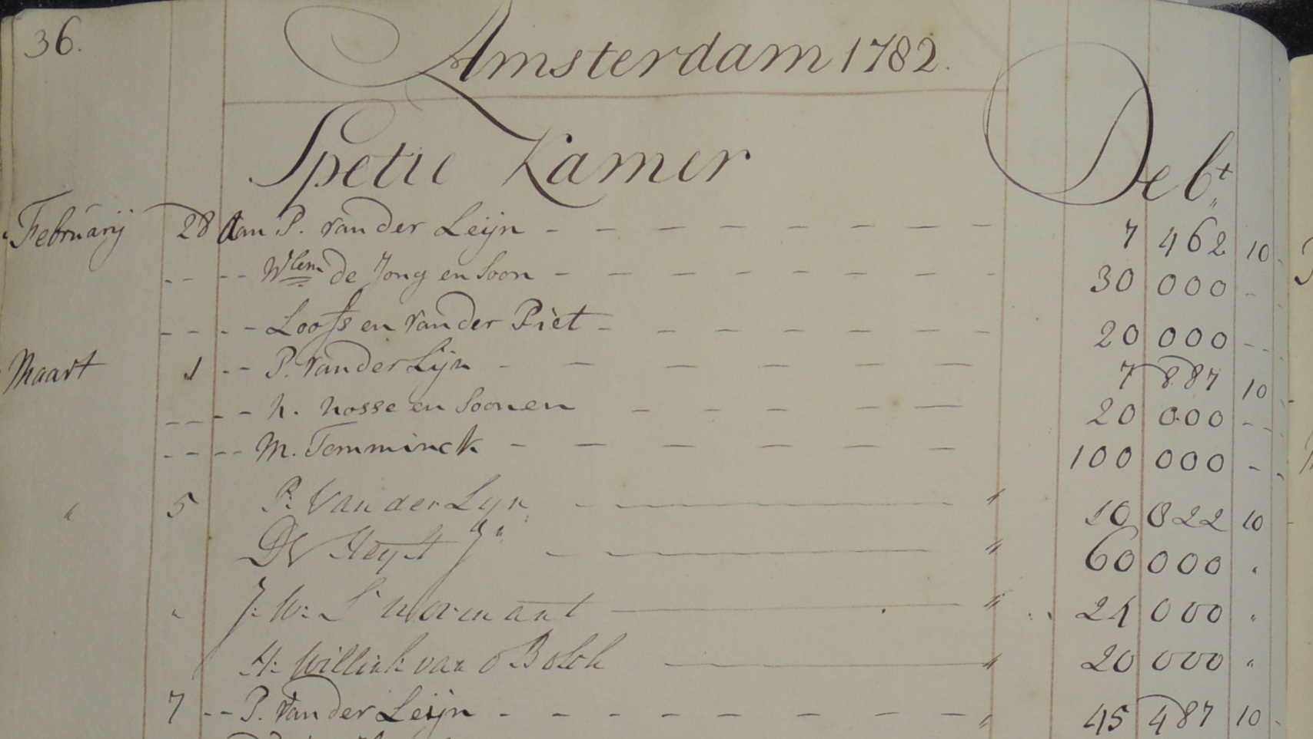
Liabilities: Account Ledgers

Slide 48
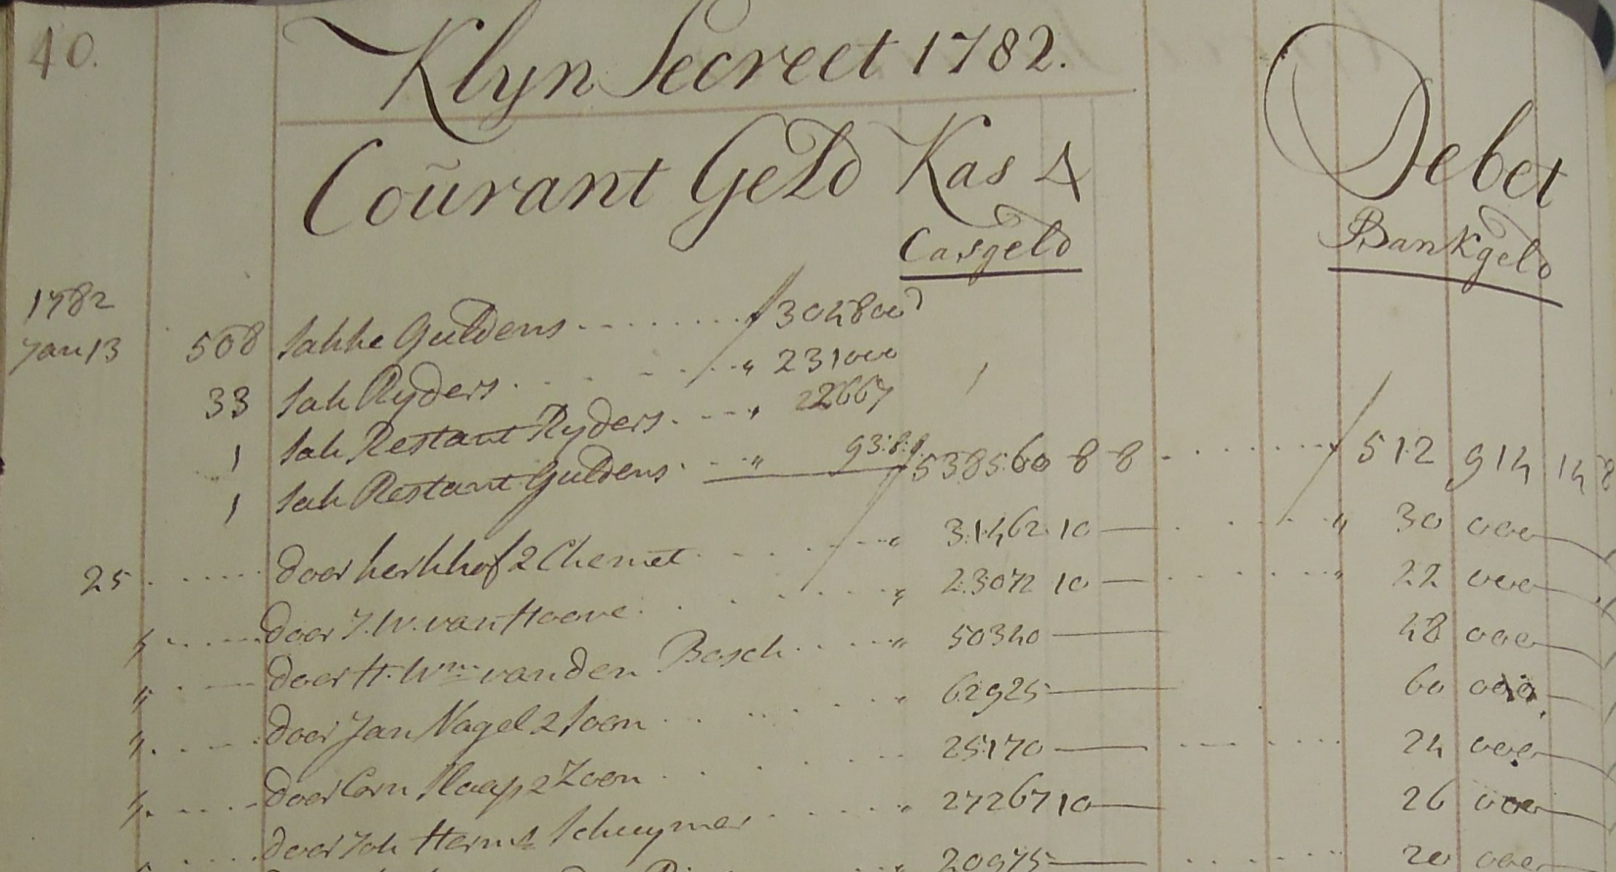
Metal Assets: Coin Books

Slide 49
Data Set
All changes in the Bank’s balance sheet
From January 1781 to January 1789
Aggregated to weekly observations.

Slide 50
Figure 4. Receipt Run

Slide 51
Figure 4. Add Open Market Purchases

Slide 52
Figure 4. Add the Agio

Slide 53
Figure 4. Add the Agio
Until January 1783

Slide 54
Figure 5. Open Market Purchase Rate

Slide 55
Crisis in Sequence
Large debts become non-performing.
This creates large negative capital.
Wholesale funding withdraws.
Coin purchases stabilize bank money.
Credibility of agio peg collapses

Slide 56
4. New Regime

Slide 57
Figure 6. Receipt Levels

Slide 58
Figure 7. Open Market Operations

Slide 59
Figure 8. Agio

Slide 60
Figure 8. Agio
Sales Rate at 3 percent

Slide 61
5. Conclusions

Slide 62
Conclusions
Quasi-fiscal lending gone bad pushed the Bank from technical insolvency to policy insolvency.
Markets ran from the receipt (repo) window.
The Bank lost its repo-based anchor on price level expectations.

Slide 63
Implications
Some modern central banks use a similar mix of facilities in a similar way: a conservative side (ECB main refinance) creates credibility that extends to a more aggressive side (ECB outright monetary transactions).
Extensive aggressiveness plus a large collateral shock can flip such a central bank into policy insolvency and jar market expectations.

Slide 64
Questions?

