Slide 1
The Failures that Ignited America’s Financial Panics: A Clinical Survey
Hugh Rockoff
Department of Economics
Rutgers University, 75 Hamilton Street
New Brunswick NJ 08901
Rockoff@econ.rutgers.edu

Slide 2
Bagehot on the origin of panics
“Such accidental events are of the most various nature: a bad harvest, an apprehension of foreign invasion, the sudden failure of a great firm which everybody trusted, and many other similar events, have all caused a sudden demand for cash”

Slide 3
Two approaches to panics
Inherent instability. Bagehot; Friedman and Schwartz; Diamond-Dybvig
Fundamental pressures. Schularick and Taylor, Calomiris and Gorton, Wesley Mitchell, etc.

Slide 4
“Systemically important banks”
A bank that could cause big trouble by failing
Identify by looking at financial connections?
What do the bank failures that precipitated panics in the past have in common?

Slide 5
Questions
Singletons or Multiples?
How were they regulated? Were they “shadow banks?”
Why did they fail?
What was there reputation before they failed?

Slide 6
Preliminary Answers
Singletons or multiples?
Multiples
How were they regulated? Were they “shadow banks?”
Shadow banks
Why did they fail?
Too many eggs in one basket, real estate
What was there reputation before they failed?
Wonderful!

Slide 7
Excluded panics.
Year | Reason for Exclusion
1730 | Colonial
1772 | Colonial
1792 | Mainly stock market??
1812 | War of 1812
1825 | Important in Europe; Seldom identified as a major U.S. panic
1833 | Contraction due to monetary policy
1860 | Civil War (South)
1861 | Civil War (National)
1878 | Confined mainly to building and loans??
1896 | Seldom mentioned by financial historians
1901 | Mainly a stock market panic
1914 | World War I
1920-21 | Contraction due to monetary policy
1937-38 | Contraction due to monetary and fiscal policy

Slide 8
Panics 1819-1857

Slide 9
Panics, 1873-1893

Slide 10
Panics 1907-2008

Slide 11
Panic of 1837
Hermann, Briggs and Company
New Orleans
Cotton Factor
J. L. and S. Josephs and Company
New York City
Bill brokers

Slide 12
Nathan Mayer Rothschild, 1777-1836

Slide 13
Reaction of the New York Herald to the failure of Josephs and Company
The astonishment created by this announcement could not have been greater if an earthquake had swallowed half the business district of our splendid city. As soon as it was known the news flew like lightening – people rubbed their eyes, and would scarcely believe the reality of the fact. Crowds collected in Wall Street – and that busy avenue was filled with anxious faces through the live long day.

Slide 14
The Herald on what nice guys they were
The Josephs and their partners were the favorites of the merchants of New York – their liberality – their aptitude for business – their gentlemanly behavior and their honorable conduct – their frank, unassuming manners – have made for them, in their days of prosperity, ‘troops of friends.’

Slide 15
Nicholas Biddle. He bet his bank on internal improvement bonds. … the Panic of 1839

Slide 16
Bank of the United States of Pennsylvania
Investment bank
Highly levered with short-term “post notes”
Cotton speculation
Investment in western internal improvement bonds (real estate at two removes)

Slide 17
1857 – the Ohio Life Insurance and Trust Company

Slide 18
Hugh McCulloch, Indiana banker – secretary of the Treasury on the Ohio Life
The intelligence was astounding. It was a bolt from a cloudless sky. The Ohio Life and Trust Company had enjoyed the highest credit. Its home business had been managed in the most careful manner. It had been distinguished for its conservatism. … Not a bill or note, no matter how small, was discounted without their approval. It had thus acquired a high reputation, and secured large deposits.

Slide 19
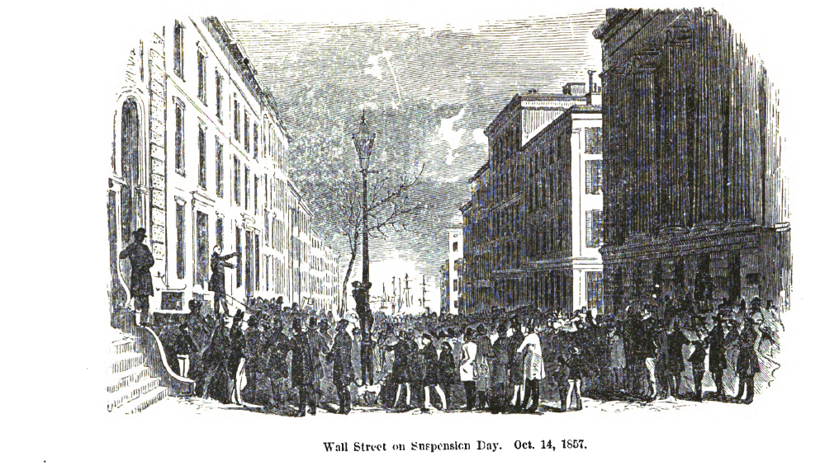

Slide 20
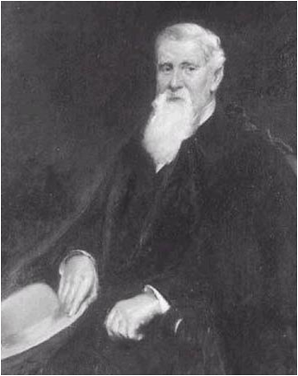
Jay Cooke. He bet his bank on the Northern Pacific Railroad. … The Panic of 1873

Slide 21
Reaction to the failure of Jay Cooke
“Like a thunderclap in a clear sky” said the Philadelphia Press. No one could have been more surprised said the Philadelphia Inquirer, if snow had fallen amid the sunshine of a summer noon” (Oberholtzer 1907, 423).

Slide 22
Jay Cooke and Company
Investment bank
Highly levered. Small deposits
Northern Pacific railroad (real estate at one remove)

Slide 23
Crisis of 1873
Notes:
Friedman and schwartz don’t have monthly data until 1907
Quarterly data, but there is a lot of interpolating going on

Slide 24
Ferdinand Ward Jr. The failure of Grant and Ward precipitated the Panic of 1884

Slide 25
Panic of 1884

Slide 26
Senator Mitchell lost heavily when the Wisconsin Marine and Fire Insurance Bank failed in 1893
Notes:
Father of Billy Mitchell

Slide 27
Wisconsin Marine and Fire Insurance Bank
Private Investment Bank
Highly regarded. “George Smith’s money”
Senator Mitchell becomes president, invests heavily in projects of Ferdinand Schlesinger

Slide 28
Loans to Ferdinand Schlesinger (“the man who wished to be the Napoleon of the Iron World”) helped bring down the Wisconsin Marine and Fire Insurance Bank

Slide 29
Crisis of 1893

Slide 30
The Rate of Unemployment after Panic of 1893 and the Panic of 2008

Slide 31
F. A. Heinze. His copper speculations led to the Panic of 1907

Slide 32
Crisis of 1907
Notes:
Switches to monthly data
More obvious in the deposit-currency ratio

Slide 33
Panic of 1930
Caldwell and Company, November
Investment bank
Highly levered with deposits from businesses and municipalities
Stocks of southern companies
“Morgan of the South”
Bank of United States, December
Levered with small deposits
Real estate, Bankus Corporation

Slide 34
Bernard K. Marcus on the way to the Tombs. He bet his bank on real estate … 1930

Slide 35
Crisis of 1930
Notes:
Caldwell and Company November

Slide 37
Richard S. Fuld, Jr. CEO of Lehman Brothers.

Slide 38
Table 2. Fortune Magazine’s list of America’s most admired securities firms
Rank | March 2006 | March 2007 | March 2008
1 | Merrill Lynch | Lehman Brothers Holdings | Goldman Sachs Group
2 | Lehman Brothers Holdings | Bear Stearns | Morgan Stanley
3 | Bear Stearns | Goldman Sachs Group | Lehman Brothers Holdings
4 | Goldman Sachs Group | Legg Mason | Charles Schwab
5 | Franklin Resources | Morgan Stanley | Legg Mason
6 | A.G. Edwards | A.G. Edwards | Franklin Resources
7 | Legg Mason | Merrill Lynch | AXA Financial
8 | AXA Financial | Franklin Resources | Bear Stearns
9 | Charles Schwab | AXA Financial | Merrill Lynch
10 | Morgan Stanley | E*TRADE Financial | E*TRADE Financial

