Slide 1
Some Issues in Early U.S. Monetary History
Peter L. Rousseau and Richard Sylla
Vanderbilt & NBER; NYU & NBER
Workshop on Monetary & Financial History, Atlanta Fed, June 24-27, 2013

Slide 2
U.S. monetary regimes to 1930s
Pre Constitution: mixture of specie and colonial/state/national fiat paper issues
1790-1861: specie monetary base and convertible (usually) bank notes and deposits
1862-1878: base of inconvertible Treasury currency (e.g., greenbacks), national bank notes (backed by Treasury bonds), and bank deposits convertible to inconvertible base
1879-1933: de facto and de jure gold standard (base is gold plus Treasury currency, national bank notes, and—after 1914—Federal Reserve notes and bank reserve deposits) with convertible national and state bank deposits

Slide 3
Asymmetric interpretations of post-1914 and 1791-1811, 1817-1836
As after 1914, the U.S. had two national/central (or ‘proto central’) banks in the earlier two periods, and like the Fed, they had branches throughout the country.
The usual interpretation of the 1790-1861 monetary regime treats the two Banks of the United States as ordinary banks, not central banks.
Is that a valid or a questionable interpretation?

Slide 4
Build-up to the Panic of 1792
Seton, cashier of the BONY, worried in Jan. letter to Hamilton in Philadelphia that NY speculators were borrowing from the newly opened BUS in Phila., placing both deposits and notes of the BUS in BONY, and then withdrawing (or trying to) the amounts in specie in an attempt to bring down BONY to further their own bank schemes.
After initially accepting some such deposits, BONY refused to accept more.
Hamilton replied: “Everybody here sees the propriety of your having refused the paper of the Bank of the United States in such a crisis in your affairs.”

Slide 5
1792 (ctd.)
In Feb., Seton was still worried because the BUS had a deposit of $176K in BONY that it might withdraw in specie, but also reported to Hamilton that BONY held $230K of BUS notes.
Hamilton replied: “You appear to me to mistake a point, which is, that…you will have to pay the Bank of the U States the amount of their deposit in specie. They certainly cannot make a difficulty about receiving their own notes. This idea I think you may safely proceed upon.”
Hamilton thus taught the state banks a lesson, probably an easy one once they had some experience: BUS notes were as good as specie in meeting demands on them by the BUS, which would be frequent because, as the US government’s bank, the BUS would often receive state bank notes in payments of taxes, etc., and then return them to the state banks for payment.
In other words, BUS notes were base money or “high powered money.” Since deposits at the BUS could easily be converted to BUS notes, perhaps BUS deposits could also be considered base money.

Slide 6
Early banks did not ignore Hamilton’s lesson
But many subsequent scholars have done that.
Exception 1: Jack Rutner in a U. of Chicago Ph.D. thesis (1974), “Money in the Antebellum Economy”: “One of the more interesting results to emerge from the new monetary estimates is…that the pre-1843 determinants should properly include as components of high-powered money monetary obligations of the [second] Bank of the United States” (p. 4).
Exception 2: Lawrence Officer (EEH, 2002): “Bank [of US] note and deposit assets were considered by the state banks as part of reserves.”
But Peter Temin in his influential book, The Jacksonian Economy (1969), treated the second BUS as an ordinary bank like the many state banks.
There are, however, some oddities in Temin’s monetary data compiled on that assumption. Note especially the low, single-digit “currency ratios” of the early 1830s. Engerman (1970) commented on this expression of “confidence” in the banking system and the “social savings” of the second BUS under Biddle.

Slide 7
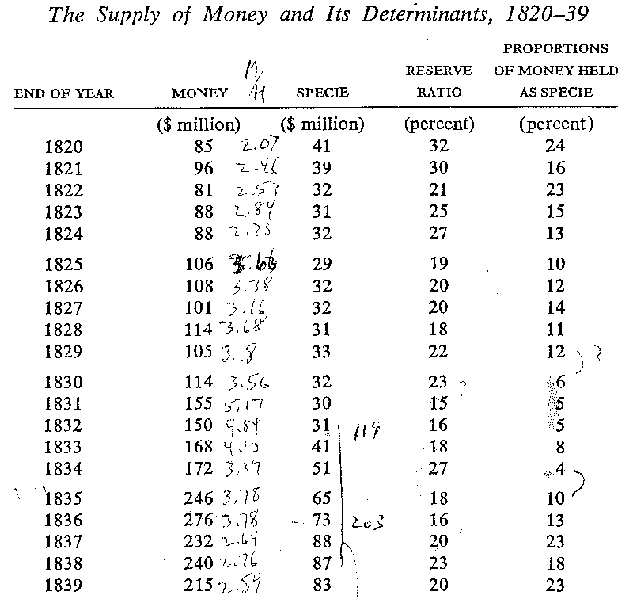
Temin’s Jacksonian Economy monetary data

Slide 8
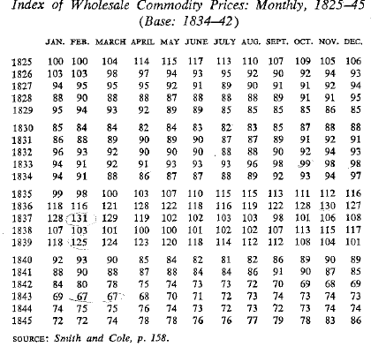

Slide 9
Money multipliers with variants of the monetary base
Specie is base
Specie plus BUS notes (less BUS specie) constitute base (hpm1)
Specie plus BUS liabilities (notes and deposits less specie holdings) are base (hpm2)

Slide 10
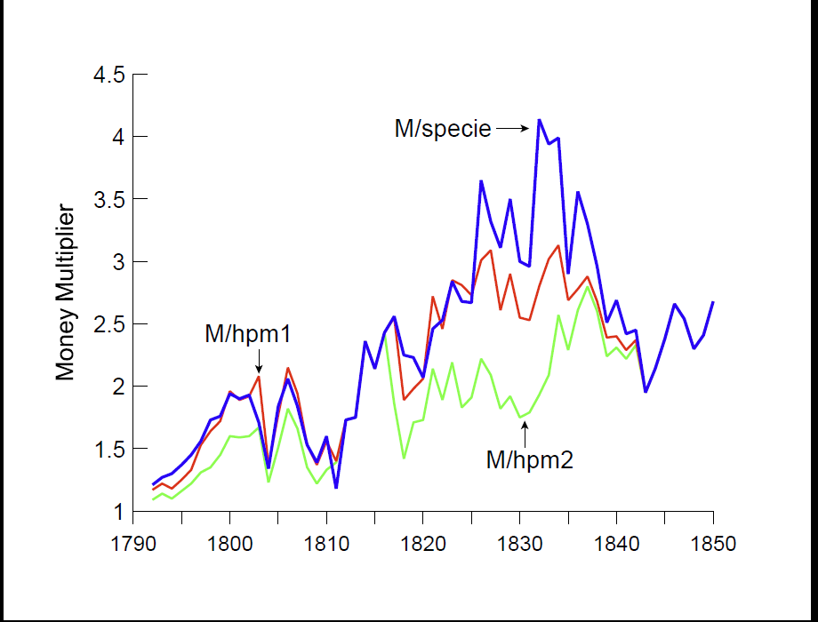

Slide 11
Standard deviations of the three detrended money-multiplier series:
M/specie 0.551
M/hpm1 0.377
M/hpm2 0.249

Slide 12
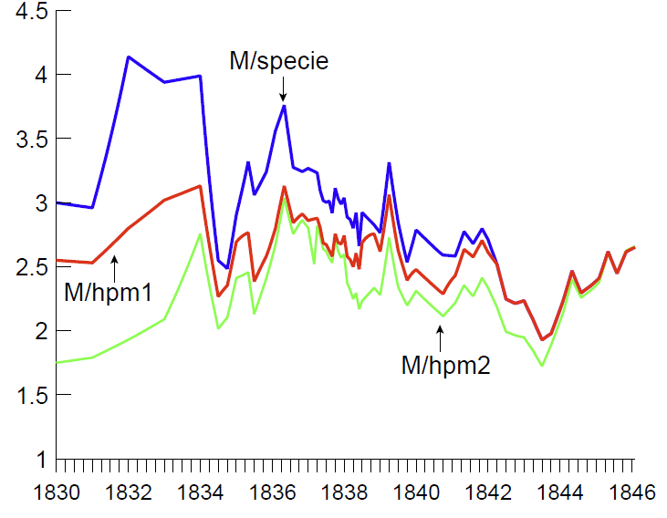
Closer look at 1830s

Slide 13
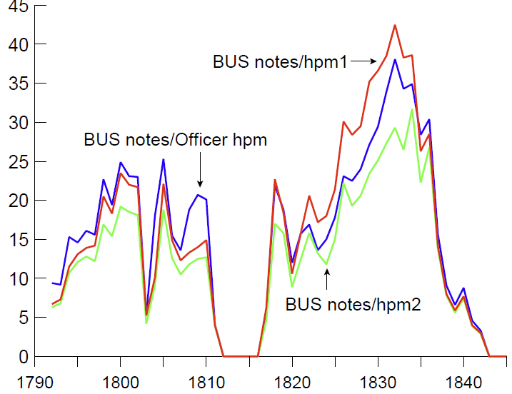
BUS-note proportion of base(s)

Slide 14
Observations
First BUS notes were 10-25% of the various monetary bases for most of its 1791-1811 existence, and go to zero in 1811.
Second BUS notes were 15-40+% of the bases for much of its 1816-1836 existence. The proportion peaks around the time of Jackson’s veto, then begins a steep decline, especially after the federal charter ends in 1836.

Slide 15
Implications?
If first and second BUS notes/liabilities were base money, what were the financial and economic effects of their advents, careers, and disappearances?
After it opened, the first BUS’s balance-sheet expansion and contraction contributed to the bubble and panic of early 1792 (Cowen 2000; Sylla, Wright, and Cowen 2009).
Liquidation of the first BUS during and after 1811 is associated with a doubling in the numbers and authorized capital of state banks from 1810 to 1814. Effects?

Slide 16
Implications? (ctd)
Second BUS’s first years were problematic and featured the 1819 panic, which later created difficulties for it with the Jacksonians. Why?
Officer’s base falls in 1832, the veto year, then rises 1833-35 (specie inflows?). It is essentially flat 1836-1841, except for a spike in 1838 (cause of that spike?). How does this relate to the panic of 1837 (Rousseau 2002) and financial turbulence of 1839-1842?
Winding down of second BUS as federal bank led to more state-chartered banking in early 1830s (Knodell 2006), just as ending of first BUS did in 1811-1814.

Slide 17
Agenda
Treating the first and second BUS’s as central banks, some or all of the liabilities of which were base money, calls for new estimates of the money stock and its determinants, 1790s-1840s (and to 1860s) that build upon estimates in Rousseau and Sylla (2005).
An ambitious goal would be to have a monetary history of the US, 1790-1860, to complement that of Friedman and Schwartz for the next century of US history.

