Slide 1
Bloody Foreigners! Overseas Equity on the London Stock Exchange, 1870-1913
Richard S. Grossman
Workshop on Monetary and Financial History
Federal Reserve Bank of Atlanta/Emory University
June 26, 2013

Slide 2
Objective
New indices on overseas equity traded on British stock exchanges (primarily, but not exclusively, London)
  Quantity
  Returns, capital gains, and dividends

Slide 3
Available data
Existing indices
  Barclays de Zoete Wedd: 30 blue chips from 1919
  LCES: 20 “companies that had been important in 1913” from 1923
  Bowley, Schwartz, and Smith (reconstituite LCES for 1924-31, using 72 securities)
  Smith and Horne (monthly, 1867-1914, 25-77 industrial securities)

Slide 4
Drawbacks of Smith and Horne
Small sample, 25-77 securities
Industrial, so no observations on banks, discount companies, insurance companies, or railways
No dividends, so total returns not available
No sensible weighting scheme

Slide 5
Subsequent improvements
Edelstein’s (1976, 1982) index of home and foreign investments (90-150 securities of many types) between 1870 and WW1
Grossman’s (2002) annual indices based on 520-1150 equity securities

Slide 6
Motivation
Explain slowdown in Victorian growth
  Investment was low in UK relative to US, Germany and capital outflow was substantial
  Was it more costly to raise capital in London?
  Was London better at channeling capital overseas than directing toward domestic industry?
  Or, were investors just seeking diversification

Slide 7
Literature
Goetzmann and Ukhov (2006) use Edelstein’s data
Chabot and Kurz (2010) collect 500,000 observations on US and UK stocks and bonds (4000 total)
Both find that overseas investment was attractive because of higher returns and greater diversification

Slide 8
Motivation, con’t
Finance issues
  Dividend policy, Merton and Modigliani (1961), Black (1976)
  Debt vs. equity returns, Mehra and Prescott (1985)
  Home bias, French and Poterba (1991)
  Contingent liability, Jefferys (1938 [1977]; (1946), Kashyap, Rajan, and Stein (2008), Flannery (2009), and Grossman and Imai (2011)

Slide 9
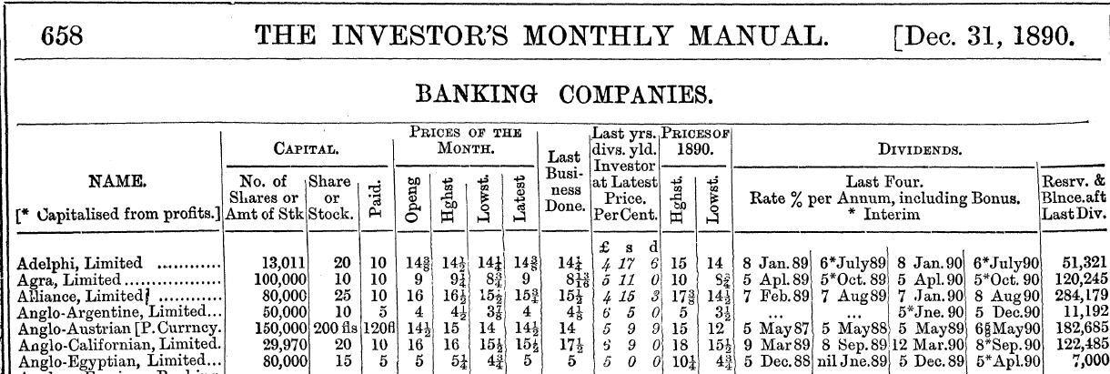
Data and Methodology
Terminology
Number of shares
Amount
Paid (par)
Dividends

Slide 10
Calculating returns
Capital gain_{t} = (P_{t}- P_{t-1})/P_{t-1}
Dividend yield_{t} = (Dividend_{t} * Par_{t})/ P_{t-1}
Total return = capital gain + yield

Slide 11
Problems
Distinguishing debt from equity
  What does the word “stock” actually mean in Britain
Types of securities
Foreign currencies
Dates of dividends
Par changes
Missing data

Slide 12
Data set
39,240 security-year observations
2913 securities
2588 firms

Slide 13
What constitutes overseas equity?
Where it conducted business vs. where it was registered/headquartered
South African gold mine
Indian tea plantation
Railroad from Chile to Peru
Canadian and US land companies
Shipping/cable companies
Not categorized (2%)

Slide 15
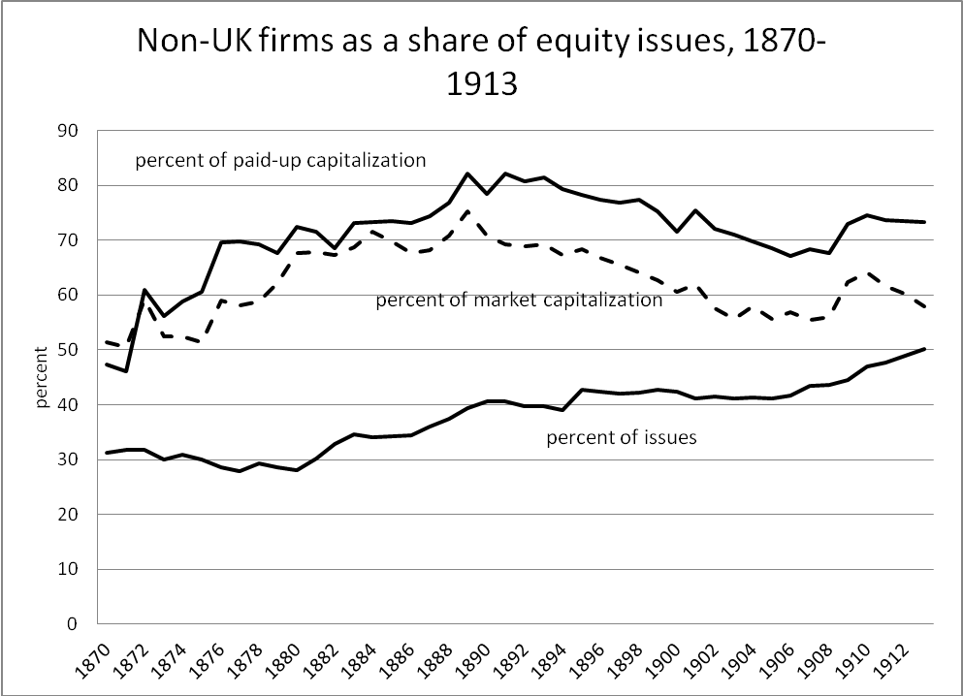

Slide 16
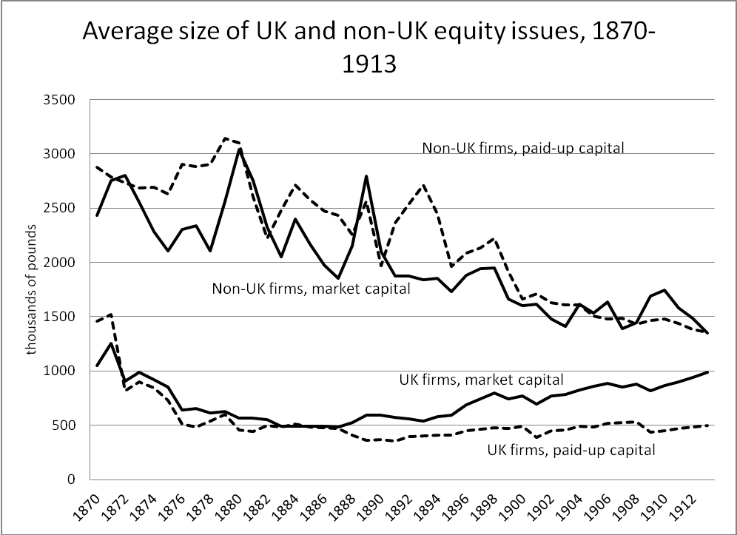

Slide 17
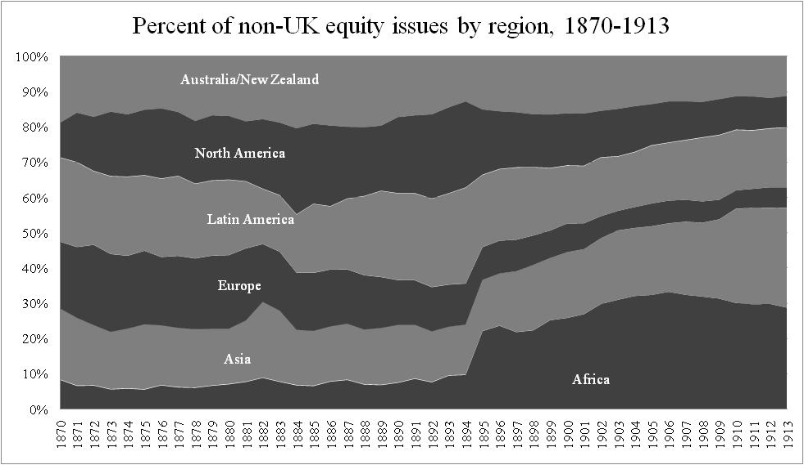

Slide 18
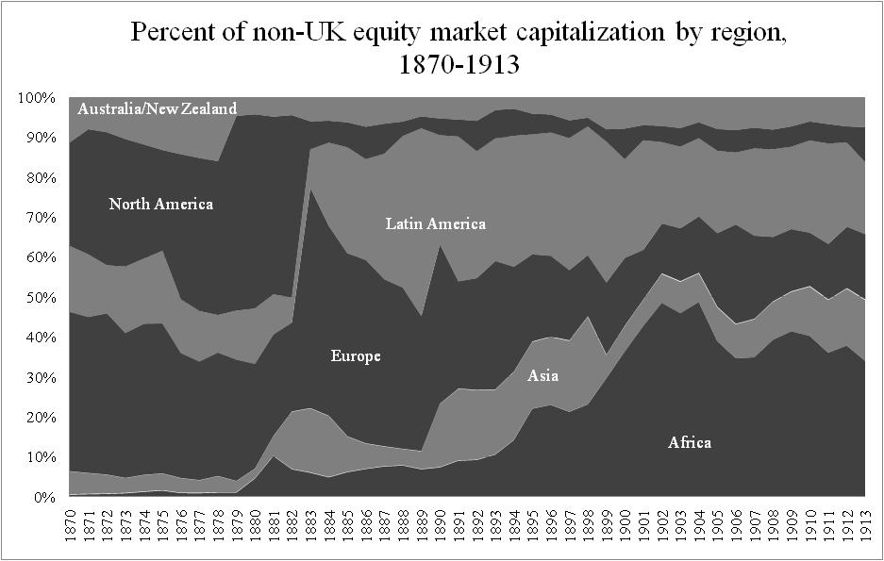

Slide 20
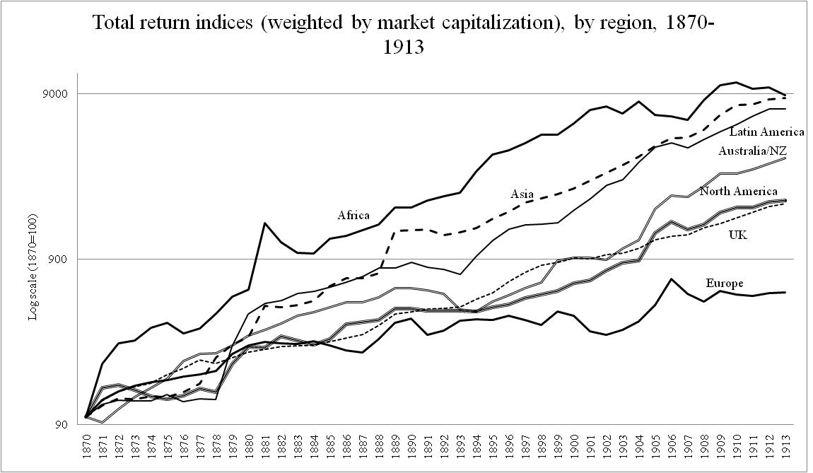

Slide 22
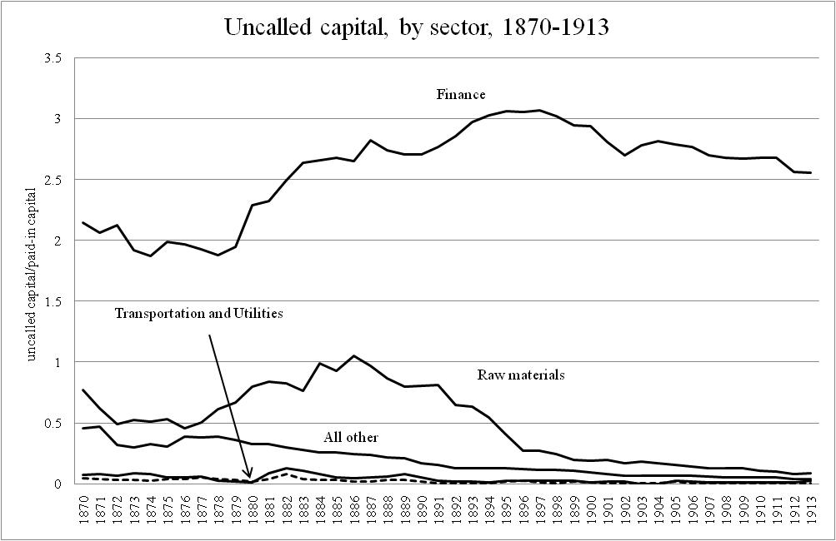

Slide 23
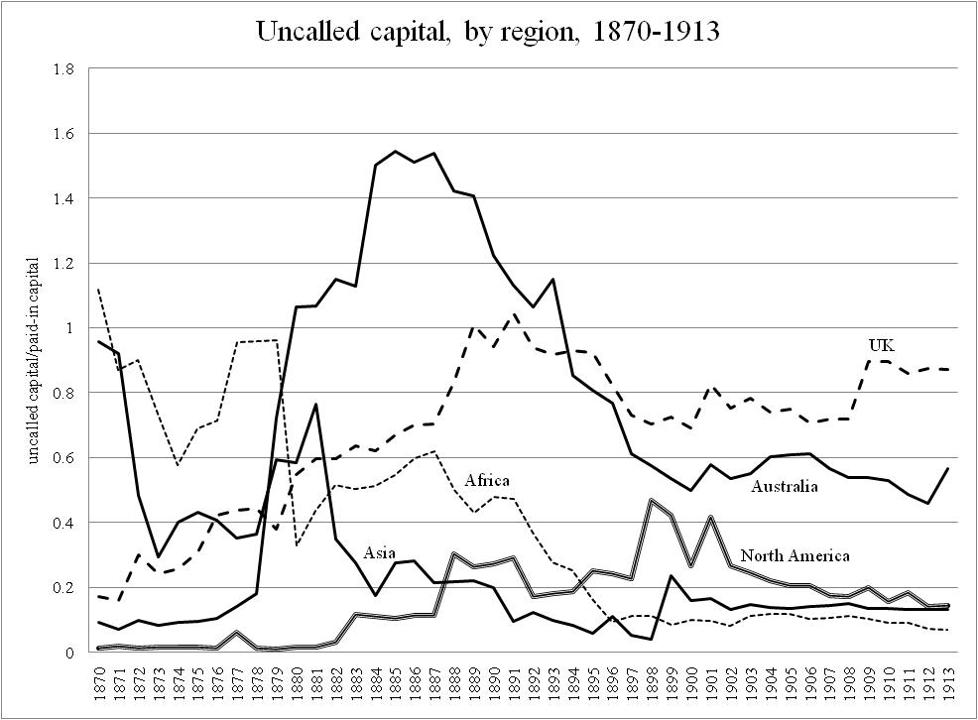

Slide 29
Conclusions
Developed markets had lower returns and volatility
  Australia exception
Similar dividend yields across regions, with differences in total return coming from capital gains
Higher correlations among developed regions and between developed regions and colonies
Raw materials highest returning, utilities lowest
Contingent capital used when leverage was high and/or assets less accessible to creditors

Slide 30
Improving the data
Extending the data to 1929, using Yale ICF data
Including foreign currency issues
Including “stock”s

