Slide 1

The Future of Banks:
Market, Regulatory, and Technological Challenges
Randall S. Kroszner
Norman R. Bobins Professor of Economics
University of Chicago, Booth School of Business, and NBER
Prepared for the Federal Reserve Bank of Atlanta conference
“Central Banking in the Shadows: Monetary Policy and
Financial Stability Postcrisis”

Slide 2
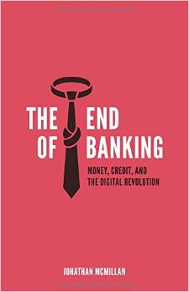
Commercial Banking: R.I.P. ?

Slide 3
Banking is Dead, Long Live Banking?
“The banking industry is becoming irrelevant economically, and it’s almost irrelevant politically”
William Isaac, former chairman of the Federal Deposit Insurance
“The major problems faced by the banking industry, most notably its eroding competitive positions in the financial community and the crushing burden of regulation”
Carter Golembe, dean of bank consultants
“The universal banking model is dead”
  Antony Jenkins, Barclays Chief Executive
➔ The obituary for some banks may be a bit premature but perhaps not all Banks….

Slide 4

“Ernie Banks, legendary 'Mr. Cub,' dead at 83”
Chicago Tribune, Jan 24 2015

Slide 5
Focus on Impact of Technology and Regulation
1) Examine longer term and post-crisis trends
  Entry, Competition with Shadow Banks, Economies of Scale and Scope
2) Impact of banking and finance on growth
  Framework needed for trade-offs in policy making
3) Are banks still “special”? Roles of Tech and Reg
  Banks as liquidity providers and transformers
  Banks as info processors, monitors – “soft” info
  Role of innovations in payments/digital currencies
    ➔ Impact on “banking channel” of monetary policy
4) Focus on some specific business lines
5) Conclude: Banking as tech/data analytics

Slide 6
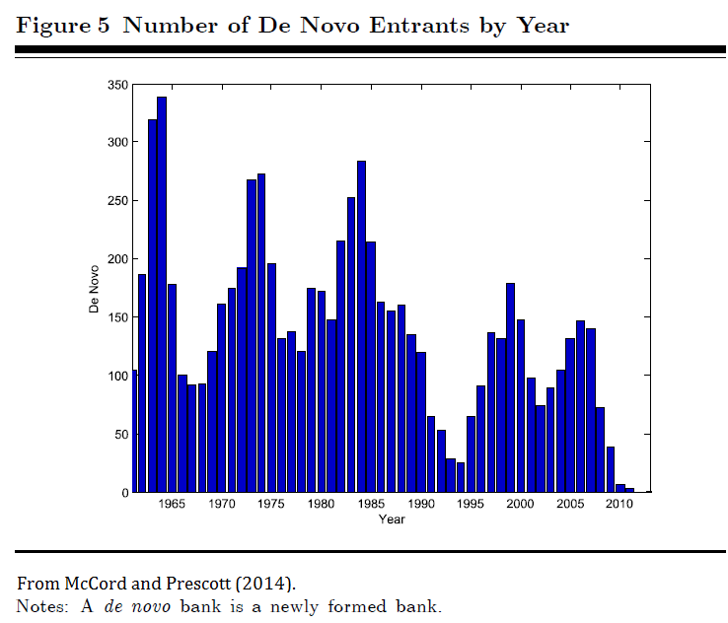
New bank entry following the crisis is nearly non-existent

Slide 7

Impact of Regulation and Technology? Bank of Bird-in-Hand, the only new bank to open in the U.S. since 2010, when Dodd-Frank was passed, doesn’t offer online banking, but its sole branch does have a drive-through window that can accommodate a horse and buggy (WSJ).

Slide 8
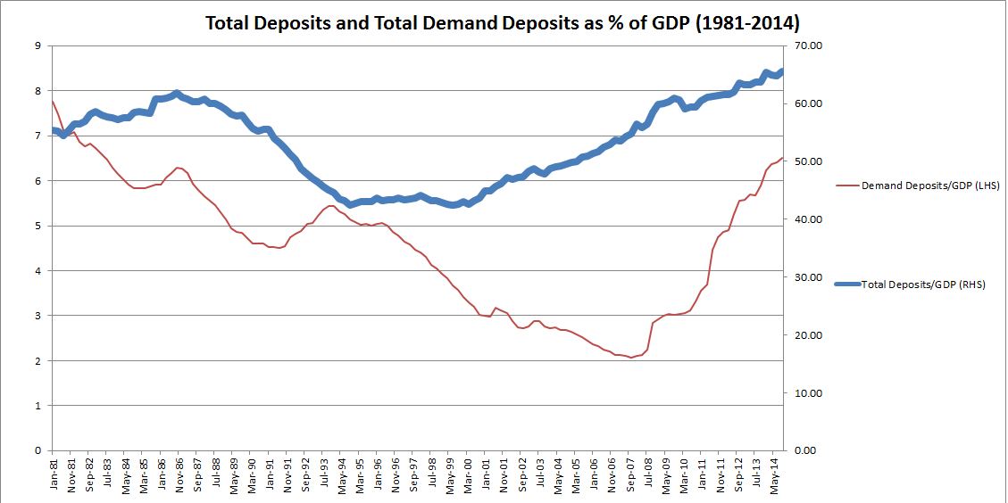
Total Deposits/GDP Rising in the US

Slide 9
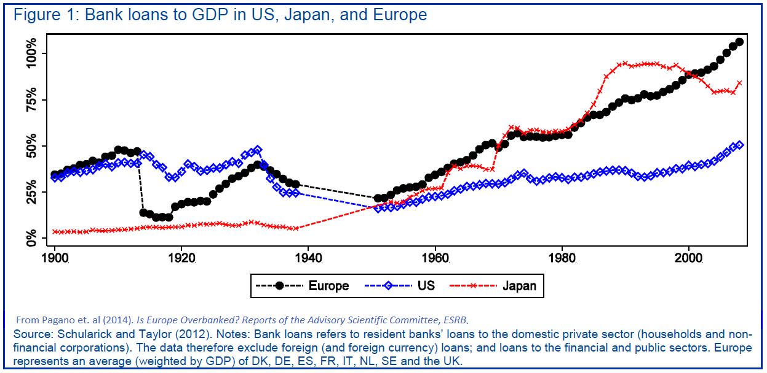
Bank Loans are rising relative to GDP globally

Slide 10
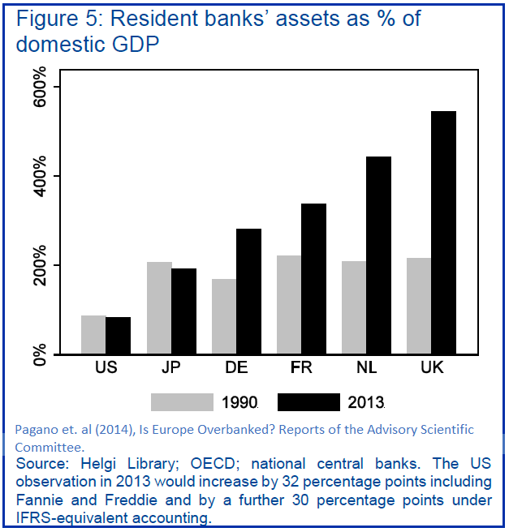
Since 1990, Bank Assets/GDP have been flat in US and Japan but have risen in Europe

Slide 11
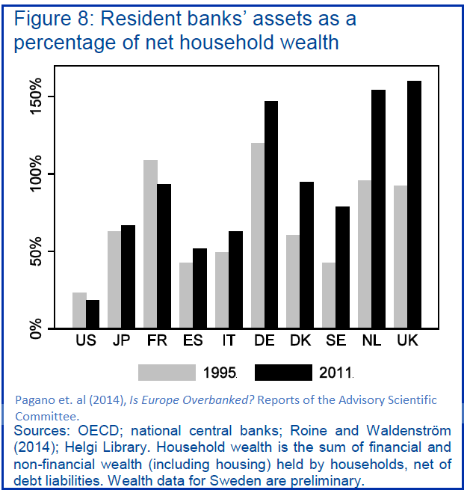
Relative to Household Wealth, Bank Assets have declined in the US but have mostly risen elsewhere

Slide 12
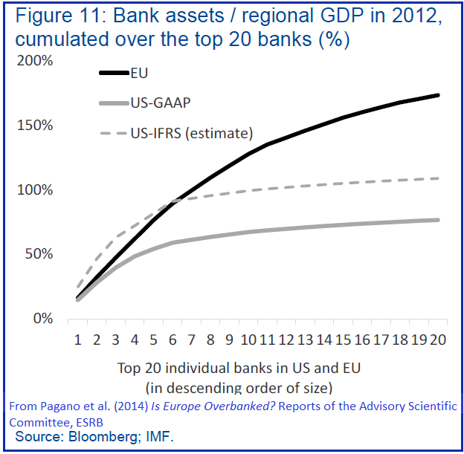
Bank Concentration is similar in the US and EU for the top 5 banks but not for top 20

Slide 13
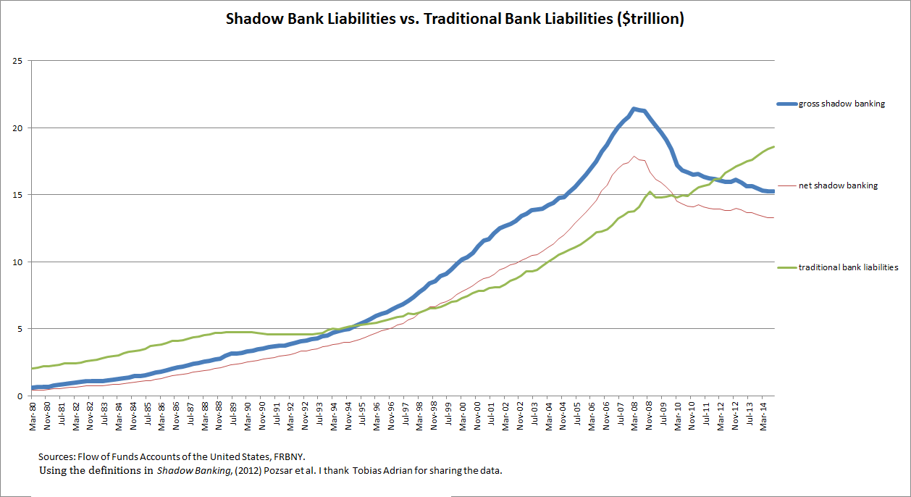
Since the crisis, Shadow Banking Liabilities down and Traditional Bank Liabilities up

Slide 14
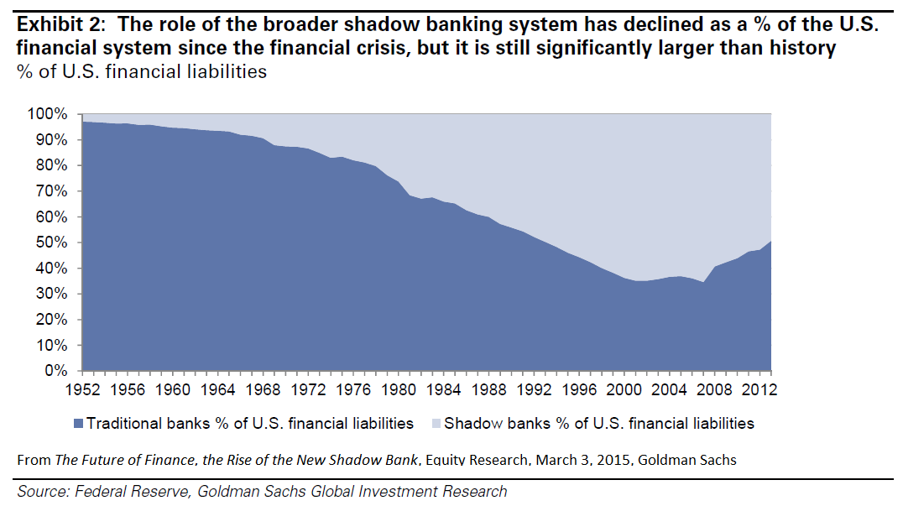
Using a somewhat different definition, market analysts report similar results

Slide 15
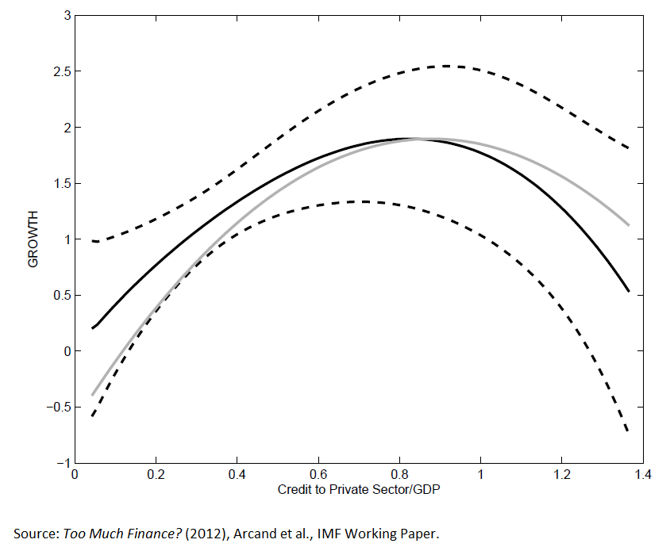
Can there be “too much” finance? Estimates of growth impacts of different levels of financial depth

Slide 16
Are banks still “special”? Reg and Tech
Banks role in liquidity transformation and provision
  Regulation: Liquidity and Capital reqs. Market making?
Banks role as information processors, credit analyzers, capital allocators, and monitors
  Technology: Is there any “soft” information left?
Commercial and central banks role in money creation
  Reg and Tech: Potential for digital currencies?
Implications for the “banking channel” of monetary policy
  Evidence suggests that “big data” has not (yet?) eliminated the “special” role of banks

Slide 17
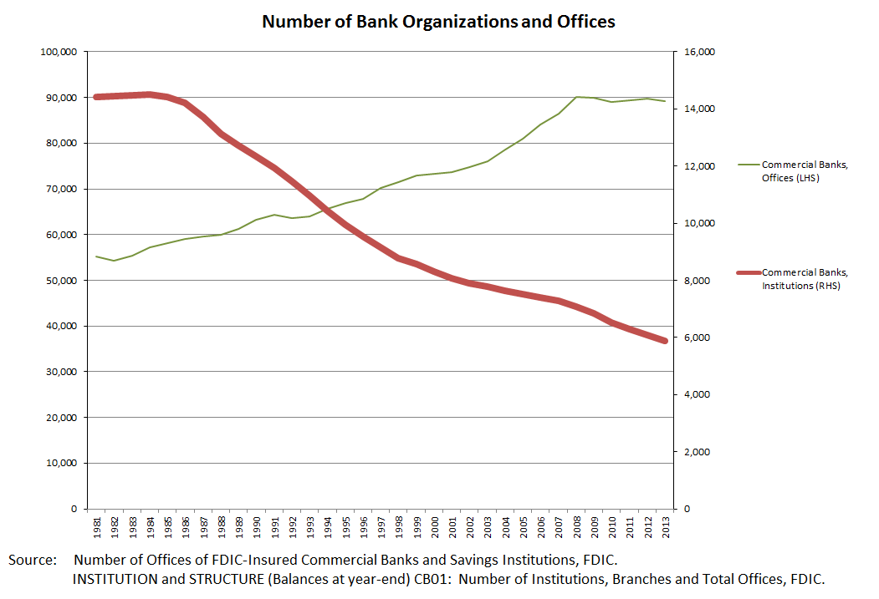
While the number of banks has plunged, bank offices have grown: Continuing importance of liquidity transformation and value of “soft” local information?

Slide 18
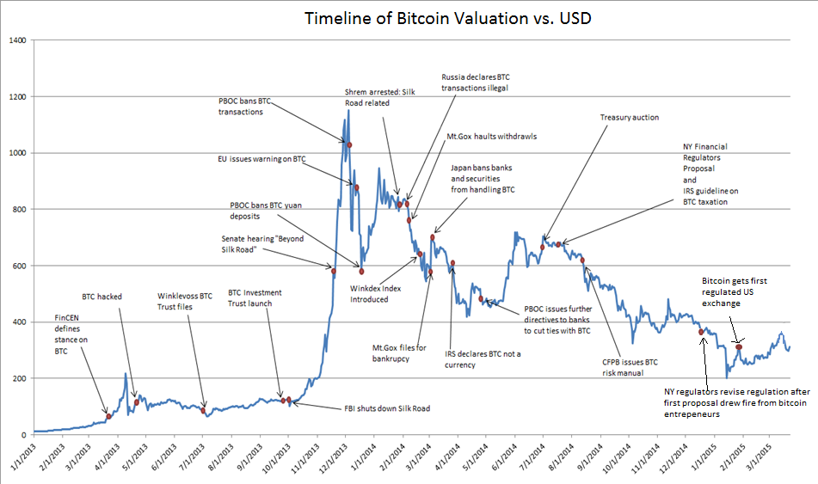
Impact of Market Events and Regulation on the Value of Bitcoin

Slide 19
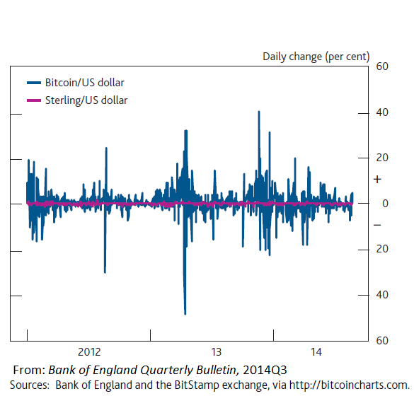
Bitcoin is Volatile as a Store of Value

Slide 20
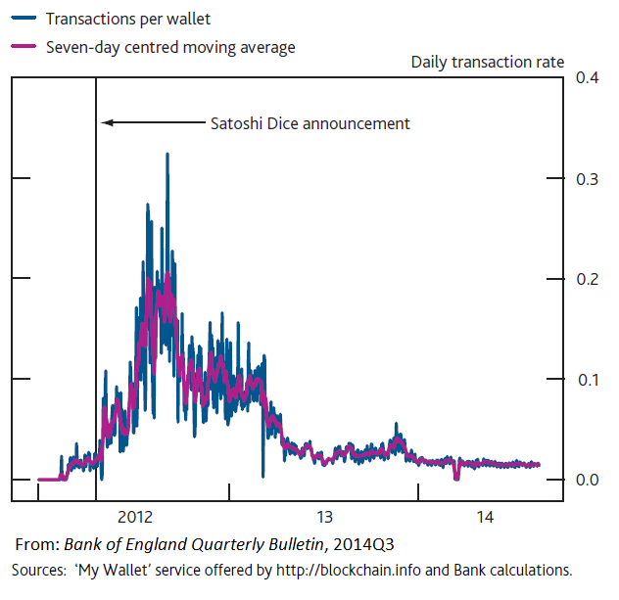
Bitcoin has not (yet) taken off as a Medium of Exchange

Slide 21
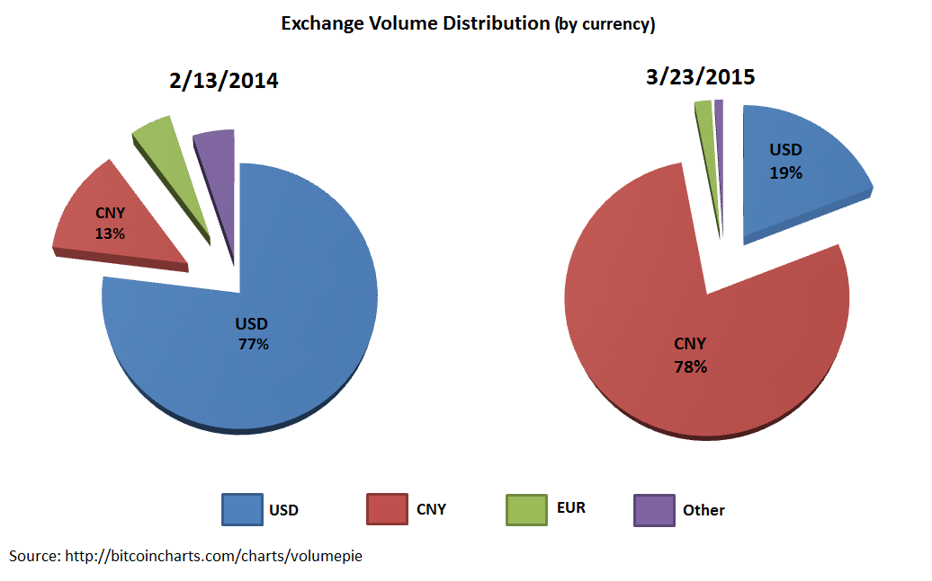
Bitcoin has evolved to be primarily a vehicle for transferring funds out of Renminbi, despite the PBOC

Slide 22
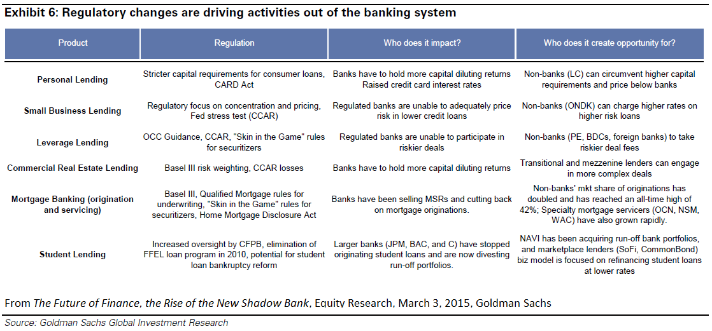
Regulatory changes are increasing the opportunities for non-bank competitors in a number of markets

Slide 23
Conclusions and Speculations
We may be at a “defining moment” for both commercial banks and central banks
Disruptive innovation and dyspeptic regulators will hold the keys to the future
Importance of a framework for considering cost-benefit trade-offs
Evidence suggests banks are still “special”
  → But for how long?
Regulators and central banks will need to be aware of risks but also embrace technological advances
Future of banks may depend on acting as technology -data analytics firms in financial services rather than financial services firms using technology/“big data”

Slide 24
Gross, Net Shadow Banking, 2008-2014
 | Peak Shadow Banking (March 2008), Bil $ | Most Recent (Sept 2014), Bil $ | Percentage Change
Money Market Mutual Funds: Shares Outstanding [Liabilities] | 3382.5 | 2565.3 | -24.1
All Sectors: Liabilities: Open-Market Paper | 1784.6 | 996.1 | -44.1
GSEs: Liabilities; Agency & GSE-backed Securities | 2938.1 | 6186.1 | 110.5
Mortgage Pools: Assets: Mortgages | 4602.2 | 1623.6 | -64.7
Asset-Backed Security Issuers: Total Financial Liabilities | 4459.4 | 1396.4 | -68.6
All Sectors: Liability: Fed Funds & Security Repurchase Agreements | 4310.0 | 2907.4 | -32.5
Monetary Authority: Liabilities: Security RPs | 44.1 | 410.1 | 829.9
Total Gross Shadow Banking | 21521.0 | 16085.4 | -25.2
Total Net Shadow Banking | 17949.2 | 14125.2 | -21.3

Slide 25
Traditional Banking, 2008-2014
 | Peak Shadow Banking (March 2008), Bil $, | Most Recent (Sept 2014), Bil $ | Percentage Change
U.S. Charted Depository Institutions (Ex. Credit Unions) Total Liabilities | 11148.8 | 14272.0 | 28.0
Foreign Banking Offices in U.S. | 1383.7 | 2108.0 | 52.3
Banks in U.S. Affiliated Areas, Total Liabilities | 94.1 | 87.5 | -6.9
Bank Holding Companies, Total Liabilities | 1078.0 | 2102.5 | 95.0
Total Traditional Banking | 13704.8 | 18570.2 | 35.5

