Slide 1
“The Macroeconomics of Shadow Banking” by Alan Moreira and Alexi Savov
Discussion by Fabio M Natalucci
Board of Governors of the Federal Reserve System
Federal Reserve Bank of Atlanta 2015 Financial Markets Conference
Central Banking in the Shadows: Monetary Policy and Financial Stability Postcrisis
The views expressed here are solely the responsibility of the author and should not be interpreted as reflecting the views of the Board of Governors of the Federal Reserve System or its staff.

Slide 2
Main Question
Is shadow banking an optimal outcome?
Previous literature has emphasized
  Shortage of entrepreneurial or financial intermediary net worth and the role of leverage in magnifying and propagating shocks
  Regulatory arbitrage as a driver of shadow banking growth
This paper focuses on liquidity transformation
  Shadow banking is the process of issuing liquid securities against risky assets
  Shadow money is liquid only in normal times (not crash proof, illiquid at times of crashes)

Slide 3
The Elements of the Story
Shadow banking is optimal
  Households demand liquidity to insure against liquidity events
  Liquidity provision is constrained by collateral
  While money-like securities require enough collateral to remain liquid at all times, shadow money is cheaper to produce as it uses collateral when it is abundant
  Shadow banking allows for greater liquidity creation for each dollar of available collateral
When uncertainty is low, increased liquidity supply results in a crowding out of money, greater savings, higher prices, investment, and growth

Slide 4
The Elements of the Story (cont’d)
But booms in liquidity and economic activity lead to a buildup in economic fragility
  When uncertainty increases, households demand crash-proof liquidity
  Financial intermediaries reduce supply of overall liquidity to meet demand for collateral-intensive money
  Collateral premiums rise, asset price fall, investment and economic activity contract
  Endogenous collateral runs (or margin spirals) reinforce the downturn

Slide 5
Outline of the Discussion
A few thoughts on the assumptions and the policy implications of the paper
  Ex-ante vs. ex-post liquidity
  Equity issuance is not costless in the midst of a crisis
    Collateral runs vs. runs on financial institutions
  Externalities created by the shadow banking sector
    What would a central planner do?
  Monetary policy and regulatory initiatives in this framework
The regulatory effort since the financial crisis
  Focus on liquidity risk

Slide 6
Ex-ante vs. Ex-post Liquidity
In the model, households use liquid securities to insure against liquidity events but they are aware ex-ante that shadow money ceases to be liquid in a crash:
L(t) = m(t) +s(t) [1-dJ(t)]
Pre-crisis, however, shadow banking referred to the creation of ex-ante seemingly safe, seemingly liquid financial instruments (Tarullo 2012)
  Surge in demand for safe, liquid assets for precautionary or transactional purposes
  Met by shadow banking-driven creation of assets thought to be safe and liquid

Slide 7
Ex-ante vs. Ex-post Liquidity cont’d
But tail risk associated with shadow banking instruments had not been understood and internalized by either buyers nor sellers
There was a widespread belief that risk-free assets could be created by augmenting an already seemingly safe asset with a promise by a financial institution to provide liquidity or bear credit losses
  Contractual provisions (e.g., ABCP)
  Implicit support (e.g., MMFs, triparty repo market, sec lenders)
When investors questioned the credibility of that promise, and thus the apparent safety and liquidity of those instruments, the financial system became suddenly vulnerable to runs

Slide 8
Equity Issuance is not Costless in a Crisis
In the model, financial intermediaries can issue equity at no cost
  Any discrepancy between assets and the value of existing equity, shadow- money and money is always made up by issuing new equity
In reality, financial institutions are rarely able to issue equity during a crisis
  Strains emerge in short-term funding markets
  Eventually investors “see through the collateral” and repo run turns into fully fledged runs on financial institutions
By contrast, the model predicts that “the price of A (risky) capital is always higher with shadow banking than without because prices capitalize the lower funding costs in a shadow banking-driven boom. The possibility of future booms leads to less severe downturns.”
  This seems to the result of the assumption that financial institutions do not fail

Slide 9
Externalities Created by the Shadow Banking
In the model, shadow banking is optimal
However, the economic boom driven by increased shadow banking liquidity is associated with a buildup in economic fragility
Many models (e.g., Stein (2013)) show that economic agents do not internalize the externalities from collateral constraints
  Fraction of asset lost in a crash Kappa A (t)
What would be the social planner’s optimal mix of traditional vs. shadow banking intermediation?
Should a central bank use its balance sheet and monetary policy framework to affect the mix of public/private short-term, safe assets available to investors?
  See Carlson et al. (2014)

Slide 10
Monetary Policy and Regulatory Initiatives
The paper focuses on competitive equilibrium where shadow banking is optimal
We don’t really know whether there is any reason for policy intervention without a welfare function and welfare analysis
So I will discuss the implications of monetary policy and regulatory initiatives in the paper with this caveat in mind
We can think of policy intervention as an exercise in comparative statics
  The policies considered are designed as a change in a particular parameter of the model

Slide 11
Monetary Policy and Regulatory Initiatives (cont’d)
LSAPs
  In the model, asset purchases are interpreted as replacing risky capital A with safe capital B
    LSAPs push up the price of risky capital and down the price of safe capital
    Because of additional available collateral, liquidity provision increases, boosting asset prices and investment
  In reality, the Federal Reserve purchased longer-term government securities in exchange for reserves to put downward pressure on long-term rates
    Portfolio balance channel
    Investors reach out the duration and credit curve --> prices of both safe and risky assets rise (yields decline)
    LSAPs as implemented in the model resemble more facilities like PDCF set up during the crisis

Slide 12
Monetary Policy and Regulatory Initiatives (cont’d)
MEP
  In the model, OT reduces the duration of safe assets on the intermediary’s balance sheet
    Central bank buys long-term bonds and sells floating-rate bonds
    Because floating-rate bonds cannot act as a hedge (they always trade at par), price of risky capital declines
    As a result, contrary to LSAP in the model, OT reduces total collateral available
  In reality, MEP was designed to have an effect similar to LSAP
    Purchases of longer-term government securities were financed with sales of short-term government securities
    Difference is that Federal Reserve balance sheet was unchanged in size

Slide 13
Monetary Policy and Regulatory Initiatives (cont’d)
Liquidity requirements
  Liquidity regulation is introduced as an upper bound on the issuance of total liquid securities (money and shadow money) in order to limit liquidity mismatches with illiquid assets
  But the definition of liquidity regulation seems at odds with LCR and NSFR
    LCR = (stock of HQLA / total net cash outflows over 30 days) > 100%
    NSFR = (ASF / RSF) >100%
Volcker rule
  Interpreted as a mandatory segregation of safe and risky assets, it reduces liquidity provision by preventing asset pooling
  How would the result change if the high costs of financial crisis are explicitly accounted for in welfare analysis?
SLR
  Would a leverage ratio have any impact in this framework?
  Likely not if equity is costless…

Slide 14
In Sum
Very elegant, thought provoking paper
The model has many potentially testable predictions (e.g., equity premium or safety premium that evolves with uncertainty)
  It would be nice to see these empirical results

Slide 15
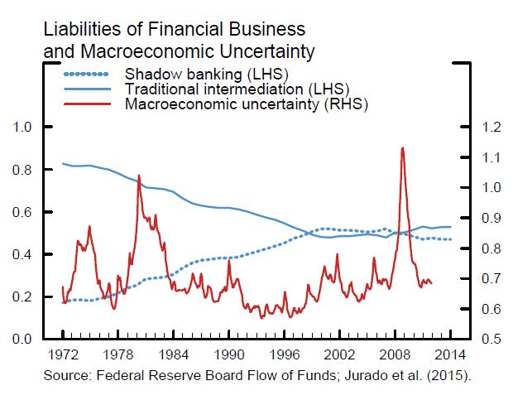
Shadow Banking and Uncertainty

Slide 16
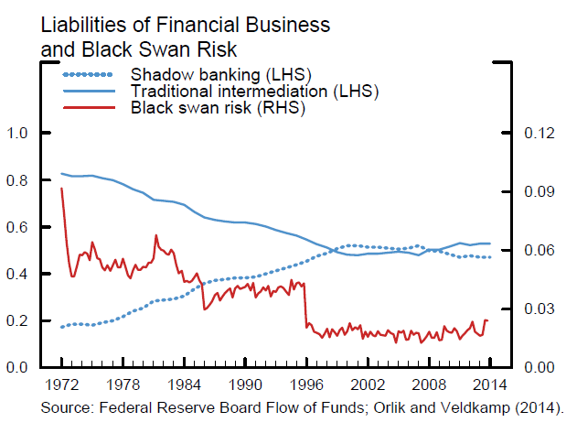
Shadow Banking and Crash Risk

Slide 17
Concluding
We need to think harder about socially optimal mix of intermediation
  More broadly, about the balance between financial stability and growth
Finally, further analysis seems appropriate to better assess the interaction between policy actions and liquidity transformation activities

Slide 18
The Regulatory Effort Since the Crisis
A brief tour of the regulatory effort since the financial crisis (Powell 2015)
  Financial institutions: a stronger core of the financial system
    Higher levels of higher quality capital (risk-based ratios and SLR)
    Liquidity regulation (LCR, NSFR, liquidity stress testing)
    Forward-looking, dynamic capital stress testing
    FSB work on margin rules for SFTs
    Ongoing work on resolution of large financial institutions
  Financial infrastructures: a more resilient plumbing of the system
    Triparty repo market reform
    Centrally-cleared standardized derivatives and CCPs
    SEC 2014 MMF rule amendments

Slide 19
The Regulatory Effort Since the Crisis (cont’d)
Will risks and activities move to the more opaque, less regulated periphery of the financial system?
Will risks emerge in different forms and shapes?
  For example, new ways to provide financial leverage or perform liquidity transformation
  Do we understand them?
  Can we monitor them?
  Do we have the tools to address them?
A concern is that liquidity transformation and risk has migrated to the periphery of the system

Slide 20
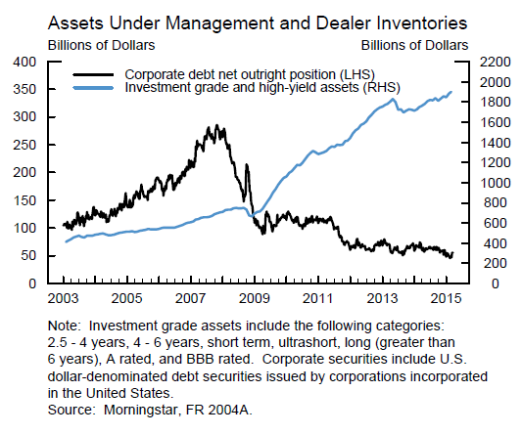
AUM and Dealer Inventories

Slide 21
Liquidity Risk
According to a number of market participants, the combination of more conservative risk management practices since the crisis, various regulatory initiatives, and evolving market structure has resulted in a significant decline in liquidity across a number of markets
How significant is the deterioration in liquidity?
Are there any policy implications/risks?
  Example: 2013 “taper tantrum”

Slide 22
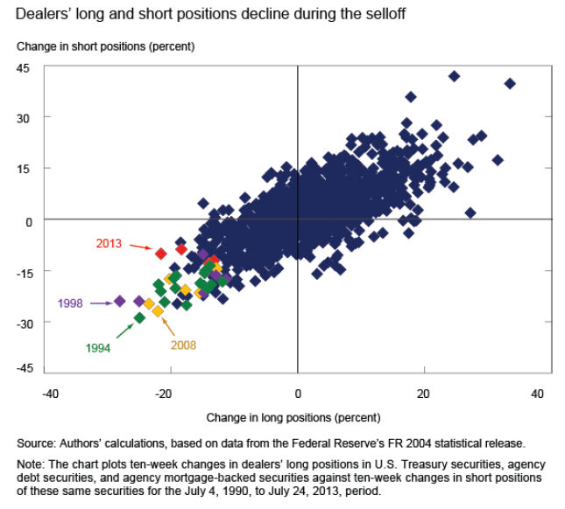
Balance Sheet Capacity and Market Liquidity during the 2013 Selloff in Fixed Income Markets by T. Adrian, M. Fleming, J. Goldberg, M. Lewis, F. Natalucci, and J. Wu (FEDS Notes October 2013)

