Slide 1
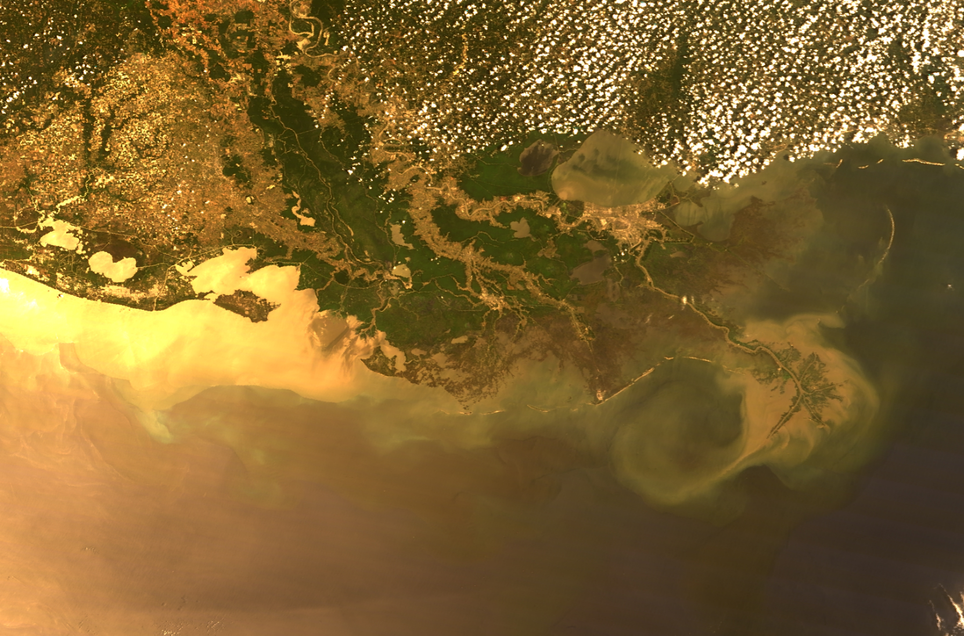

Slide 2
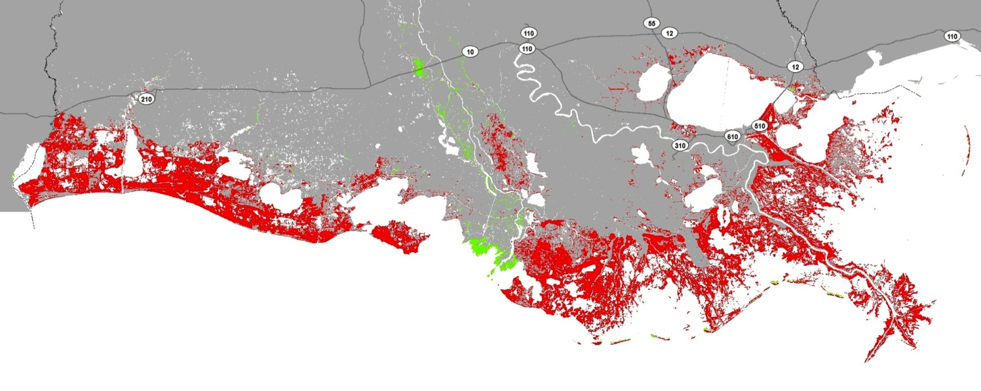
Our Coastal Crisis Will Continue
Potential to lose up to 1,750 square miles of land
With No Action Over the Next 50 Years

Slide 3
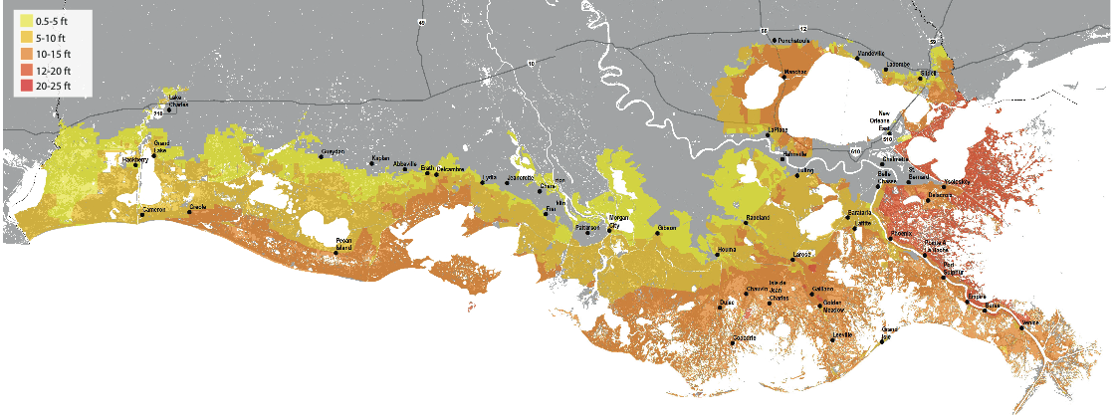
Increasing Vulnerability to Livelihoods

Slide 5
The Future

