Slide 1
Getting Into the Game:
Sport as a Stimulus for Urban Economic Development
By:
Robert A. Baade
A.B. Dick Professor of Economics, Lake Forest College and President Emeritus, International Association of Sports Economists (IASE)
for the Public Affairs Forum Sponsored by the Federal Reserve Bank of Atlanta
Birmingham, Alabama on July 17, 2014

Slide 2
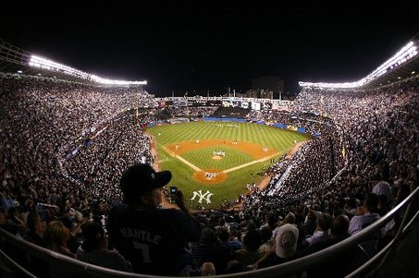
Purpose: Is commercial sport a catalyst for urban economic development?

Slide 3
Commercial sport is heavily subsidized in the US
The real demand is for luxury boxes, not more seats. So the average working person is asked to put a tax on their home or pay sales or some other consumer tax to build luxury boxes in which they cannot afford to sit. Frequently, the new stadium is smaller. The working person is asked to be satisfied with “sense of pride” they get from this arrangement, which will last until another team bids more for their players, or until another city bids for the team.
Houston Mayor, Bob Lanier
Testimony Before the Senate
Judiciary Committee
November 29, 1995

Slide 4
Stadiums Built/Proposed
Number of stadiums

Slide 5
Cost of Stadiums
Millions of 2007 dollars

Slide 6
Percentage Financed by Public
Percent

Slide 7
Who benefits from stadium subsidies?

Slide 8
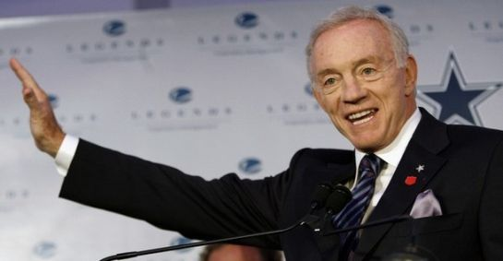
Owners?

Slide 9

Players?

Slide 10
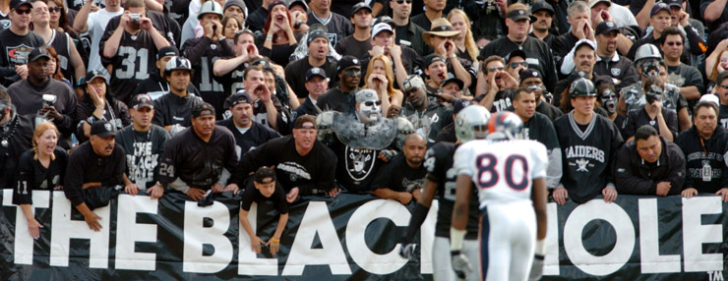
Fans?

Slide 11
Proportion of Facilities Financed by the Public and Private Sectors by League and the
Impact of New Facilities on Revenues and Incomes by League
Leagues building Average total Contribution (%) Incremental Incremental
new venues cost ($m)* Public Private revenues ($m) incomes ($m)
______________________________________________________________________________________
Major League Baseball 269 77 23 19.1 12.7
National Basketball Association 169 31 69 17.4 5.4
National Football League 257 74 26 18.8 12.0
National Hockey League (NHL) 148 42 58 15.7 7.7
Shared NBA and NHL facilities 191 11 89 20.3 11.6

Slide 12
MLB Payrolls ($m) Before and After New Stadiums Built Between 1991 and 2001
________________________________________________________________________________
Team (year new Team payroll Total payroll Total payroll Total payroll Total payroll)
stadium opened: t) for year t t - 2 t - 1 t + 1 t + 2
(% of payroll t) (% of payroll t) (% of payroll t) (% of payroll t)
________________________________________________________________________________
Arizona (1998) 29.16 n.a. n.a. 70.37 77.88
(241) (267)
Atlanta (1997) 50.49 45.2 47.93 59.54 75.07
(90) (95) (118) (149)
Baltimore (1992) 20.99 10.04 14.63 26.92 37.67
(48) (70) (128) (179)
Chicago White Sox (1991) 16.83 7.60 9.49 28.41 34.60
(45) (56) (169) (206)
Cleveland (1994) 28.49 8.24 15.72 35.19 45.32
(29) (55) (124) (159)
Colorado (1995) 31.15 8.83 22.98 34.92 42.87
(28) (74) (112) (138)
Detroit (2000) 61.74 22.63 34.96 49.36 55.05
(37) (57) (80) (89)
Houston (2000) 52.36 40.63 55.29 60.39 63.45
(78) (106) (115) (121)
Milwaukee (2001) 45.10 42.93 35.78 50.29 40.63
(95) (79) (112) (90)
Pittsburgh (2001) 57.76 24.22 29.56 42.32 54.81
(42) (51) (73) (95)
San Francisco (2000) 53.54 40.32 46.06 63.28 78.30
(75) (86) (118) (146)
Seattle (1999) 44.37 39.67 52.03 59.22 74.72
(89) (117) (133) (168)
Texas (1994) 32.42 29.74 35.64 32.37 35.86
(92) (110) (100) (111)
Average (57) (73) (125) (147)
_________________________________________________________________________________

Slide 13
Ticket Prices Before and After New Stadiums Built Between 1991 and 2001
______________________________________________________________________________
Team (year new Ticket prices Ticket prices Ticket prices Ticket prices Ticket prices
Stadium opened: t) for year t t - 2 t - 1 t + 1 t + 2
(% of prices t) (% of prices t) (% of prices t) (% of prices t)
______________________________________________________________________________
Atlanta (1997) 15.54 12.00 13.06 17.78 19.21
(77) (84) (114) (124)
Baltimore (1992) 9.65 n.a. 10.30 11.12 11.12
(107) (115) (115)
Chicago White Sox (1991) 10.28 n.a. n.a. 11.70 11.70
(114) (114)
Cleveland (1994) 12.06 7.70 8.70 12.06 14.52
(64) (72) (100) (120)
Colorado (1995) 10.61 7.91 7.90 10.61 11.38
(75) (74) (100) (107)
Detroit (2000) 24.83 10.40 12.23 23.90 20.44
(42) (49) (96) (82)
Houston (2000) 20.01 11.88 13.30 20.03 18.87
(59) (66) (100) (94)
Milwaukee (2001) 18.12 11.02 11.72 17.63 n.a.
(60) (65) (97)
Pittsburgh (2001) 21.48 10.71 11.80 19.51 n.a.
(50) (55) (91)
San Francisco (2000) 21.24 11.47 12.12 23.38 20.84
(54) (57) (110) (98)
Seattle (1999) 23.42 14.94 19.01 23.38 24.60
(64) (81) (100) (105)
Texas (1994) 12.07 8.93 8.93 12.07 11.96
(74) (74) (100) (99)
Average 16.71 (60) (66) (102) (104)
_______________________________________________________________________________

Slide 14
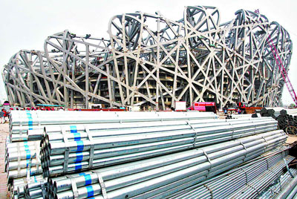
Do cities and regions benefit from sports subsidies?

Slide 15
Ex ante analysis
Minnesota lawmakers heard last month that a $954 million Vikings stadium would employ 8,000 construction workers another 5,400 people supported by construction-related spending and 3,400 in the new facility. Team vice president Lester Bagley called it a "significant jobs and economic stimulus package."
(Associated Press, March 5, 2009)

Slide 16
Ex ante or prospective analysis is difficult.
Precise estimates require extensive knowledge on the way different sectors of the economy interact.
Despite the best efforts of economists, a model that explains urban economic growth within acceptable margins of error eludes the profession.
That reality makes all ex ante analysis somewhat suspect.

Slide 17
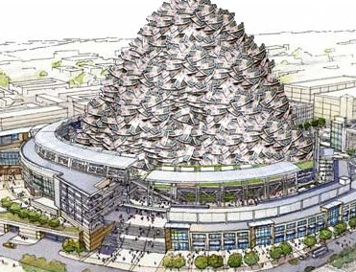
Why ex post analysis is necessary to evaluate the efficacy of commercial sports subsidies?

Slide 18

Empirical Results

Slide 19
Economic Impact Estimates Provided by Boosters for Selected Teams, Facilities, and Events
Year of Study | Team, Facility, or Event | Area Measured | Impact ($millions)
1992 | NBA All Star Game | Metro Orlando | 35ª
1995 | Summer Olympic Games | Metro Atlanta | 5,142^{b}
1996 | Cincinnati Reds (MLB) – Old Stadium* | Metro Cincinnati | 158^{c}
1996 | Cincinnati Reds – New Stadium* | Metro Cincinnati | 192^{c}
1998 | Arizona Diamondbacks | Metro Phoenix | 319^{c}
1999 | Super Bowl | South Florida (Miami, Dade and Broward Counties) | 396^{d}
1999 | Boston Red Sox (MLB) – Current Stadium* | Metro Boston | 120^{c}
1999 | Boston Red Sox – New Stadium* | Metro Boston | 186^{c}
1999 | San Antonio Spurs (NBA) | Metro San Antonio | 71^{c}
1999 | Summer Olympics Dallas | Metro Dallas | 4,000e
2000 | Houston Rockets (NBA) | MetroHouston | 187^{c}
2001 | World Cup Soccer | Countries of Japan and South Korea | 24,800 (Japan) 8,900 (S. Korea)^{f}

Slide 20
Quality of life and compensating differentials arguments
Economists know the price of everything and the value of nothing.
---Oscar Wilde

Slide 21

What do contingent valuation studies tell us?

Slide 22
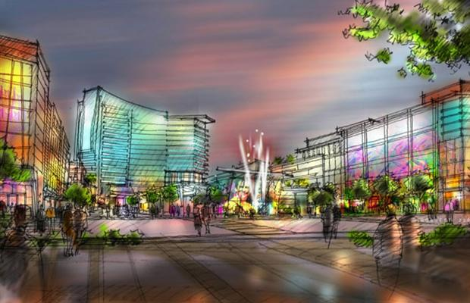
Compensating differentials
Entertainment village in Ottawa, Canada: Project would include offices, restaurants, bars, apartments, hotels for area near Senators’ arena

Slide 23
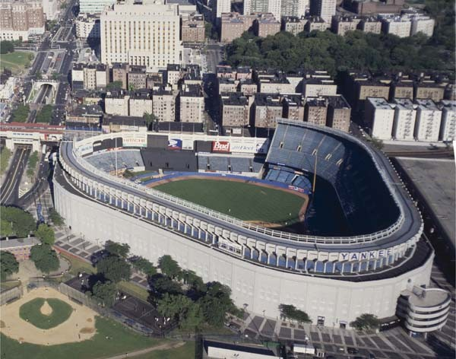
The new Yankee Stadium in New York

Slide 24
Conclusions and policy implications
The sum total of the evidence does not suggest that sport subsidies standing alone produce social value in excess of their social costs.
As part of a larger redevelopment plan, expenditures on teams, facilities, and sports mega-events may induce an increase in economic activity in the urban core, but that may come at the expense of other parts of the metropolitan or regional economies.

Slide 25
Finally, since the preponderance of evidence does not support the notion that subsidies for sport alone can serve as catalysts for economic development, subsidy debates should focus on the public benefits as they relate to the enhanced quality of life imparted by teams, facilities, and sports mega-events.
Future research should focus on techniques for estimating the hedonic component of subsidies for sport, and both the contingent valuation method and estimates for compensating differentials show promise in that regard.
Moon Landrieu may have been right: It is the very building of it that is important, not how much it is used or its economics.

