Slide 1

Consumer Finance Across the Lifespan
Eric J. Johnson
Marketing Division, the Center for Decision Sciences
and the Consumer Financial Protection Bureau
Supported by NSF Grant SES-0352062, National Institute for Aging
with support from the Social Security Administration
The Russell Sage and the Alfred P. Sloan Foundation
The National Endowment for Financial Education.
FRB Atlanta July 23, 2014
Notes:
This presentation represents research unrelated to my employment. The views expressed are those of the author[s] and do not necessarily represent
those of the Director of the Consumer Financial Protection Bureau or other Bureau staff.

Slide 2

A Grey Tsunami
The over 65 population of the world will double by 2035
One in five Americans will be over 65 by 2030.
Why does this
matter?

Slide 3
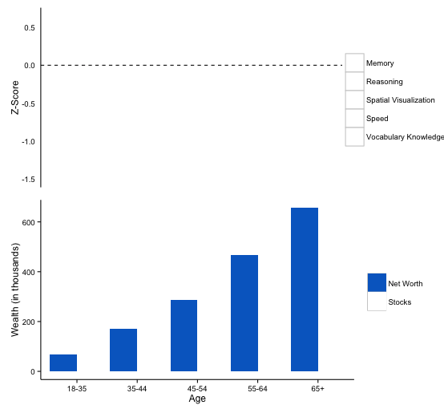
Source: 2011 Survey of Income and Program Participation
Notes:
. Those over 55 control over 63% of wealth and 71% of financial assets.

Slide 4
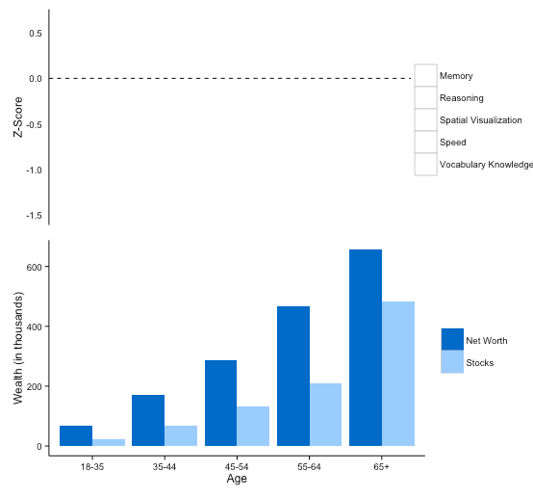

Slide 5
Consumers’ decisions to spend and save.
Every day we make decisions that will affect our future financial well beings.
  In economics, the workhorse model for consumer financial decisions is the permanent income/life cycle savings hypothesis.
  What can consumer research and psychology add to this?

Slide 6
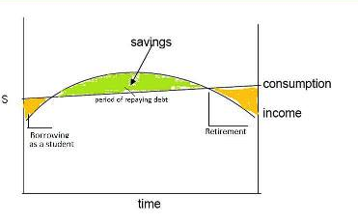
The Permanent Income /
Life Cycle Savings Hypothesis
People save and spend based on estimated future income
Goal is to ‘bounce the last check you write’
Involves:
  Exponential Discounting
  Expectation of future income and spending
  Usually Solved by Backward Induction

Slide 7
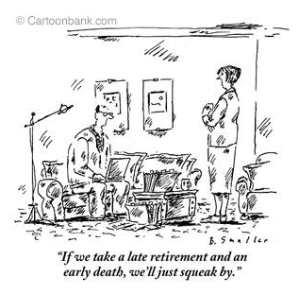
In contrast…..

Slide 8

Source: Salthouse 2010
Notes:
Those over 65, who are reduced in GF by almost a full standard deviation, control 33% of the wealth in the US. Those over 55 control over 63% of wealth and 71% of financial assets.

Slide 9
Attracted Popular and Academic Interest.
Targets for fraud
Concern from industry
  Are customers capable of making informed decisions?
  Are they liable for detecting decreased capability?
Obvious implication for public policy and decumulation decisions
Independent of Dementia
Notes:
Elders are regularly targeted.

Slide 10


Slide 11
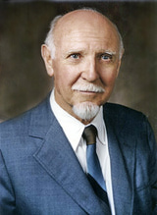
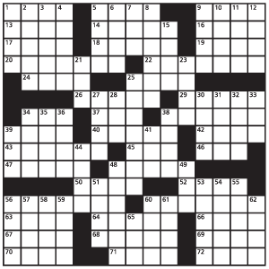
Can Crystallized Intelligence Compensate?
Crystallized intelligence is what we learn about the world, usually through experience and instruction
Not determined only by IQ
Cattell saw this as intellectual capital

Slide 12
Compensating Cognitive Competencies (CCC) Hypothesis
Crystallized Intelligence
Positive Effect of Age
c
Decision performance
Age
Negative Effect of Age
Fluid Intelligence
Notes:
Negative mediation also known as suppressor
AKA Complementary/Competitive mediators
Notice we don’t need a main effect of age!

Slide 13
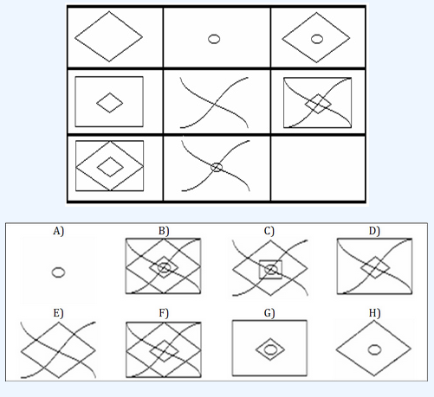
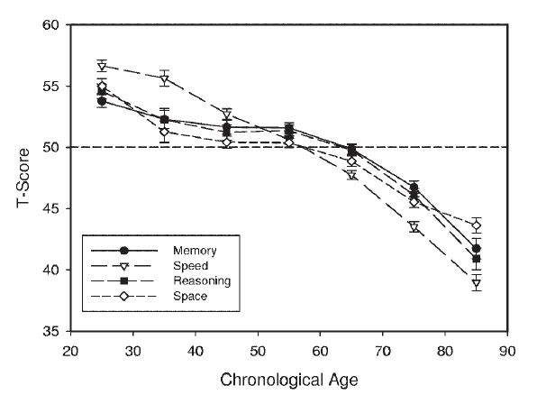
Fluid intelligence declines with age
Changes with age…
Fluid intelligence (G_{f}) is the ability to generate and transform information on the fly
- Seems critical for decision making!
Fluid
intelligence
Salthouse, 2010
Notes:
SPECIFICALLY, 100’s of papers have shown that fluid intelligence declines steeply with age.
Fluid intelligence is defined as … and seems critical for decision-making. For those unfamiliar with the term, it’s measured using domain-general tasks like Raven’s progressive matrices like the example shown here. Participants are asked to identify the missing element that completes the pattern. The patterns vary in difficulty, and this is an easy one. Any takers?
Using tasks like this, researchers have shown that 60 years-old have lost more than 1SD in fluid intelligence since their 20s ---- something I like to remind my coauthor, Eric, when we have disputes on the paper. (PAUSE FOR LAUGHS).
BUT even people in their 20’s are suffering from cognitive decline. Heck, I’ve lost 1/20SD just working on this paper (PAUSE FOR LAUGHS)

Slide 14

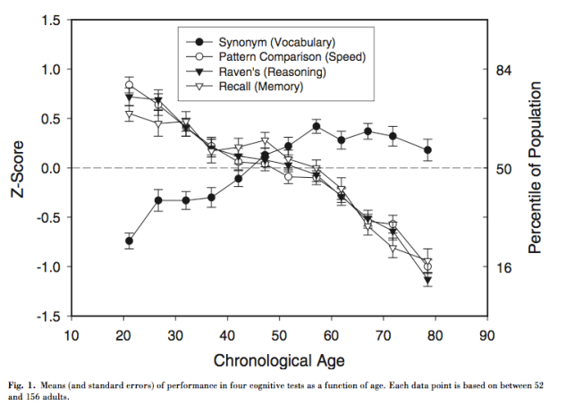
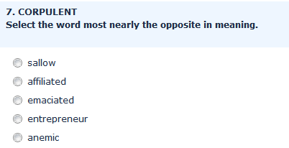

Perhaps experience is compensating
Changes with age…
Crystallized
Intelligence
Crystallized intelligence (G_{c}) is a stable depository of knowledge acquired through culture, education, and life experience (Carroll, 1993; Cattell, 1971, 1987)
Salthouse, 2010
Notes:
FOR EXAMPLE, perhaps experience.
The standard measure of experience based knowledge that cognitive aging researchers use is crystallized intelligence or Gc. It is measured, again in a domain-general fashion, using tests of vocabulary and general knowledge. In some sense, you can think of it as crossword puzzle ability, which it correlates highly with.
Importantly, just as Gf decreases with age, Gc increases with age, at least until the 60’s, after which it plateaus

Slide 15
Crystallized Intelligence (Financial Literacy)
FL1. Imagine that the interest rate on your savings account was 1% per year and inflation was 2% per year. After 1 year, would you be able to buy more than, exactly the same as, or less than today with the money in this account?
  More than today
  Exactly the same as today
  Less than today
  Do not know
  Over 1/3 of Americans say they don’t know or get the wrong answer

Slide 16
So, What Did We Find?
Crystalized intelligence helps.
It overcomes the decline in fluid
intelligence
Older people are better decision
makers.
  Example: Given the same income, education, fluid intelligence, crystalized intelligence boost credit scores.

Slide 17
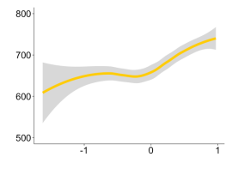

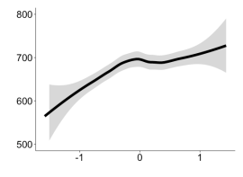
Crystallized Intelligence
Positive
Effect
Age
Credit
Score
Fluid Intelligence
Negative
Effect

Slide 18
Consider Ann, a college graduate who earns $50,000 and average cognitive ability.
In our data we would predict a credit score of 693.
What happens if we increase
  Fluid Intelligence by 10 IQ points? 713
  Crystalized Intelligence by the same amount? 750
The effect of Crystalized Intelligence is the equivalent of 25 years of normal aging.
Ann’s mortgage rate goes from 4.22% to 3.82%, saving her $24,879 over the life of a loan!
Notes:
One standard deviation lower on both she would be just above subprime and cost her $77,741 over the life of a loan.

Slide 19
Where are we…..
Financial Decisions in older people are better than the young BUT for different reasons
  They DO lack Fluid Intelligence
  But are improved by Crystalized Intelligence, particularly financial literacy.
BUT:
  A paradox: Financial literacy helps, but financial literacy education does not!
  Decreases in Fluid Intelligence continue, increases in Crystalized Intelligence slow down.

Slide 20
What happens over the full life course?
“Golden Age of Reason” (Agarwal et al. 2010)
  Fortune 500 CEOs avg. age of 56
  U.S. Presidents inaugurated at 55
Notes:
Another limitation of our results is that we don’t have participants across the entire lifespan. Remember, I didn’t have middle-aged participants and the older participants were only 66 on average, not *that* old.
Although I didn’t collect them, I CAN extrapolate and interpolate from what others know about fluid and crystallized intelligence changes over age. Plugging that into our model, [click] we get these inverse-U shaped curves. [pause] This happens because crystallized intelligence eventually plateaus after 60.
So this is good news for most of us. It means that middle age adults should actually be the best at decision-making, so we’re actually still approaching our decision-making peaks. The peak seems to be around thee mid 50s. This coincides with the average age of Fortune 500 CEO’s and US presidents.
This is also consistent with work by Sumit Agarwal and David Laibson (2010) showing that financial ability peaks in the mid-50’s, what they call the “Golden Age of Reason”.

Slide 21
Implications for Public Policy
We have created good savings plans for retirement for the uninterested (The SMarT Plan, Target Date Funds, etc.)
How about using that savings?
  What does “Decumulation for Dummies” look like?
  When should you make decisions about drawing down for retirement?
Financial Service Firms need to develop suitable products, Government(s) need to facilitate their creation.
Notes:
“Savings for Dummies”

