Slide 1

Lesson 1
Katrina Strikes
Part 2
GOALS AND DECISION MAKING

Slide 2
Lesson Objectives
Lesson 1: Katrina Strikes
Students will:
Differentiate between needs and wants.
Identify and develop short-, intermediate-, and long-term goals.
Recognize the need for financial preparedness in the face of a disaster.
2

Slide 3
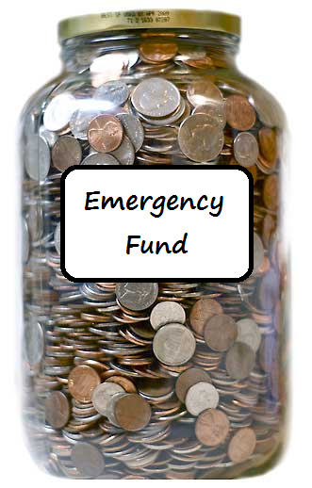
Lesson 1: Katrina Strikes
Emergency and financial Preparedness
Part of being financially prepared for an emergency is having enough savings to tide you over until life goes back to normal.
How much money you will need in an emergency?
You can accomplish having enough savings by setting financial goals.
3

Slide 4

Lesson 1: Katrina Strikes
Goals
Short-term goals
Less than one year
Intermediate-term goals One to five years
Long-term goals
More than five years
4

Slide 5
Lesson 1: Katrina Strikes
Set Goals
Two Types of Goals
  Personal
  Financial
Define Spending & Savings Goals
  Short term
  Intermediate term
  Long term
Be SMART
Specific, Measurable, Attainable, Realistic, Time Bound
Implement, Review, Revise, Repeat
5

Slide 6

Lesson 1: Katrina Strikes
Wants Vs. Needs
A want is something that you desire or would like.
Video games
Phones
iPad
A basic need is something you must have to survive.
Air
Food
Water
Shelter
Clothing
6

Slide 7
Lesson 1: Katrina Strikes
You purchase medicine for a medical condition.
You move into a dorm on campus.
You purchase groceries for the week.
You find a fabulous apartment off campus.
You purchase gas to evacuate in an emergency.
You take a trip to the beach during spring break.
You go to dinner with your friends.
Your favorite music artist releases a new album.
You drink water to stay hydrated.
Your shoes are too small and they hurt your feet
You drop your cell phone and it no longer works.
WANTS VS NEEDS
You stop by a favorite coffee shop for a beverage.
Wants
Needs
You drop your cell phone and it no longer works.
Your shoes are too small and they hurt your feet.
Your favorite music artist releases a new album.
You purchase medicine for a medical condition.
You take a trip to the beach during spring break.
You purchase gas to evacuate in an emergency.
You go to dinner with your friends.
You purchase groceries for the week.
You stop by a favorite coffee shop for a large beverage.
You drink water to stay hydrated.
You find a fabulous apartment off campus.
You move into a dorm on campus.
7

Slide 8
Lesson 1: Katrina Strikes
Scarcity and decision making
Scarcity
You have unlimited wants versus limited resources.
Decision
Making
Prioritize and make decisions.
With every decision you make, you must give up something.
Opportunity cost is the highest-valued alternative that you give up when you make a decision.
Opportunity
Cost
8

Slide 9

Lesson 1: Katrina Strikes
Decision making
People make decisions by weighing the costs and benefits of alternatives.
Costs: The negative outcomes the decision maker identifies
Benefits: The positive outcomes the decision maker identifies
Costs and benefits can be monetary or non-monetary. Cost-benefit analysis involves selecting the alternative for which you perceive the most benefits relative to the costs.
The consequences of the decisions people make lie in the future.
9

Slide 10
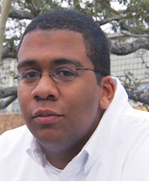
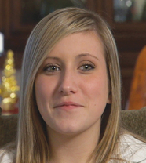
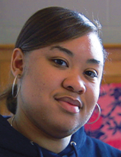
Lesson 1: Katrina Strikes
Learning Through Real-Life Experiences
This video clip provides an overview of the hurricane as well as challenges faced by three students and their families who lived through a natural disaster. They will share what they learned about being financially prepared for an emergency.
Nick
Jacquelyn
Jamie
As you watch the video, identify the needs, wants, and goals of the individuals.
10

Slide 11
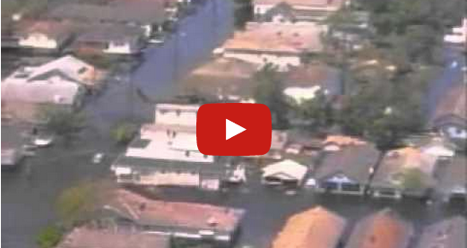
Lesson 1: Katrina Strikes
Katrina Strikes
11
Notes:
Julie—As in the lesson, should we simply link to the video on YouTube, rather than to the web page on the FRB Atlanta site that you said is going away?

Slide 12
Lesson 1: Katrina Strikes
WORD
DESCRIPTION
Natural Disaster
A naturally occurring event that can cause severe threats to the public health
Emergency Preparedness
A plan of action put in place prior to a natural disaster or unforeseen event.
Emergency Fund
A reserve of cash kept available to meet the costs of any unexpected financial emergency
Goals
Things we would like to achieve or purchase in the future.
Want
Something that you desire or would like
Basic Need
Something you must have to survive
Risk
The uncertainty about the outcome of a situation or event
Scarcity
The concept that we have unlimited wants and needs in a world of limited resources
12

Slide 13
Lesson 1: Katrina Strikes
IN Summary
A want is something that you desire or would like.
A basic need is something you must have to survive.
Goals should be specific, measurable, attainable, realistic, and time bound.
Part of being financially prepared for an emergency is having enough savings to tide you over until life goes back to normal.
13

Slide 14
Katrina’s Classroom was developed by a team of
Senior Economic and Financial Education Specialists at the Federal Reserve Bank of Atlanta.
Claire Loup, New Orleans Branch • Julie Kornegay, Birmingham Branch • Jackie Morgan, Nashville Branch
For additional classroom resources and professional development opportunities,
please visit www.frbatlanta.org/education
14

